Slide 1
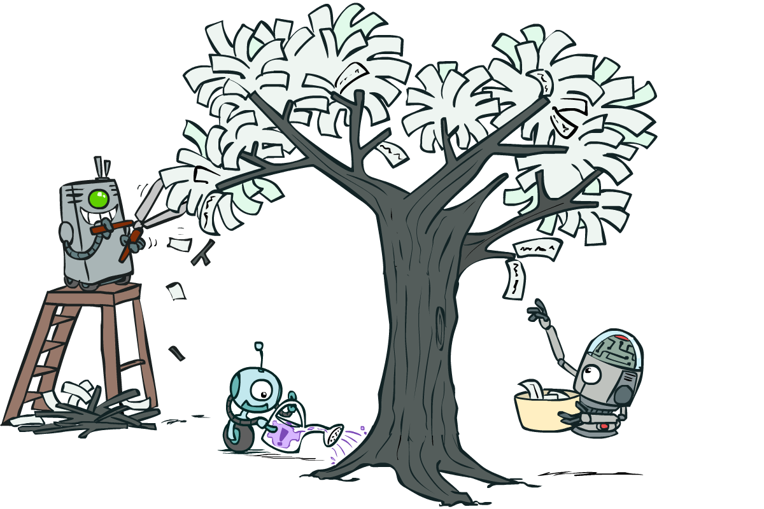
CS 188: Artificial Intelligence
Neural Nets (wrap-up) and Decision Trees
Instructors: Pieter Abbeel and Dan Klein --- University of California, Berkeley
[These slides were created by Dan Klein and Pieter Abbeel for CS188 Intro to AI at UC Berkeley. All CS188 materials are available at http://ai.berkeley.edu.]
Notes:
Please retain proper attribution, including the reference to ai.berkeley.edu. Thanks!

Slide 2
Deep Neural Network
x₁
softmax
x₂
…
x₃
…
…
…
…
…
x_{L}
g = nonlinear activation function

Slide 3
Deep Neural Network: Also Learn the Features!
Training the deep neural network is just like logistic regression:
  just w tends to be a much, much larger vector ☺
  just run gradient ascent
  + stop when log likelihood of hold-out data starts to decrease

Slide 4
Neural Networks Properties
Theorem (Universal Function Approximators). A two-layer neural network with a sufficient number of neurons can approximate any continuous function to any desired accuracy.
Practical considerations
  Can be seen as learning the features
  Large number of neurons
    Danger for overfitting
    (hence early stopping!)

Slide 5
How well does it work?

Slide 6

Computer Vision
Notes:
6

Slide 7
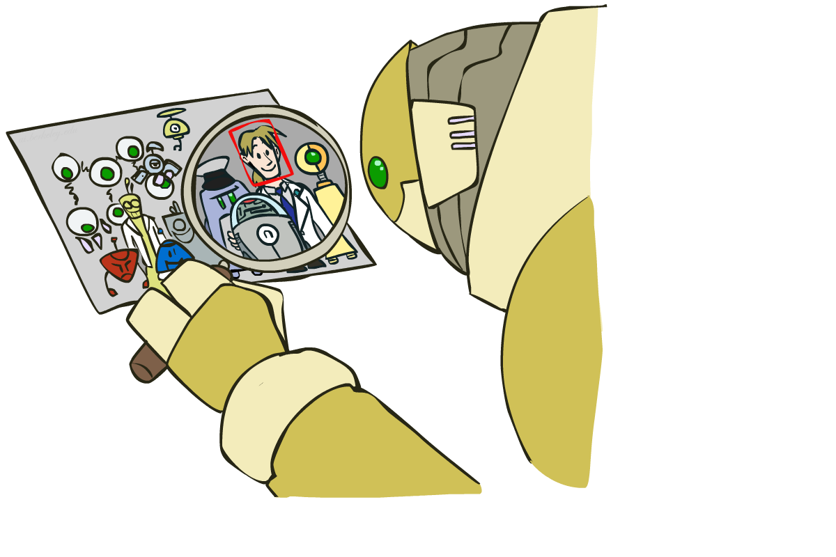
Object Detection
Notes:
7

Slide 8

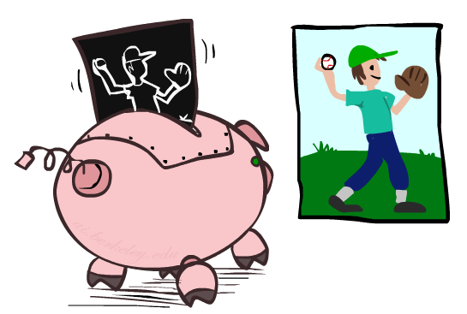

Manual Feature Design
Notes:
8

Slide 9
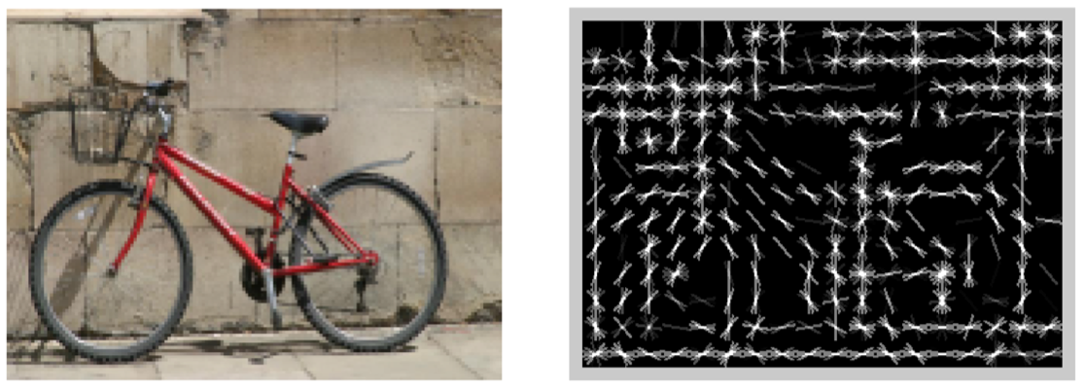
Features and Generalization
[HoG: Dalal and Triggs, 2005]
Notes:
9

Slide 10
Features and Generalization
Image
HoG
Notes:
HoG, SIFT, Daisy
Deformable part models
10

Slide 11
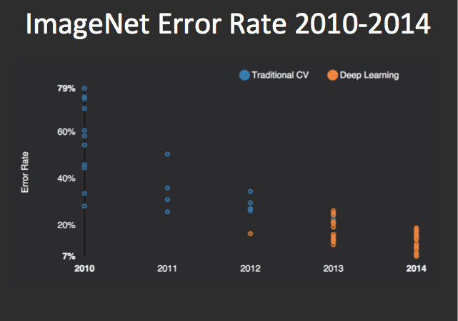
Performance
graph credit Matt Zeiler, Clarifai

Slide 12
Performance
graph credit Matt Zeiler, Clarifai

Slide 13
Performance
AlexNet
graph credit Matt Zeiler, Clarifai

Slide 14
Performance
AlexNet
graph credit Matt Zeiler, Clarifai

Slide 15
Performance
AlexNet
graph credit Matt Zeiler, Clarifai

Slide 16
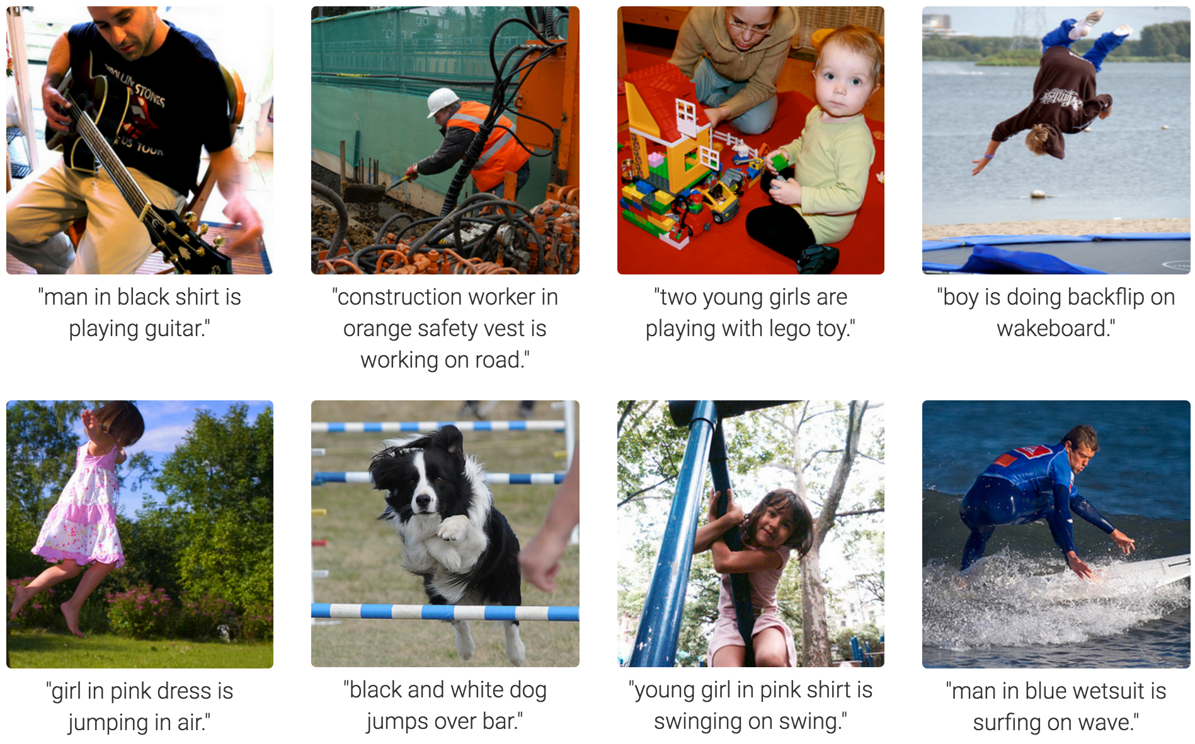
MS COCO Image Captioning Challenge
Karpathy & Fei-Fei, 2015; Donahue et al., 2015; Xu et al, 2015; many more

Slide 17
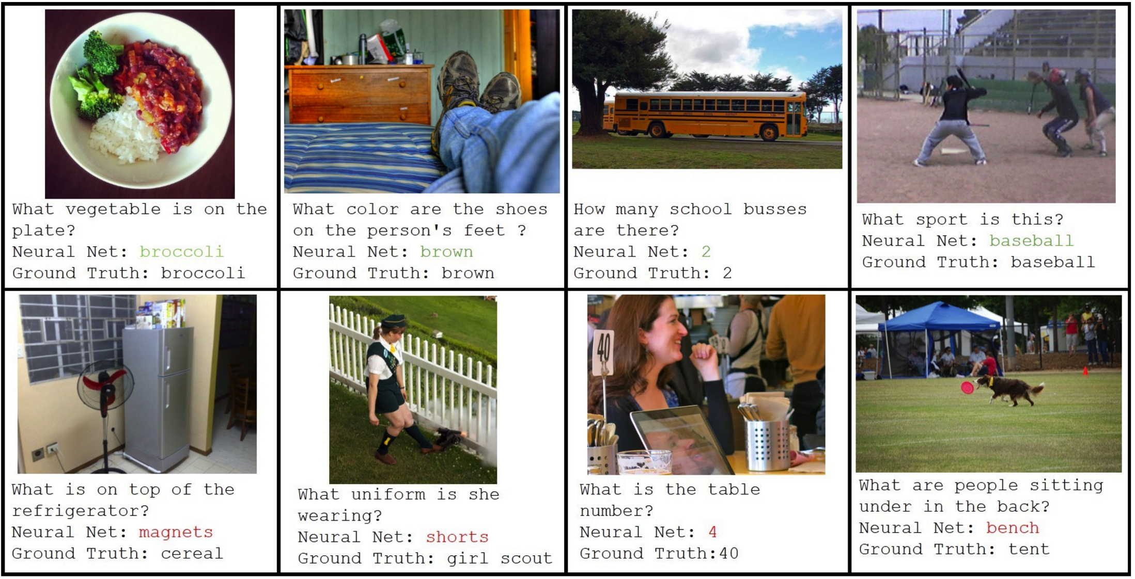
Visual QA Challenge
Stanislaw Antol, Aishwarya Agrawal, Jiasen Lu, Margaret Mitchell, Dhruv Batra, C. Lawrence Zitnick, Devi Parikh

Slide 18
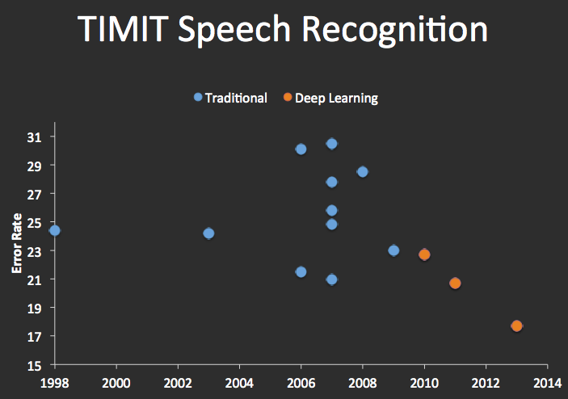


Speech Recognition
graph credit Matt Zeiler, Clarifai

Slide 19
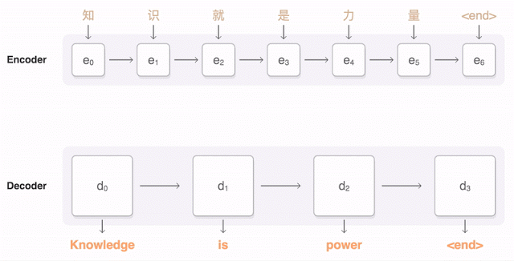
Machine Translation
Google Neural Machine Translation (in production)
Notes:
https://research.googleblog.com/2016/09/a-neural-network-for-machine.html

Slide 20
Today
Neural Nets -- wrap
Formalizing Learning
  Consistency
  Simplicity
Decision Trees
  Expressiveness
  Information Gain
  Overfitting
Clustering

Slide 21
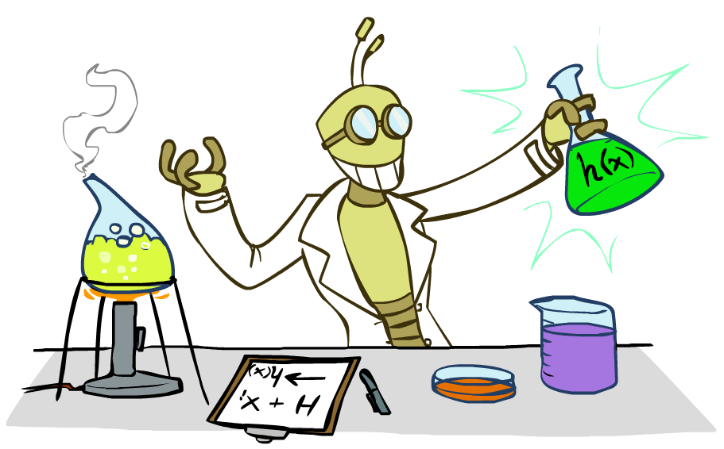
Inductive Learning

Slide 22



Inductive Learning (Science)
Simplest form: learn a function from examples
  A target function: g
  Examples: input-output pairs (x, g(x))
  E.g. x is an email and g(x) is spam / ham
  E.g. x is a house and g(x) is its selling price
Problem:
  Given a hypothesis space H
  Given a training set of examples x_{i}
  Find a hypothesis h(x) such that h ~ g
Includes:
  Classification (outputs = class labels)
  Regression (outputs = real numbers)
How do perceptron and naïve Bayes fit in? (H, h, g, etc.)

Slide 23
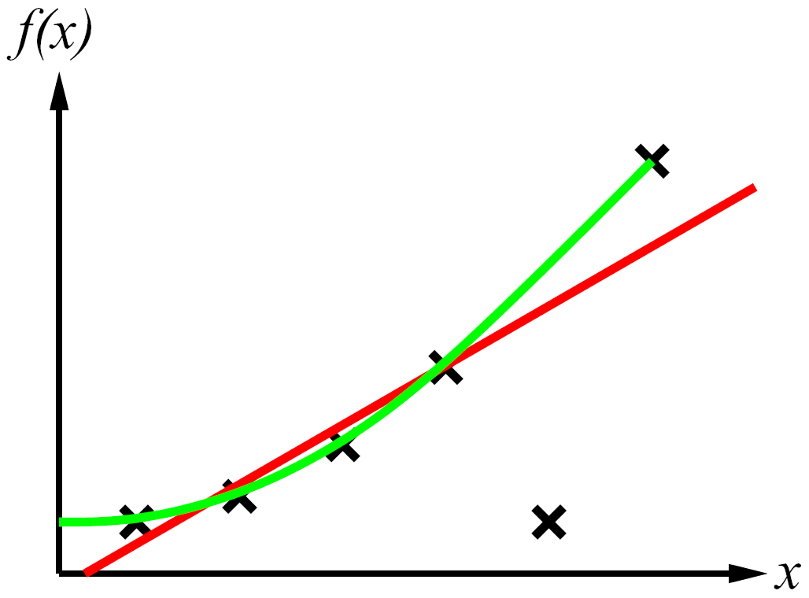
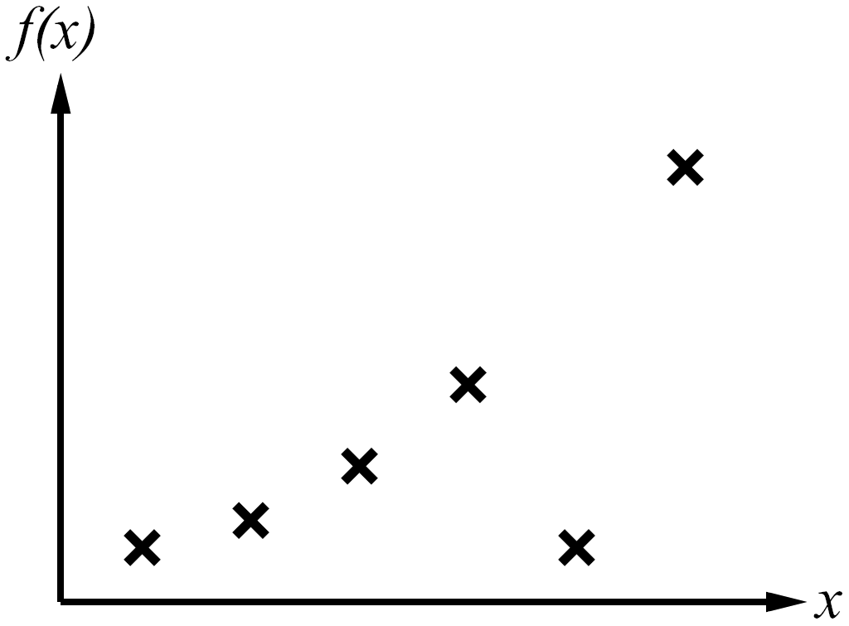
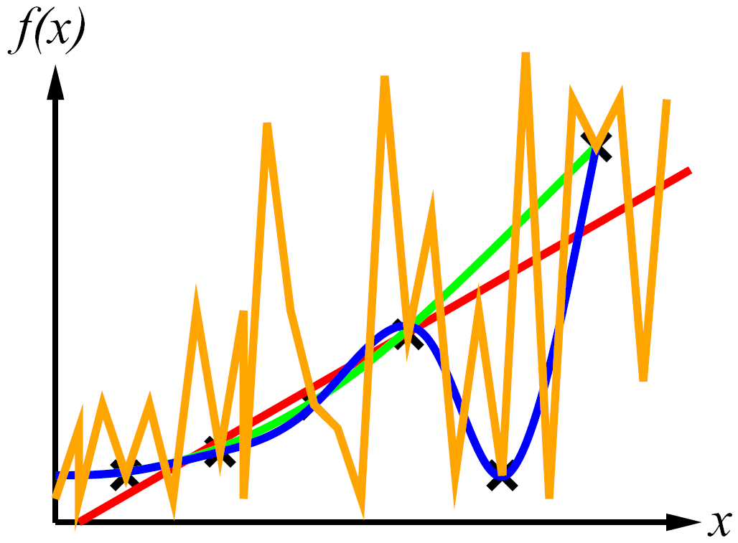
Inductive Learning
Curve fitting (regression, function approximation):
Consistency vs. simplicity
Ockham’s razor

Slide 24
Consistency vs. Simplicity
Fundamental tradeoff: bias vs. variance
Usually algorithms prefer consistency by default (why?)
Several ways to operationalize “simplicity”
  Reduce the hypothesis space
    Assume more: e.g. independence assumptions, as in naïve Bayes
    Have fewer, better features / attributes: feature selection
    Other structural limitations (decision lists vs trees)
  Regularization
    Smoothing: cautious use of small counts
    Many other generalization parameters (pruning cutoffs today)
    Hypothesis space stays big, but harder to get to the outskirts

Slide 25
Decision Trees

Slide 26
Reminder: Features
Features, aka attributes
  Sometimes: TYPE=French
  Sometimes: f_{TYPE=French}(x) = 1

Slide 27
Reminder: Features
Features, aka attributes
  Sometimes: TYPE=French
  Sometimes: f_{TYPE=French}(x) = 1

Slide 28
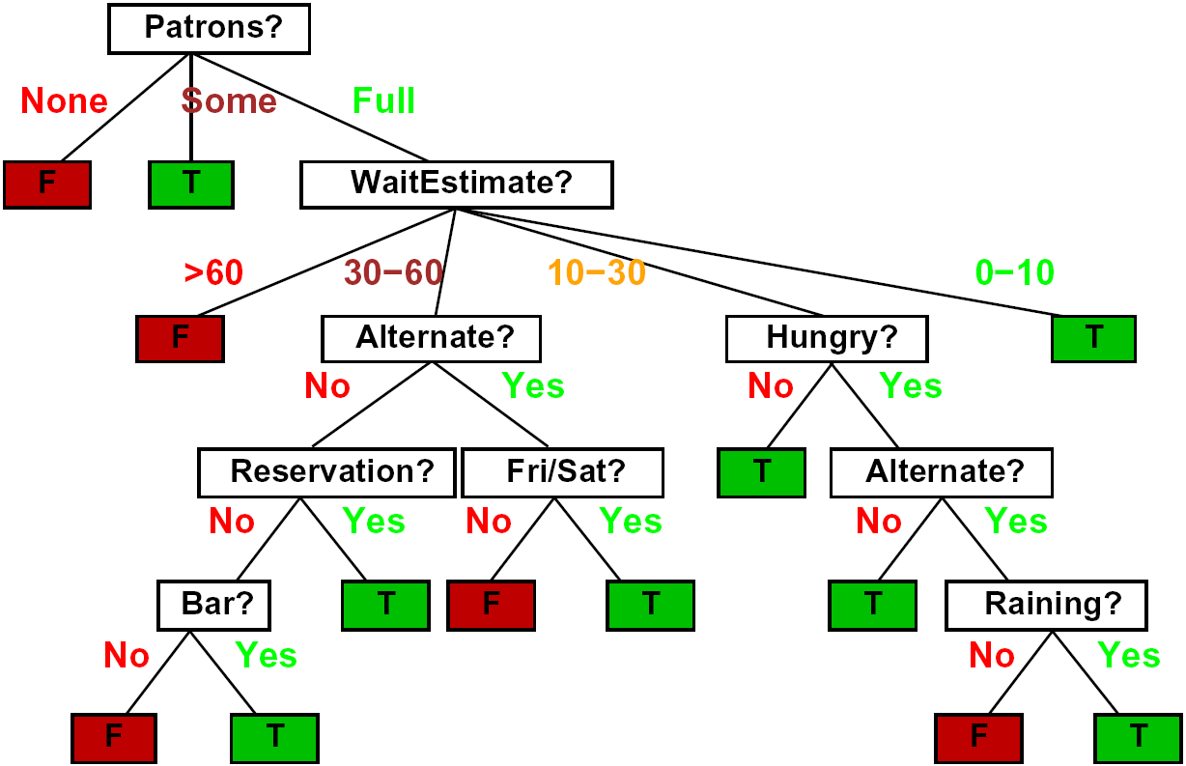
Decision Trees
Compact representation of a function:
  Truth table
  Conditional probability table
  Regression values
True function
  Realizable: in H

Slide 29

Expressiveness of DTs
Can express any function of the features
However, we hope for compact trees

Slide 30
Comparison: Perceptrons
What is the expressiveness of a perceptron over these features?
For a perceptron, a feature’s contribution is either positive or negative
  If you want one feature’s effect to depend on another, you have to add a new conjunction feature
  E.g. adding “PATRONS=full ∧ WAIT = 60” allows a perceptron to model the interaction between the two atomic features
DTs automatically conjoin features / attributes
  Features can have different effects in different branches of the tree!
Difference between modeling relative evidence weighting (NB) and complex evidence interaction (DTs)
  Though if the interactions are too complex, may not find the DT greedily

Slide 31
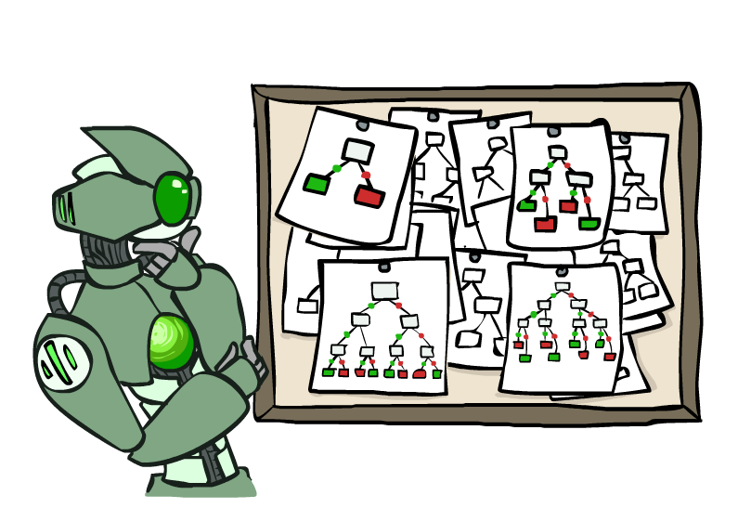
Hypothesis Spaces
How many distinct decision trees with n Boolean attributes?
  = number of Boolean functions over n attributes
  = number of distinct truth tables with 2^{n} rows
  = 2^(2^{n})
  E.g., with 6 Boolean attributes, there are
  18,446,744,073,709,551,616 trees
How many trees of depth 1 (decision stumps)?
  = number of Boolean functions over 1 attribute
  = number of truth tables with 2 rows, times n
  = 4n
  E.g. with 6 Boolean attributes, there are 24 decision stumps
More expressive hypothesis space:
  Increases chance that target function can be expressed (good)
  Increases number of hypotheses consistent with training set (bad, why?)
  Means we can get better predictions (lower bias)
  But we may get worse predictions (higher variance)

Slide 32
Decision Tree Learning
Aim: find a small tree consistent with the training examples
Idea: (recursively) choose “most significant” attribute as root of (sub)tree

Slide 33
Choosing an Attribute
Idea: a good attribute splits the examples into subsets that are (ideally) “all positive” or “all negative”
So: we need a measure of how “good” a split is, even if the results aren’t perfectly separated out

Slide 34
Entropy and Information
Information answers questions
  The more uncertain about the answer initially, the more information in the answer
  Scale: bits
    Answer to Boolean question with prior <1/2, 1/2>?
    Answer to 4-way question with prior <1/4, 1/4, 1/4, 1/4>?
    Answer to 4-way question with prior <0, 0, 0, 1>?
    Answer to 3-way question with prior <1/2, 1/4, 1/4>?
A probability p is typical of:
  A uniform distribution of size 1/p
  A code of length log 1/p

Slide 35
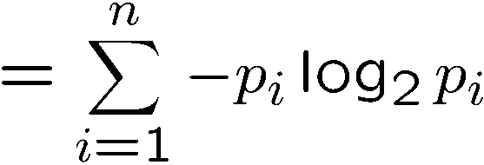
Entropy
General answer: if prior is <p₁,…,p_{n}>:
  Information is the expected code length
Also called the entropy of the distribution
  More uniform = higher entropy
  More values = higher entropy
  More peaked = lower entropy
  Rare values almost “don’t count”
1 bit
0 bits
0.5 bit

Slide 36
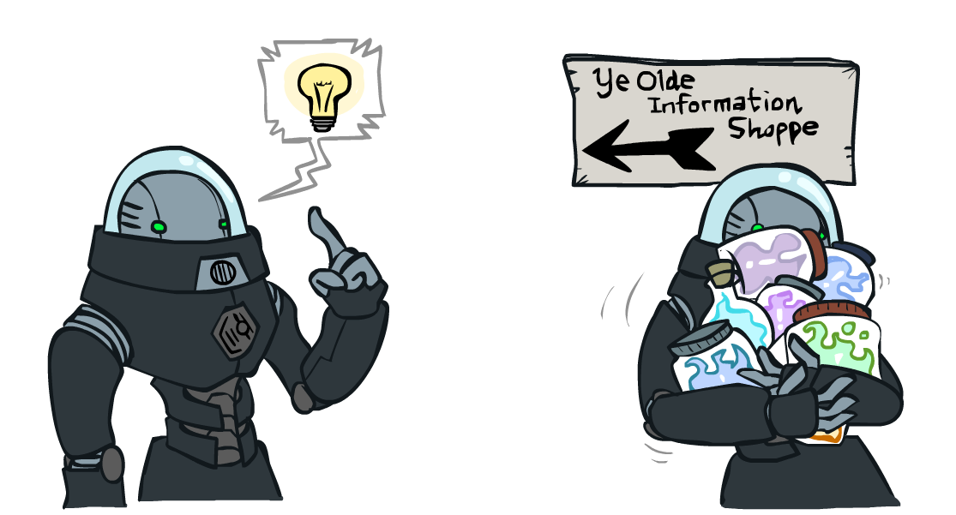
Information Gain
Back to decision trees!
For each split, compare entropy before and after
  Difference is the information gain
  Problem: there’s more than one distribution after split!
  Solution: use expected entropy, weighted by the number of examples

Slide 37
Information Gain
Back to decision trees!
For each split, compare entropy before and after
  Difference is the information gain
  Problem: there’s more than one distribution after split!
  Solution: use expected entropy, weighted by the number of examples
  Note: hidden problem here! Gain needs to be adjusted for large-domain splits – why?

Slide 38
Next Step: Recurse
Now we need to keep growing the tree!
Two branches are done (why?)
What to do under “full”?
  See what examples are there…

Slide 39
Example: Learned Tree
Decision tree learned from these 12 examples:
Substantially simpler than “true” tree
  A more complex hypothesis isn't justified by data
Also: it’s reasonable, but wrong

Slide 40
Example: Miles Per Gallon
40 Examples

Slide 41
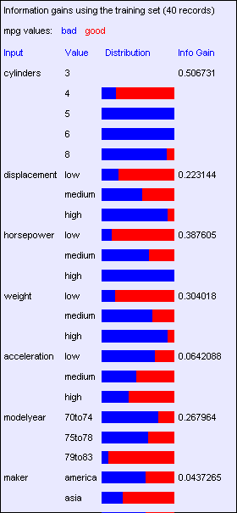
Find the First Split
Look at information gain for each attribute
Note that each attribute is correlated with the target!
What do we split on?

Slide 42
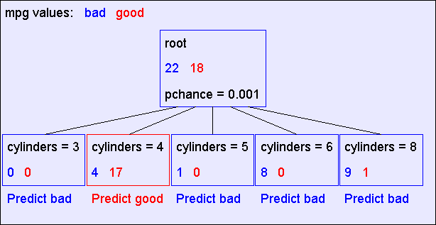
Result: Decision Stump

Slide 43
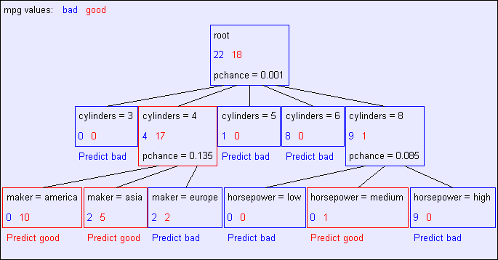
Second Level

Slide 44
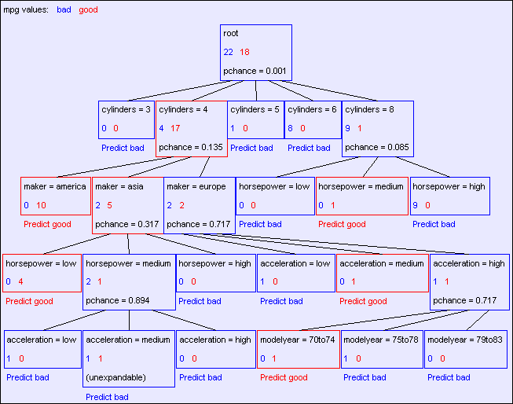
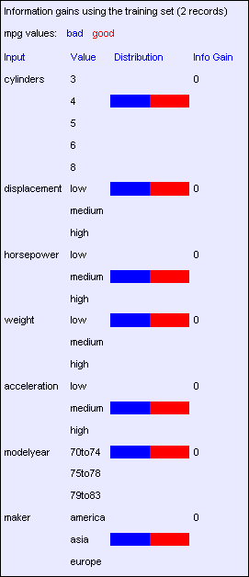
Final Tree

Slide 45
Reminder: Overfitting
Overfitting:
  When you stop modeling the patterns in the training data (which generalize)
  And start modeling the noise (which doesn’t)
We had this before:
  Naïve Bayes: needed to smooth
  Perceptron: early stopping

Slide 46

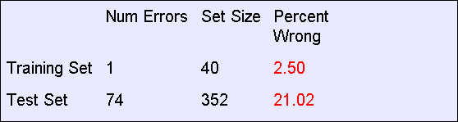
MPG Training Error
The test set error is much worse than the training set error…
…why?

Slide 47
Consider this split

Slide 48
Significance of a Split
Starting with:
  Three cars with 4 cylinders, from Asia, with medium HP
  2 bad MPG
  1 good MPG
What do we expect from a three-way split?
  Maybe each example in its own subset?
  Maybe just what we saw in the last slide?
Probably shouldn’t split if the counts are so small they could be due to chance
A chi-squared test can tell us how likely it is that deviations from a perfect split are due to chance*
Each split will have a significance value, p_{CHANCE}

Slide 49

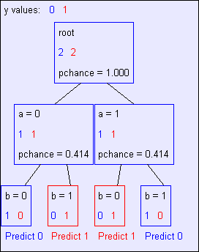
Keeping it General
Pruning:
  Build the full decision tree
  Begin at the bottom of the tree
  Delete splits in which
  p_{CHANCE} > MaxP_{CHANCE}
  Continue working upward until there are no more prunable nodes
  Note: some chance nodes may not get pruned because they were “redeemed” later
y = a XOR b

Slide 50
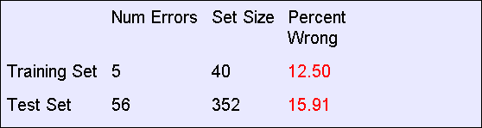
Pruning example
With MaxP_{CHANCE} = 0.1:
Note the improved test set accuracy compared with the unpruned tree

Slide 51
Regularization
MaxP_{CHANCE} is a regularization parameter
Generally, set it using held-out data (as usual)
Training
Held-out / Test
Accuracy
Decreasing
Increasing
MaxP_{CHANCE}
Small Trees
Large Trees
High Bias
High Variance

Slide 52
Two Ways of Controlling Overfitting
Limit the hypothesis space
  E.g. limit the max depth of trees
  Easier to analyze
Regularize the hypothesis selection
  E.g. chance cutoff
  Disprefer most of the hypotheses unless data is clear
  Usually done in practice

Slide 53
Next Lecture: Applications!

