Slide 1
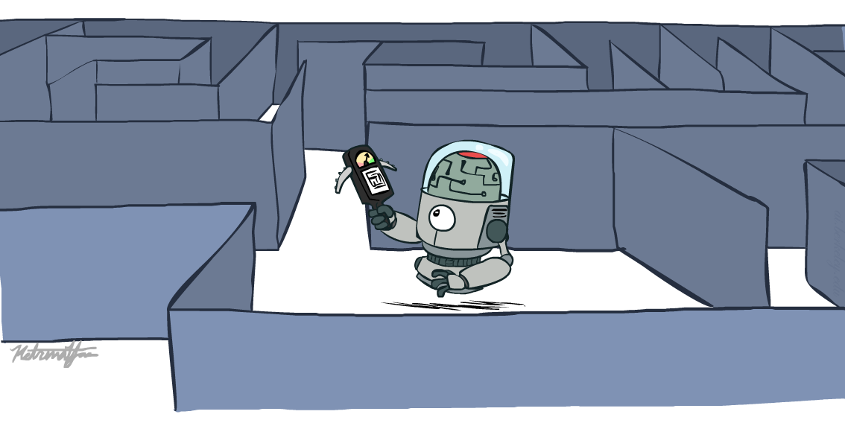
COE 4213564 Introduction to Artificial Intelligence
Search in Complex Environments
Many slides are adapted from CS 188 (http://ai.berkeley.edu), CIS 521, CS 221, CS182, CS4420.
Notes:
Please retain proper attribution, including the reference to ai.berkeley.edu. Thanks!

Slide 2
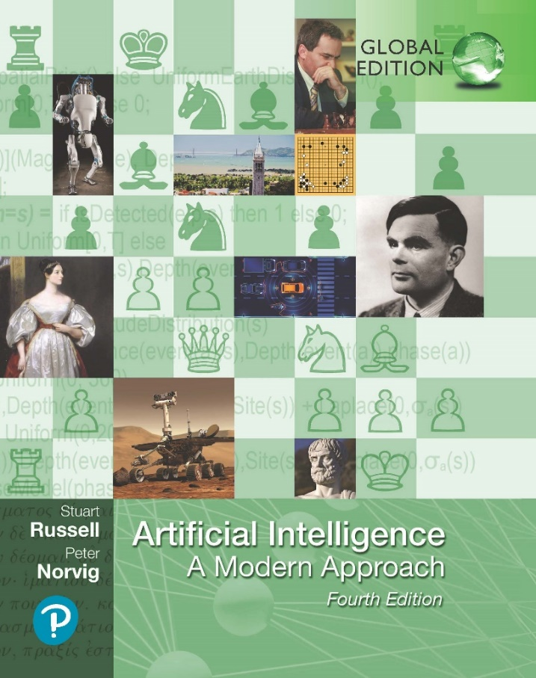
Search in Complex Environments
COE 4213564 : Introduction to Artificial Intelligence
Chapter 4
Fourth Edition, Global Edition
Artificial Intelligence: A Modern Approach
© 2022 Pearson Education Ltd.

Slide 3
Iterative Improvement Methods
The search algorithms that we have seen so far are designed to explore search spaces systematically.
This systematicity is achieved by keeping one or more paths in memory and by recording which alternatives have been explored at each point along the path.
When a goal is found, the path to that goal also constitutes a solution to the problem.
The best of these methods can currently handle search spaces of up to 10¹⁰⁰ states / ~1,000 binary variables. (where a set of variables define a state or configuration.)
What if we have much larger search spaces?
Search spaces for some real-world problems may be much larger e.g.,
10^{30,000} states as in certain reasoning and planning tasks
State space is large/complex and keeping whole frontier in memory is impractical
Some of these problems can be solved by Iterative Improvement Methods

Slide 4
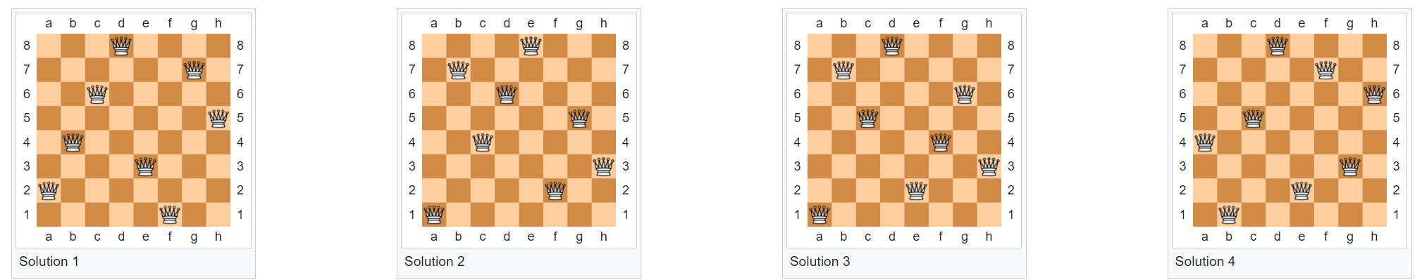
Finding a valid final configuration or state
In many problems, the path to the goal is irrelevant.
The goal state itself is the solution
For example, in the 8-queens problem, we care only about finding a valid final configuration (or state) of 8 queens.
A set of variables define a state or configuration. A valid configuration or state is defined by domains for every variable and constraints among variables.
The eight queens puzzle is the problem of placing eight chess queens on an 8×8 chessboard so that no two queens threaten each other.
The eight queens puzzle has 92 distinct solutions.
If solutions that differ only by the symmetry operations of rotation and reflection of the board are counted as one, the puzzle has 12 solutions.

Slide 5
Iterative Improvement Methods
In many optimization problems the goal state itself is the solution
The state space is a set of complete configurations
Search is about
finding the optimal configuration (as in TSP) or
just a feasible configuration (as in scheduling problems, timetable)
In such cases, one can use iterative improvement, or local search methods.
These methods are suitable for problems in which all that matters is the solution state, not the path cost to reach it.
An evaluation or objective function h must be available that measures the quality of each state
Main Idea: Start with a random initial configuration and make small, local changes to it that improve its quality.
Many important applications : integrated-circuit design, factory floor layout, job shop scheduling, automatic programming, telecommunications network optimization, crop planning, and portfolio management.

Slide 6
Local Search and Optimization Problems
Local search algorithms operate by searching from a start state to neighboring states, without keeping track of the paths, nor the set of states that have been reached.
Two key advantages:
they use very little memory; and
they can often find reasonable solutions in large or infinite state spaces for which systematic algorithms are unsuitable.
They are not systematic—they might never explore a portion of the search space where a solution actually resides.
Local search algorithms can also solve optimization problems, in which the aim is to find the best state according to an objective function.

Slide 7
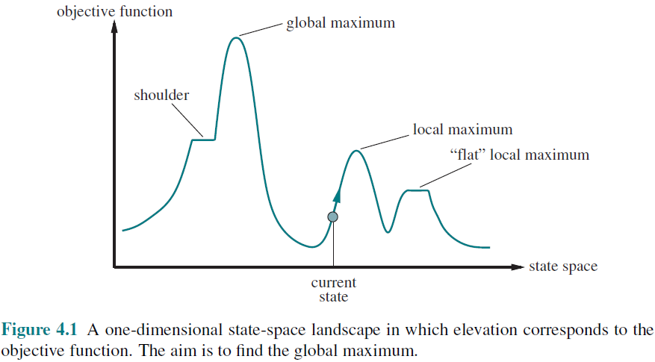
State-space landscape
To understand local search, consider the states of a problem laid out in a state-space landscape, as shown in Figure 4.1. Local search algorithms explore this landscape.
Each point (state) in the landscape has an “elevation” defined by the value of the objective function.
If elevation corresponds to an objective function, then the aim is to find the highest peak—a global maximum—and we call the process hill climbing.
If elevation corresponds to cost in continuous space, then the aim is to find the lowest valley—a global minimum—and we call it gradient descent.
A complete local search algorithm always finds a goal if one exists;
An optimal algorithm always finds a global minimum/maximum
Problem: depending on initial state, can get stuck in local maxima/minima

Slide 8
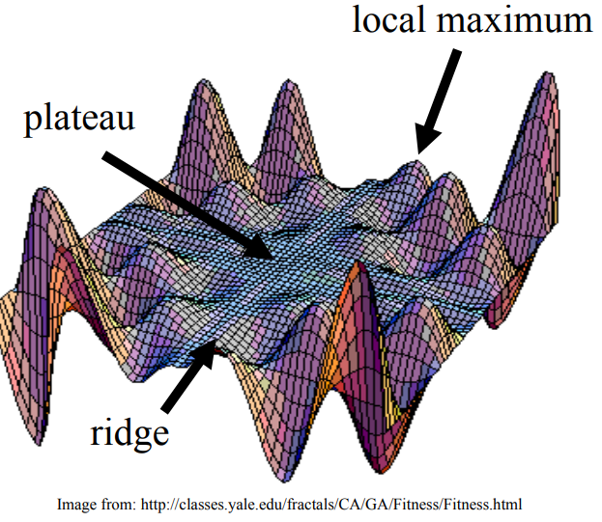
Exploring the Landscape
Local Maxima: peaks that arenʼt the highest point in the space
Plateaus: the space has a broad flat region that gives the search algorithm no direction (random walk)
Ridges: flat like a plateau, but with drop-offs to the sides; steps to the North, East, South and West may go down, but a step to the NW may go up.

Slide 9
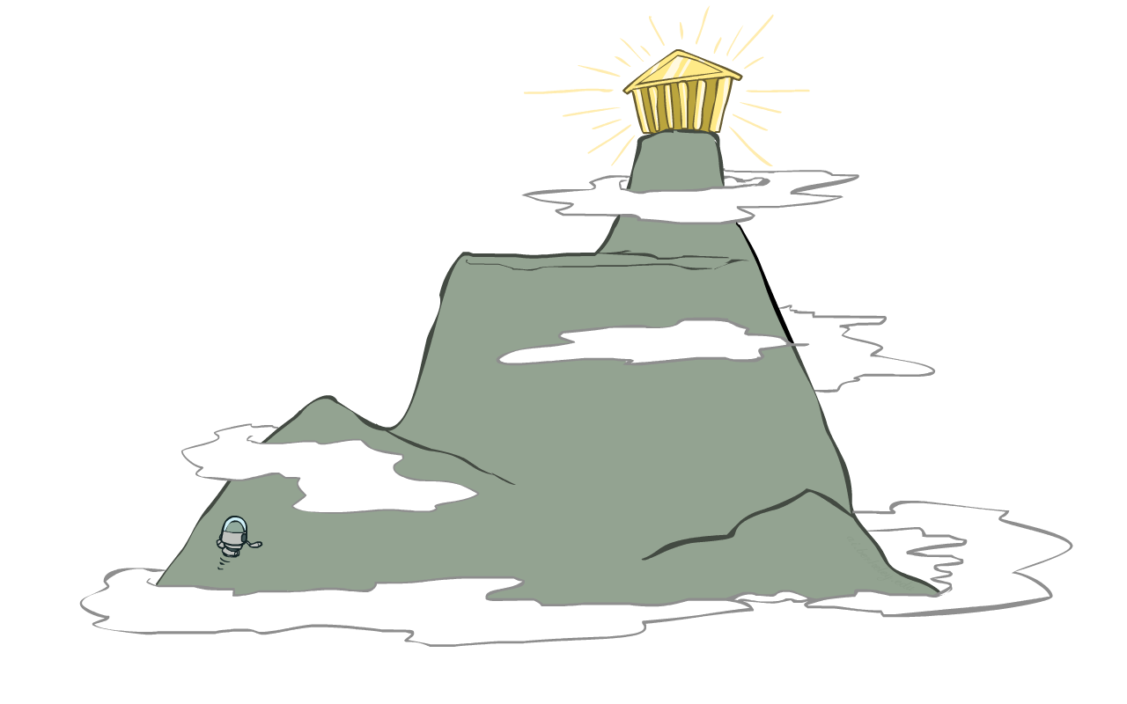
Hill-climbing search
Simple, general idea:
Start wherever
Repeat: move to the best neighboring state
If no neighbors better than current, quit

Slide 10
Hill-climbing search

Slide 11
Hill-climbing algorithm
function HILL-CLIMBING(problem) returns a state
current ← make-node(problem.initial-state)
loop do
neighbor ← a highest-valued successor of current
if neighbor.value ≤ current.value then
return current.state
current ← neighbor
“Like climbing Everest in thick fog with amnesia”

Slide 12
Hill-climbing search
It is simply a loop that continually moves in the direction of increasing value—that is, uphill. It terminates when it reaches a “peak” where no neighbor has a higher value.
The algorithm does not maintain a search tree, so the data structure for the current node need only record the state and the value of the objective function.
Hill climbing does not look ahead beyond the immediate neighbors of the current state. (This resembles trying to find the top of Mount Everest in a thick fog while suffering from amnesia.)
Hill climbing is sometimes called greedy local search because it grabs a good neighbor state without thinking ahead about where to go next.

Slide 13
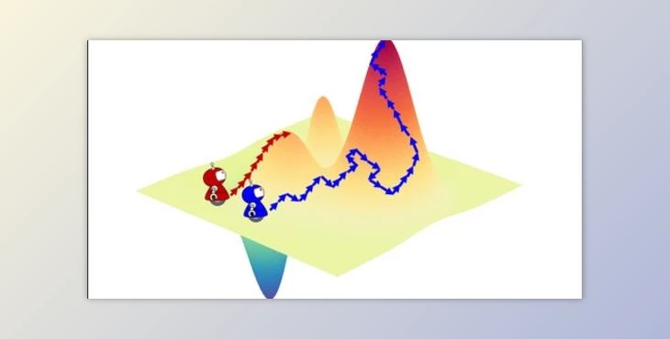
The heuristic objective(cost) function
An evaluation or objective function h must be available that measures the quality of each state
Main Idea: Start with a random initial configuration and make small, local changes to it that improve its quality.
Ideally, the evaluation function h should be monotonic: the closer a state to an optimal goal state the better its h-value.
Each state can be seen as a point on a surface.
The search consists in moving on the surface, looking for its highest peaks: the optimal solutions.
Similar to Greedy search in that it uses h, but does not allow backtracking or jumping to an alternative path since it doesnʼt “remember” where it has been.

Slide 14
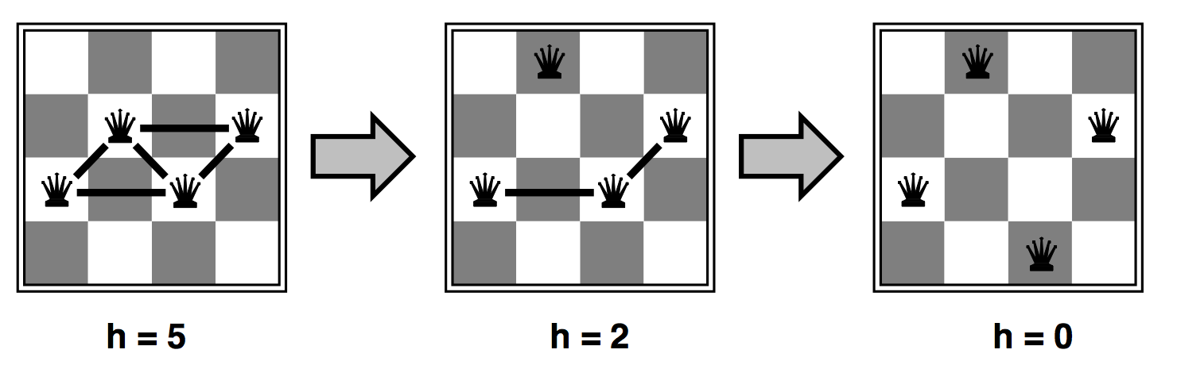
Ex: Heuristic for n-queens problem
Goal: n queens on board with no conflicts, i.e., no queen attacking another
Put n queens on an n × n board with no two queens on the same row, column, or diagonal
States: n queens on board, one per column
Actions: move a queen in its column
Heuristic value function h: number of conflicts (the number of pairs of queens that are attacking each other; this will be zero only for solutions.)
Strategy: Move a queen to reduce number of conflicts

Slide 15
Ex: Heuristic for n-queens problem

Slide 16
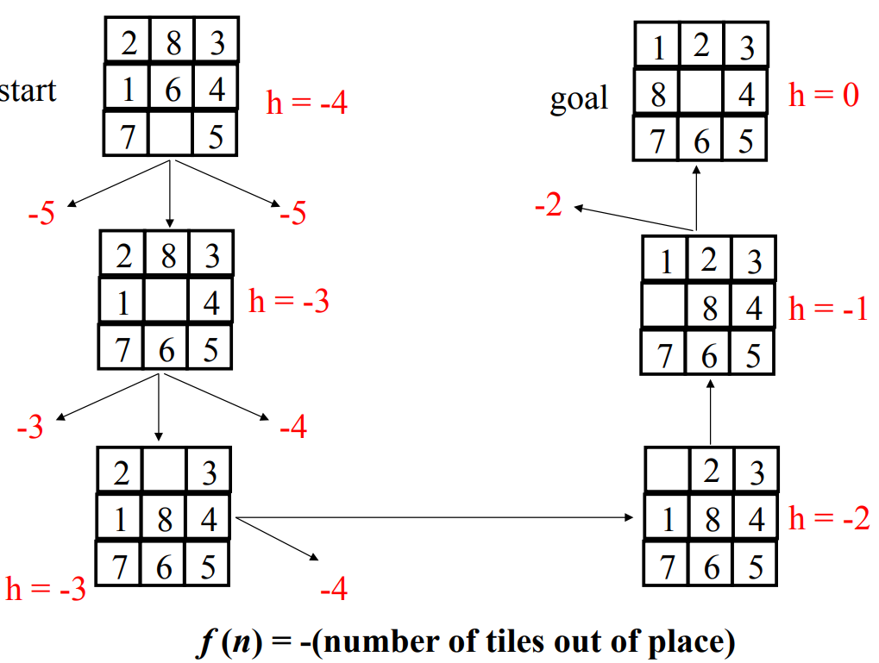
Ex:

Slide 17
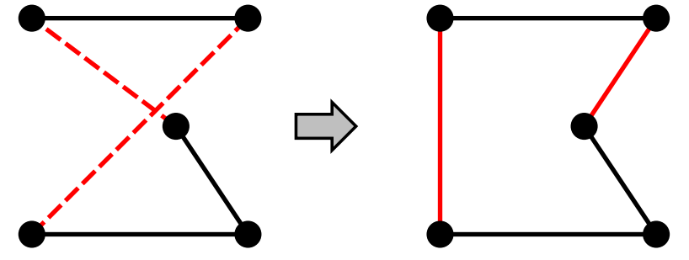
Example: TSP
Travelling Salesperson Problem (TSP) : Given a list of cities and the distances between each pair of cities, what is the shortest possible route that visits each city exactly once and returns to the origin city?" It is an NP-hard problem in combinatorial optimization, important in theoretical computer science and operations research.
Pairwise exchange method: The pairwise exchange or 2-opt technique involves iteratively removing two edges and replacing these with two different edges that reconnect the fragments created by edge removal into a new and shorter tour.
h = length of the tour
Strategy: Start with any complete tour, perform pairwise exchanges

Slide 18
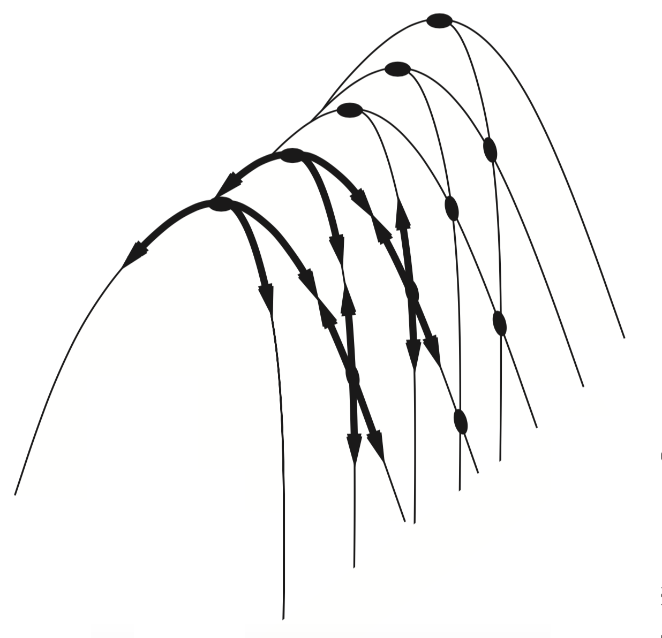
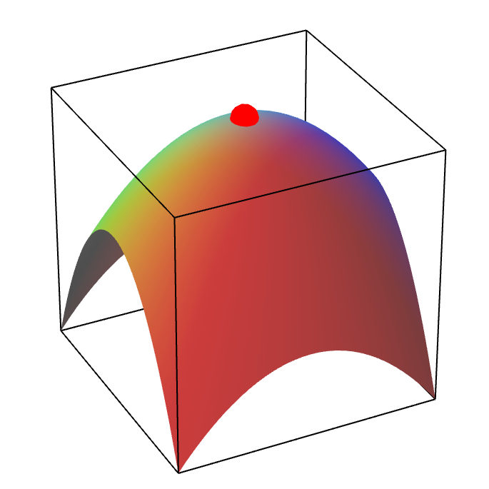
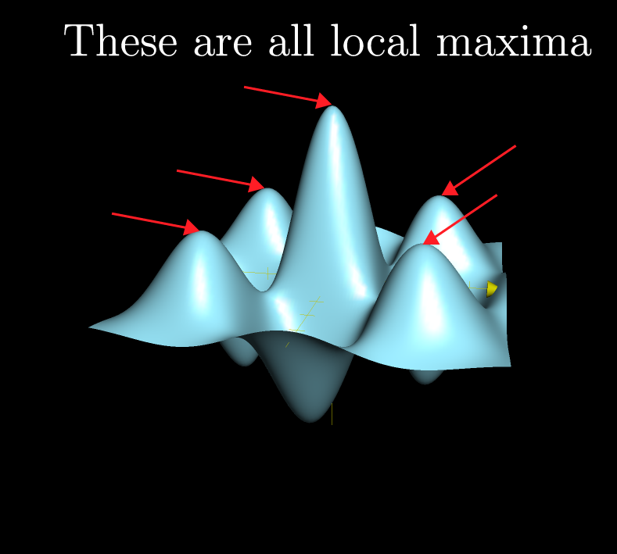
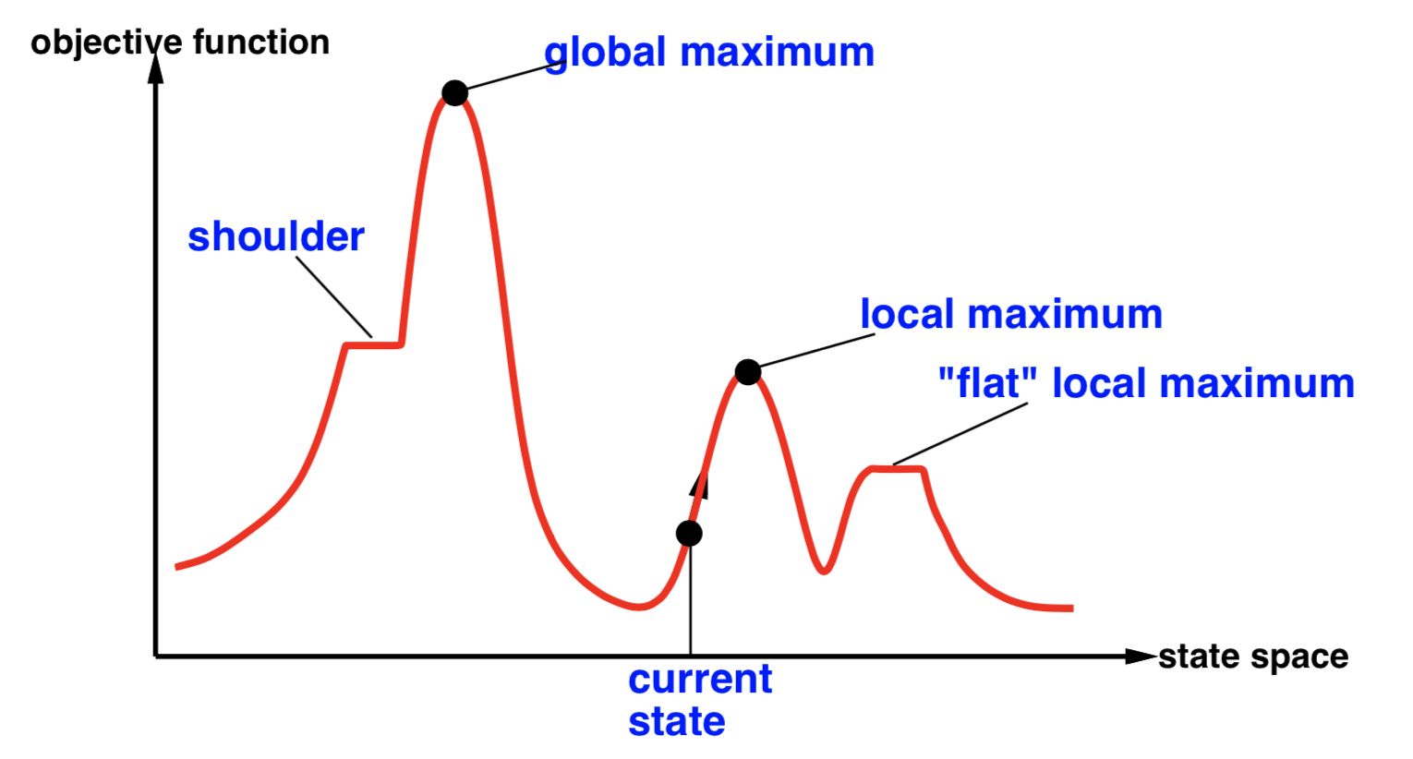
Hill Climbing Drawbacks
It is a greedy algorithm that often perform quite well. Unfortunately, hill climbing can get stuck for any of the following reasons: Local maxima, Ridges (a sequence of local maxima), Plateaus (a flat area of the state-space landscape).
Local maxima
Plateaus
Diagonal ridges:
Figure 4.4 Illustration of why ridges cause difficulties for hill climbing. The grid of states (dark circles) is superimposed on a ridge rising from left to right, creating a sequence of local maxima that are not directly connected to each other. From each local maximum, all the available actions point downhill.
Notes:
Diagonal ridges is about each move only changes one element of state vector, while the path to the hill requires all elements be changed in a move.

Slide 19
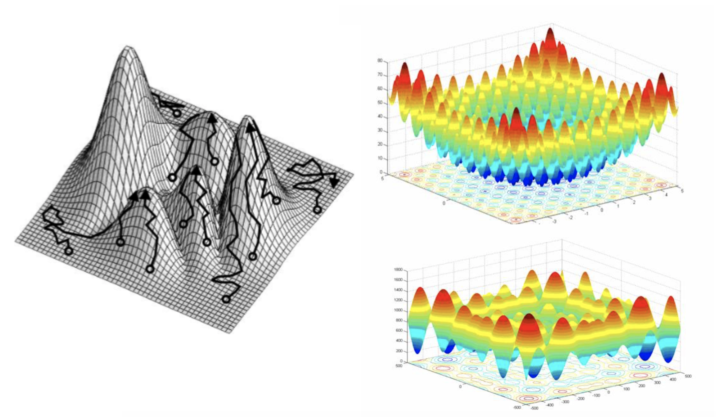
Trajectories, difficulties

Slide 20
Local search
Cost
local search can get stuck on a local maximum/minimum and not find the optimal solution
States
From : CSC 361 - Dr. Yousef Al-Ohali

Slide 21
Local search
Current Solution

Slide 22
Local search
Current Solution

Slide 23
Local search
Current Solution

Slide 24
Local search
Current Solution

Slide 25
Local search
Best
Optimal
Solution

Slide 26
Hill-climbing search
It is a greedy algorithm that often perform quite well. Hill climbing can make rapid progress toward a solution because it is usually quite easy to improve a bad state.
Unfortunately, hill climbing can get stuck for any of the following reasons: Local maxima, Ridges (a sequence of local maxima), Plateaus (a flat area of the state-space landscape).
How could we solve more problems?
One answer is to keep going when we reach a plateau—to allow a sideways move in the hope that the plateau is really a shoulder, from which progress is possible.
Stochastic hill climbing chooses at random from among the uphill moves; the probability of selection can vary with the steepness of the uphill move.
First-choice hill climbing implements stochastic hill climbing by generating successors randomly until one is generated that is better than the current state.
Another variant is random-restart hill climbing, which adopts the adage, “If at first you don’t succeed, try, try again.” It conducts a series of hill-climbing searches from randomly generated initial states, until a goal is found.

Slide 27
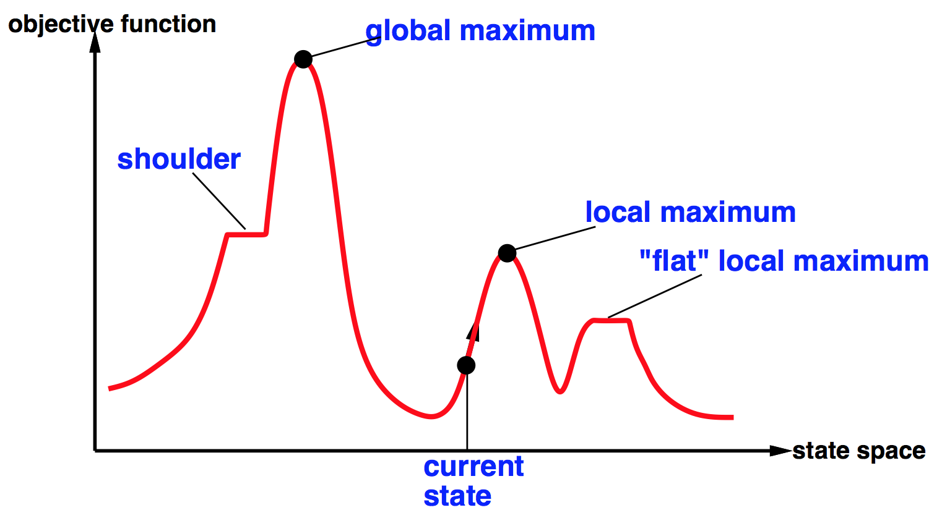




Global and local maxima
• A plateau is a flat area of the state-space landscape. It can be a flat local maximum, from which no uphill exit exists, or a shoulder, from which progress is possible.
• A hill-climbing search might get lost on the plateau.
• Random sideways moves can escape from shoulders but they loop forever on flat maxima.
- Random-restart hill climbing overcomes local maxima—trivially complete (find global optimum)
- Random sideways moves escape from shoulders but they may loop forever on flat maxima

Slide 28
Sideways move on the 8-queens problem
Starting from a randomly generated 8-queens state, steepest-ascent hill climbing gets stuck 86% of the time, solving only 14% of problem instances.
We could allow up to, say, 100 consecutive sideways moves in the 8-queens problem. This raises the percentage of problem instances solved by hill climbing from 14% to 94%.
Success comes at a cost: the algorithm averages roughly 21 steps for each successful instance and 64 for each failure.

Slide 29
The success of hill climbing
The success of hill climbing depends very much on the shape of the state-space landscape: if there are few local maxima and plateaux, random-restart hill climbing will find a good solution very quickly.
On the other hand, many real problems have a landscape that looks more like a widely scattered family of balding porcupines on a flat floor
NP-hard problems typically have an exponential number of local maxima to get stuck on.
Despite this, a reasonably good local maximum can often be found after a small number of restarts.

Slide 30

argmax and argmin notation
The argmax and argmin concept is common in many AI and machine learning algorithms
See argmax on Wikipedia (argmin is similar)
Argmax_{x} f(x) finds the value of x for which f(x) is largest

Slide 31
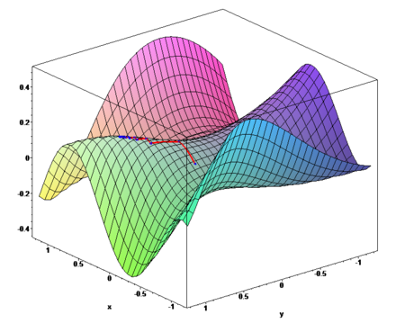
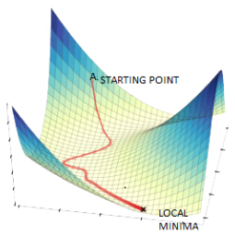
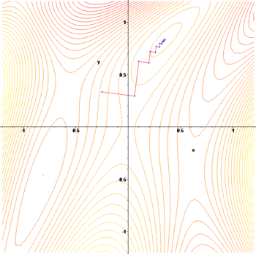
Gradient ascent / descent
Gradient descent procedure for finding the arg_{x} min f(x)
choose initial x₀ randomly
repeat
x_{i+1} ← x_{i} – η f '(x_{i})
until the sequence x₀, x₁, …, x_{i}, x_{i+1} converges
Step size η (eta) is small (perhaps 0.1 or 0.05)
Often used in machine learning algorithms
Images from http://en.wikipedia.org/wiki/Gradient_descent

Slide 32
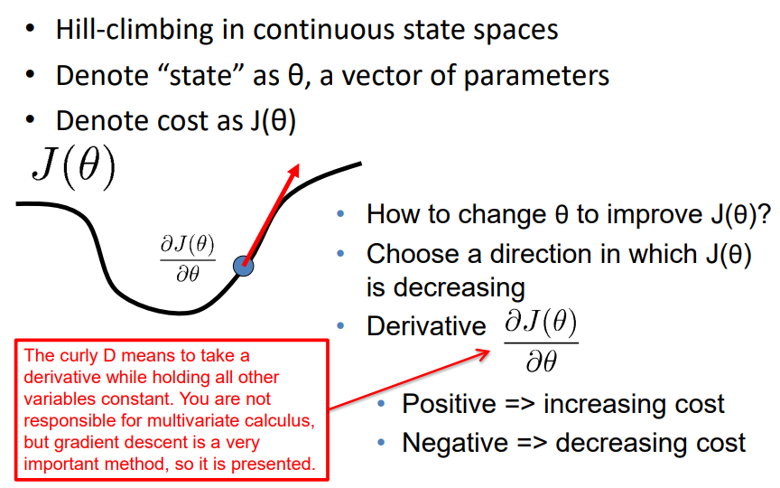
Gradient descent

Slide 33
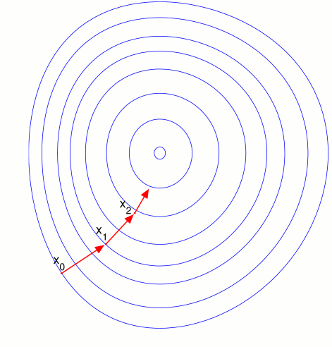
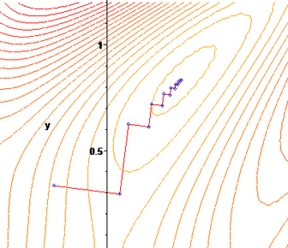

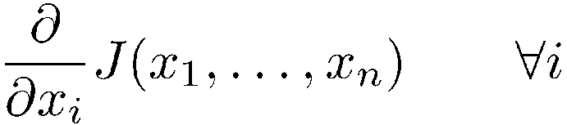
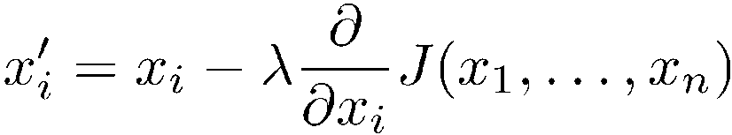
Gradient descent
Hill-climbing in continuous spaces
Gradient = the most direct direction up-hill in the objective (cost) function, so its negative minimizes the cost function.
* Assume we have some cost-function:
and we want minimize over continuous variables x₁,x₂,..,x_{n}
1. Compute the gradient :
2. Take a small step downhill in the direction of the gradient:
3. Check if
4. If true then accept move, if not “reject”.
5. Repeat.
(or, Armijo rule, etc.)
(decrease step size, etc.)

Slide 34
Gradient descent
Hill-climbing in continuous spaces
How do I determine the gradient?
Derive formula using multivariate calculus.
Ask a mathematician or a domain expert.
Do a literature search.
Variations of gradient descent can improve performance for this or that special case.
See Numerical Recipes in C (and in other languages) by Press, Teukolsky, Vetterling, and Flannery.
Simulated Annealing, Linear Programming too
Works well in smooth spaces; poorly in rough.

Slide 35
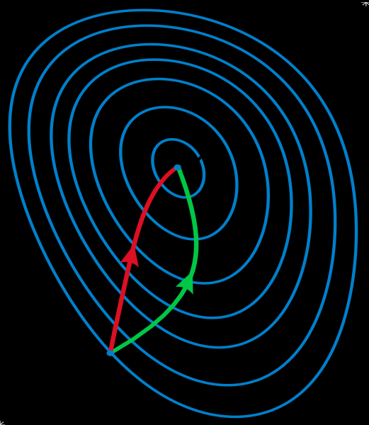
Gradient methods vs. Newton’s method
Gradient descent algorithms find local minima by moving along the direction of steepest descent while Newton's method takes into account curvature information and thereby often improves convergence.
A reminder of Newton’s method from Calculus:
x_{i+1} ← x_{i} – η f '(x_{i}) / f ''(x_{i})
Newton’s method uses 2nd order information (e.g., 2nd derivative) to take a faster route to a minimum
Second-order info. is more expensive to compute
Does not always converge; sometimes unstable
If converges, usually very fast
Works well for smooth, non-pathological functions, linearization accurate
Works poorly for wiggly, ill-behaved functions
See gradient descent
Contour lines of a function
Gradient descent (green)
Newton’s method (red)
Image from http://en.wikipedia.org/wiki/Newton's_method_in_optimization

Slide 36

Simulated annealing
A hill-climbing algorithm that never makes “downhill” moves toward states with lower value (or higher cost) is always vulnerable to getting stuck in a local maximum. In contrast, a purely random walk that moves to a successor state without concern for the value will eventually stumble upon the global maximum but will be extremely inefficient.
Therefore, it seems reasonable to try to combine hill climbing with a random walk in a way that yields both efficiency and completeness. Simulated annealing is such an algorithm.
In metallurgy, annealing is a technique involving heating & controlled cooling of a material to increase size of its crystals & reduce defects
Heat causes atoms to become unstuck from initial positions (local minima of internal energy) and wander randomly through states of higher energy
Slow cooling gives them more chances of finding configurations with lower internal energy than initial one

Slide 37
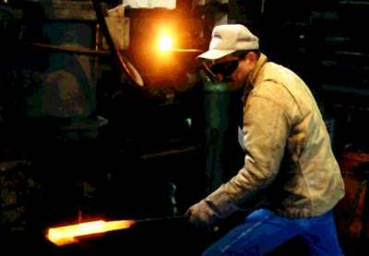

Real annealing: Sword
The worker heats the metal, then slowly cools it as he hammers the blade into shape.
If he cools the blade too quickly the metal will form patches of different composition;
If the metal is cooled slowly while it is shaped, the constituent metals will form a uniform alloy.

Slide 38
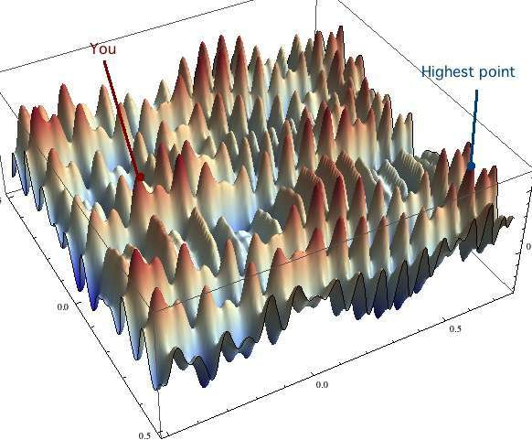
Simulated Annealing(SA) intuitions
Combines hill climbing (for efficiency) with random walk (for completeness)
Analogy: getting a ping-pong ball into the deepest depression in a bumpy surface
Shake the surface to get the ball out of local minima
Don’t shake too hard to dislodge it from global minimum
Simulated annealing:
Start shaking hard (high temperature) and gradually reduce shaking intensity (lower temperature)
Escape local minima by allowing some “bad” moves
But gradually reduce their size and frequency
The simulated-annealing solution is to start by shaking hard (i.e., at a high temperature) and then gradually reduce the intensity of the shaking (i.e., lower the temperature).

Slide 39
Simulated Annealing
Cost
Best
SA can avoid becoming trapped at local minima
SA is a stochastic algorithm involving asymptotic convergence and allowing random movements in the searched neighborhood in order to escape local minima
States
From : CSC 361 - Dr. Yousef Al-Ohali

Slide 40
Simulated Annealing
Cost
Best
States

Slide 41
Simulated Annealing
Cost
Best
States

Slide 42
Simulated Annealing
Cost
Best
States

Slide 43
Simulated Annealing
Cost
Best
States

Slide 44
Simulated Annealing
Cost
Best
States

Slide 45
Simulated Annealing
Cost
Best
States

Slide 46
Simulated Annealing
Cost
Best
States

Slide 47
Simulated Annealing
Cost
Best
States

Slide 48
Simulated Annealing
Cost
Best
States

Slide 49
Simulated Annealing
Cost
Best
States

Slide 50
Simulated Annealing
Cost
Best
States

Slide 51
Simulated Annealing
Cost
Best
States

Slide 52
Simulated Annealing
Cost
Best
States

Slide 53
Simulated Annealing
Cost
Best
States

Slide 54
Simulated Annealing
Cost
Best
States

Slide 55
Simulated Annealing
Cost
Best
States

Slide 56
Simulated Annealing
Cost
Best
States

Slide 57
Simulated Annealing
Cost
Best
States

Slide 58
Simulated Annealing
Cost
Best
States

Slide 59
Simulated Annealing
Cost
Best
States

Slide 60
Simulated Annealing
Cost
Best
States

Slide 61
Simulated Annealing
Cost
Best
States

Slide 62
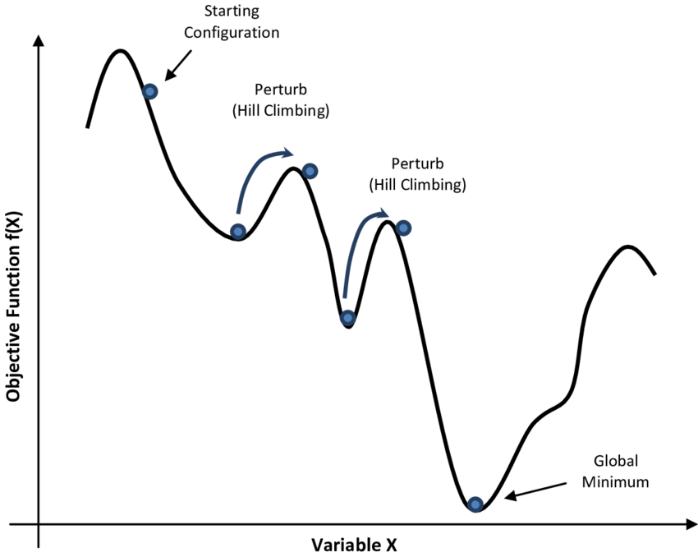
Simulated annealing (SA)
SA can avoid becoming trapped at local minima
SA is a stochastic algorithm involving asymptotic convergence and allowing random movements in the searched neighborhood in order to escape local minima
SA uses a control parameter T, which by analogy with the original application, is known as the system temperature
The higher the temperature, the higher probability of accepting a worse solution.
Typically, T decreases as the algorithm runs longer. Theoretically this algorithm always finds the global optimum but it can run very slow for some problems and in practice it would be a problem as to how to decide the rate at which to decrease T.
T starts out high and gradually decreases toward 0

Slide 63
Simulated annealing
The overall structure of the simulated-annealing algorithm (Figure 4.5) is similar to hill climbing. Instead of picking the best move, however, it picks a random move.
If the move improves the situation, it is always accepted. Otherwise, the algorithm accepts the move with some probability less than 1.
The probability decreases exponentially with the “badness” of the move—the amount ΔE by which the evaluation is worsened.
A “bad” move from A to B is accepted with a probability
-(f(B)-f(A)/T)
e
The higher the temperature, the more likely it is that a bad move can be made
As T tends to zero, probability tends to zero, and SA becomes more like hill climbing
If T lowered slowly enough, SA is complete and admissible

Slide 64
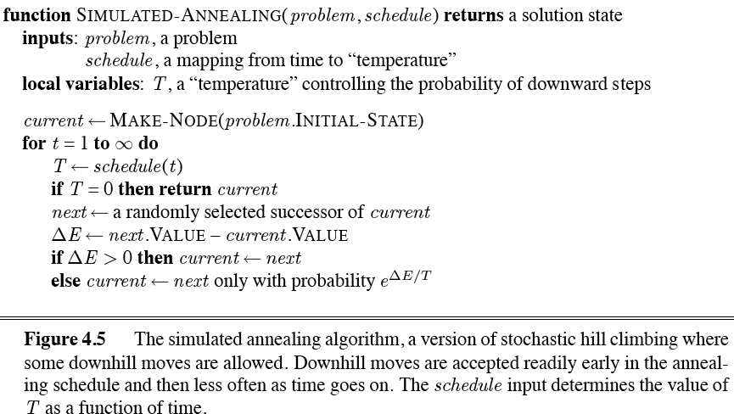
Simulated annealing algorithm

Slide 65

Simulated annealing algorithm
function SIMULATED-ANNEALING(problem,schedule) returns a state
current ← problem.initial-state
for t = 1 to ∞ do
T ←schedule(t) if T = 0 then return current next ← a randomly selected successor of current
∆E ← next.value – current.value if ∆E > 0 then current ← next else current ← next only with probability e^{∆E/T}

Slide 66
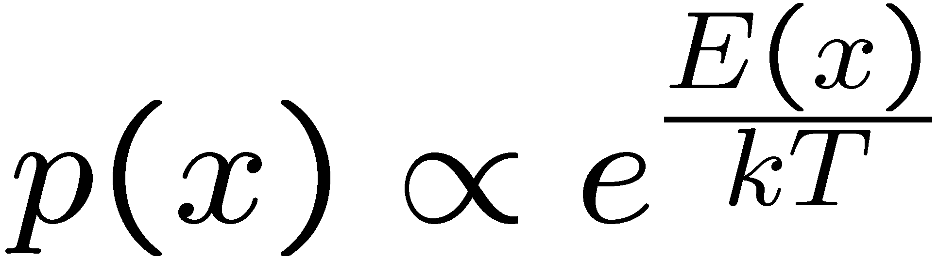
Simulated Annealing
Widely used in VLSI layout, airline scheduling, etc.
Often works very well in practice
But usually VERY VERY slow
One can prove:
If T decreases slowly enough, then simulated annealing search will find a global optimum with probability approaching 1
Unfortunately this can take a VERY VERY long time
Note: in any finite search space, random guessing also will find a global optimum with probability approaching 1
So, ultimately this is a very weak claim
Theoretical guarantee (proof):
Stationary distribution (Boltzmann): P(x) α e^{E(x)/T}
If T decreased slowly enough, will converge to optimal state!
Proof sketch
Consider two adjacent states x, y with E(y) > E(x) [high is good]
Assume x→y and y→x and outdegrees D(x) = D(y) = D
Let P(x), P(y) be the equilibrium occupancy probabilities at T
Let P(x→y) be the probability that state x transitions to state y
Notes:
P(x)P(x->y) = P(y)P(y->x)
P(x)/D = P(y)exp((E(x)-E(y))/T)/D
P(x)/P(y) = exp(E(x)/T) / exp(E(y)/T)

Slide 67
Simulated Annealing
Is this convergence an interesting guarantee?
Sounds like magic, but reality is reality:
The more downhill steps you need to escape a local optimum, the less likely you are to ever make them all in a row
“Slowly enough” may mean exponentially slowly
Random restart hillclimbing also converges to optimal state…
Simulated annealing and its relatives are a key workhorse in VLSI layout and other optimal configuration problems

Slide 68
Local beam search (LBS)
Or, K chosen randomly with
a bias towards good ones
Basic idea:
K copies of a local search algorithm, initialized randomly
For each iteration
Generate ALL successors from K current states
Choose best K of these to be the new current states
This is similar to k searches running in parallel!
LBS≠ running k random restarts in parallel instead of sequence.

Slide 69
Local beam search (LBS)
Idea:
Unlike Hill Climbing, keep k states instead of just 1
Algorithm:
Local Beam Search keeps track of k states rather than just one.
It starts with k randomly generated states.
At each step, all the successors of all the states are generated.
If any one is a goal, the algorithm halts, otherwise it selects the k best successors from the complete list and repeats.

Slide 70
Local beam search
…
a1
b1
k1
Create k random initial states
…
Generate their children
…
a2
b2
k2
Select the k best children
…
Repeat …

Slide 71
Local Beam Search
Cost
States
From : CSC 361 - Dr. Yousef Al-Ohali

Slide 72
Local Beam Search

Slide 73
Local Beam Search

Slide 74
Local Beam Search

Slide 75
Local Beam Search

Slide 76
Local Beam Search

Slide 77
Local Beam Search

Slide 78
Local Beam Search

Slide 79
Local Beam Search

Slide 80
Local Beam Search

Slide 81
Local Beam Search

Slide 82
Local Beam Search

Slide 83
Local Beam Search

Slide 84
Local Beam Search

Slide 85
Local Beam Search

Slide 86
Local Beam Search

Slide 87
Tabu search
Tabu search is a meta-heuristic optimization technique, which owes its name to its memory structures, used to store recently evaluated candidate solutions.
The candidates stored in these structures are not eligible for generation of further candidates and are thereby considered “Tabu” by the algorithm
Key idea
maintain the sequence of nodes already visited
- tabu lists and tabu nodes
Typically there are two kinds of tabu lists, a long term memory maintaining the history through all the exploration process as a whole and a short term memory to keep the most recently visited tabu movements.
Select the best configurations that is not tabu,
i.e., has not been visited before
Tabu search enhances the performance of local search by relaxing its basic rule.
First, at each step worsening moves can be accepted if no improving move is available (like when the search is stuck at a strict local minimum).
In addition, prohibitions (henceforth the term tabu) are introduced to discourage the search from coming back to previously-visited solutions.

Slide 88
Tabu Search: TS
Cost
States
From : CSC 361 - Dr. Yousef Al-Ohali

Slide 89
Tabu Search: TS
Best

Slide 90
Tabu Search: TS
Best

Slide 91
Tabu Search: TS
Best

Slide 92
Tabu Search: TS
Best

Slide 93
Tabu Search: TS
Best

Slide 94
Tabu Search: TS
Best

Slide 95
Tabu Search: TS
Best

Slide 96
Tabu Search: TS
Best

Slide 97
Tabu Search: TS
Best

Slide 98
Tabu Search: TS
Best

Slide 99
Tabu Search: TS
Best

Slide 100
Tabu Search: TS
Best

Slide 101
Tabu Search: TS
Best

Slide 102
Tabu Search: TS
Best

Slide 103
Tabu Search: TS
Best

Slide 104
Tabu Search: TS
Best

Slide 105
Tabu Search: TS
Best

Slide 106
Tabu Search: TS
Best

Slide 107
Tabu Search: TS
Best

Slide 108
Tabu Search: TS
Best

Slide 109
Tabu Search: TS
Best

Slide 110
Tabu Search: TS
Best

Slide 111
Advantages and Disadvantages of TS
Advantages and Disadvantages of TS
Advantages
Can escape local optimums by picking non-improving solutions
The Tabu List can be used to avoid cycles and reverting to old solutions
Can be applied to both discrete and continuous solutions
Disadvantages
Number of iterations can be very high
There are a lot of tuneable parameters in this algorithm
Key issue with tabu search
expensive to maintain all the visited nodes (Short-term memory only keep a small set of recently visited nodes (tabu list)=

Slide 112
Evolutionary computation
In computer science, evolutionary computation is a family of algorithms for global optimization inspired by biological evolution, and the subfield of artificial intelligence and soft computing studying these algorithms.
Evolutionary computing techniques mostly involve metaheuristic optimization algorithms. Broadly speaking, the field includes:
Agent-based modeling
Ant colony optimization
Artificial immune systems
Artificial life (also see digital organism)
Cultural algorithms
Differential evolution
Dual-phase evolution
Estimation of distribution algorithms
Evolutionary algorithms
Evolutionary programming
Evolution strategy
Gene expression programming
Genetic algorithm
Genetic programming
Grammatical evolution
Learnable evolution model
Learning classifier systems
Memetic algorithms
Neuroevolution
Particle swarm optimization
Self-organization such as self-organizing maps, competitive learning
Swarm intelligence

Slide 113
Evolutionary algorithms
Evolutionary algorithms are based on concepts of biological evolution. A ‘population’ of possible solutions to the problem is first created with each solution being scored using a ‘fitness function’ that indicates how good they are. The population evolves over time and (hopefully) identifies better solutions.
Evolutionary algorithms can be seen as variants of stochastic beam search that are explicitly motivated by the metaphor of natural selection in biology: there is a population of individuals (states), in which the fittest (highest value) individuals produce offspring (successor states) that populate the next generation, a process called recombination. There are endless forms of evolutionary algorithms, varying in the following ways:
The size of the population.
The representation of each individual.
The mixing number, which is the number of parents that come together to form offspring.
The selection process for selecting the individuals who will become the parents of the next generation
The recombination procedure. One common approach (assuming =2), is to randomly select a crossover point to split each of the parent strings, and recombine the parts to form two children.
The mutation rate, which determines how often offspring have random mutations to their representation.
The makeup of the next generation. This can be just the newly formed offspring, or it can include a few top-scoring parents from the previous generation (a practice called elitism)

Slide 114
Genetic Algorithms
Each state is seen as an individual in a population.
A genetic algorithm applies selection and reproduction operators to an initial population
The aim is to generate individuals that are most successful, according to a given fitness function.
Select parents based on fitness, and “reproduce” to get the next generation (using “crossover” and mutations)
Replace the old generation with the new generation.
Variation operators used in Reproduction create the necessary diversity, facilitating novelty
Selection reduces diversity but pushes quality by increasing fitness

Slide 115
Genetic Algorithms
Before we can apply Genetic Algorithm to a problem, we need to answer:
- How to represent an individual?
- What is the fitness function?
- How to select individuals?
- How to reproduce individuals?

Slide 116
Representation of states (solutions)
Each state or individual is represented as a string over a finite alphabet. It is also called chromosome which Contains genes. Each character in the string is a gene.
genes
1001011111
Solution: 607
Encoding
Chromosome:
Binary String
Possible Encodings:
Character strings 0101 · · · 1100
Sequences of real numbers (43.2 -33.1 · · · 0.0 89.2)
Tuples of elements (E11 E3 E7 · · · E1 E15)
Lists of rules (R1 R2 R3 · · · R22 R23)
Choosing the right encoding of state configurations to strings is crucial.

Slide 117
8-queens puzzle encoding
8-digit strings represents 8-queens states
Figure 4.6(a) shows a population of four 8-digit strings, each representing a state of the 8-queens puzzle: the c-th digit represents the row number of the queen in column c. In (b), each state is rated by the fitness function. Higher fitness values are better, so for the 8-queens problem we use the number of nonattacking pairs of queens, which has a value of 8*7/2=28.

Slide 118
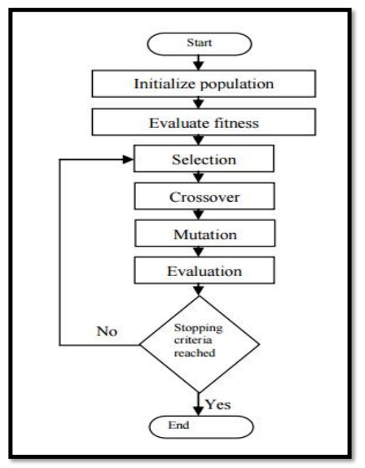
Fitness Function
Each state is rated by the evaluation function called fitness function. Fitness function should return higher values for better states:
Fitness(X) should be greater than Fitness(Y) !!
[Fitness(x) = 1/Cost(x)]
Cost
States
X
Y

Slide 119
Selection
Selection is the stage of a genetic algorithm in which individual genomes are chosen from a population for later breeding (using the crossover operator).
Methods of Selection (Genetic Algorithm)
1.1 Roulette Wheel Selection
1.2 Rank Selection
1.3 Steady State Selection
1.4 Tournament Selection
1.5 Elitism Selection
1.6 Boltzmann Selection

Slide 120
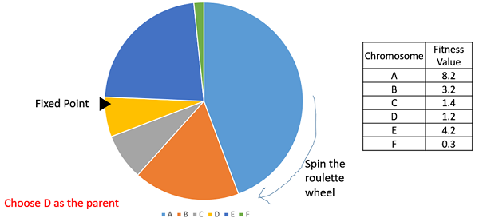
Roulette Wheel Selection
In the roulette wheel selection, the probability of choosing an individual for breeding of the next generation is proportional to its fitness, the better the fitness is, the higher chance for that individual to be chosen. Choosing individuals can be depicted as spinning a roulette that has as many pockets as there are individuals in the current generation, with sizes depending on their probability.
https://www.tutorialspoint.com/genetic_algorithms/genetic_algorithms_parent_selection.htm

Slide 121
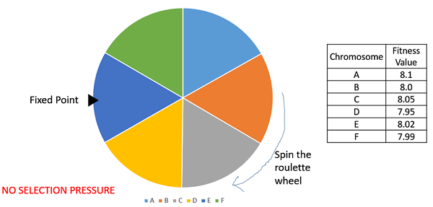
Rank Selection
Rank Selection also works with negative fitness values and is mostly used when the individuals in the population have very close fitness values (this happens usually at the end of the run). This leads to each individual having an almost equal share of the pie (like in case of fitness proportionate selection) and hence each individual no matter how fit relative to each other has an approximately same probability of getting selected as a parent. This in turn leads to a loss in the selection pressure towards fitter individuals, causing the GA to make poor parent selections in such situations.
https://www.tutorialspoint.com/genetic_algorithms/genetic_algorithms_parent_selection.htm

Slide 122
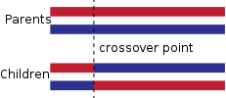
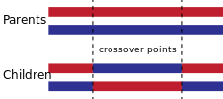
Cross-Over and Mutation
How to reproduce individuals?
Crossover, also called recombination, is a genetic operator used to combine the genetic information of two parents to generate new offspring.
The crossover of two parent strings produces offspring/children (new solutions) by swapping parts or genes of the chromosomes.
Crossover has a higher probability, typically 0.8-0.95.
One-point crossover:
A point on both parents' chromosomes is picked randomly, and designated a 'crossover point'. Bits to the right of that point are swapped between the two parent chromosomes. This results in two offspring, each carrying some genetic information from both parents.
Two-point and k-point crossover:
In two-point crossover, two crossover points are picked randomly from the parent chromosomes. The bits in between the two points are swapped between the parent organisms.

Slide 123
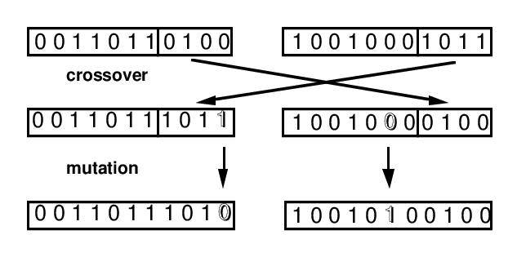
Cross-Over and Mutation
Mutation is a genetic operator used to maintain genetic diversity from one generation of a population of genetic algorithm chromosomes to the next. It is analogous to biological mutation.
Mutation is carried out by flipping some digits of a string, which generates new solutions. This mutation probability is typically low, from 0.001 to 0.05.
New solutions generated in each generation will be evaluated by their fitness that is linked to the objective function of the optimization problem.
The new solutions are selected according to their fitness—selection of the fittest. Sometimes, in order to make sure that the best solutions remain in the population, the best solutions are passed on to the next generation without much change. This is called elitism.
Order changing - two numbers are selected and exchanged : (1 2 3 4 5 6 8 9 7) => (1 8 3 4 5 6 2 9 7)
Adding a small number (for real value encoding) - to selected values is added (or subtracted) a small number:
(1.29 5.68 2.86 4.11 5.55) => (1.29 5.68 2.73 4.22 5.55)
Bit inversion - selected bits are inverted :
11001001 => 10001001
https://www.obitko.com/tutorials/genetic-algorithms/crossover-mutation.php

Slide 124
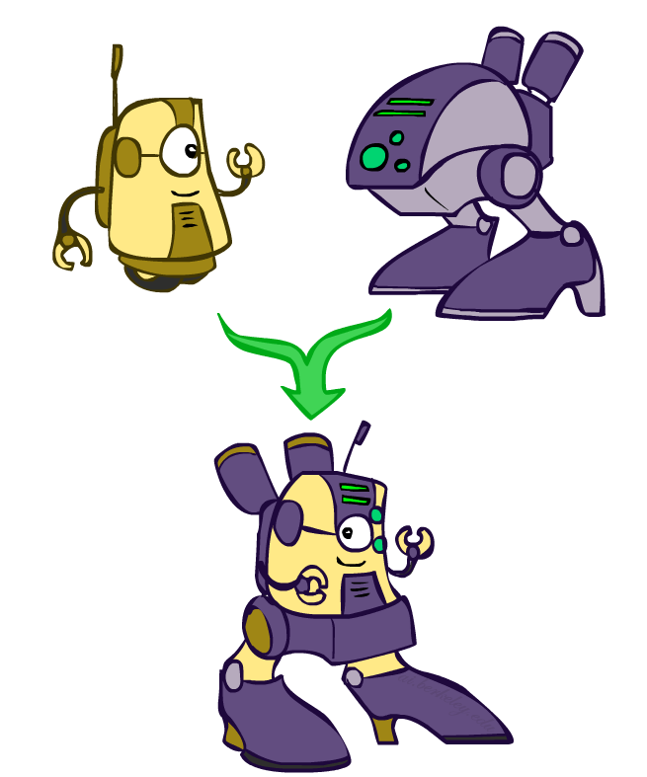
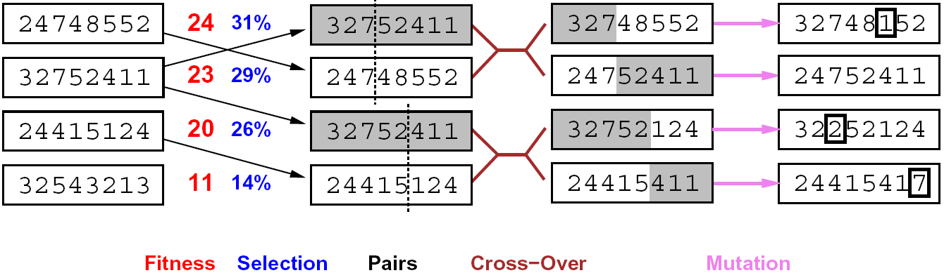
8-queens puzzle : selection
Genetic algorithms use a natural selection metaphor
Resample K individuals at each step (selection) weighted by fitness function
Combine by pairwise crossover operators, plus mutation to give variety
Fitness function: number of non-attacking pairs of queens (min = 0, max = 8 × 7/2 = 28)
The fitness values of the four states in (b) are 24, 23, 20, and 11.
24/(24+23+20+11) = 31%
23/(24+23+20+11) = 29% etc.
Higher fitness values are better.

Slide 125
8-queens puzzle : crossover and mutation
The fitness values of the four states in (b) are 24, 23, 20, and 11. The fitness scores are then normalized to probabilities, and the resulting values are shown next to the fitness values in (b). In (c), two pairs of parents are selected, in accordance with the probabilities in (b). Notice that one individual is selected twice and one not at all. For each selected pair, a crossover point (dotted line) is chosen randomly. In (d), we cross over the parent strings at the crossover points, yielding new offspring.
Finally, in (e), each location in each string is subject to random mutation with a small independent probability. One digit was mutated in the first, third, and fourth offspring. In the 8-queens problem, this corresponds to choosing a queen at random and moving it to a random square in its column.

Slide 126
Example: N-Queens
Crossover helps only if substrings are meaningful components that can be reassembled into a new meaningful configuration.

Slide 127
Genetic Algorithms
Cost
States

Slide 128
Genetic Algorithms
Mutation
Cross-Over

Slide 129
Genetic Algorithms

Slide 130
Genetic Algorithms

Slide 131
Genetic Algorithms

Slide 132
Genetic Algorithms

Slide 133
Genetic Algorithms

Slide 134
Genetic Algorithms

Slide 135
Genetic Algorithms

Slide 136
Genetic Algorithms

Slide 137
Genetic Algorithms

Slide 138
Genetic Algorithms

Slide 139
Genetic Algorithms

Slide 140
Genetic Algorithms

Slide 141
Genetic Algorithms

Slide 142
Genetic Algorithms

Slide 143
Genetic Algorithms

Slide 144
Genetic Algorithms

Slide 145
Genetic Algorithms

Slide 146
Problem Encoding
From: CS:4420

Slide 147
Problem Encoding
From: CS:4420

Slide 148
Recombination : Similar to crossover
From: CS:4420

Slide 149
GA for the Traveling Salesperson Problem
From: CS:4420

Slide 150
GA for the Traveling Salesperson Problem

Slide 151
GA for the Traveling Salesperson Problem

Slide 152
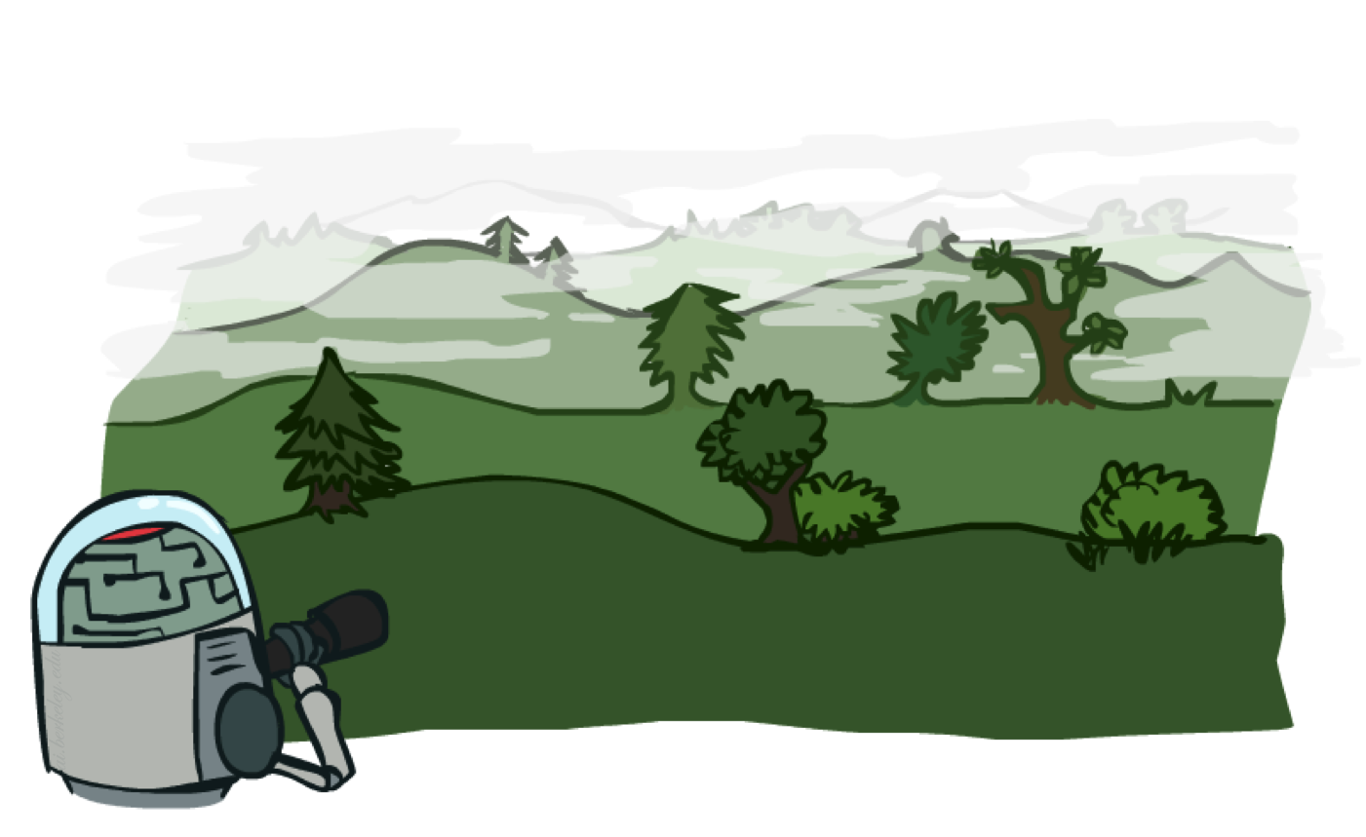
Local search in continuous spaces

Slide 153
Local Search in Continuous Spaces
There is a distinction between discrete and continuous environments. The most real-world environments are continuous. A continuous action space has an infinite branching factor, and thus can’t be handled by most of the algorithms we have covered so far (with the exception of first-choice hill climbing and simulated annealing).
Suppose we want to place three new airports anywhere in Romania, such that the sum of squared straight-line distances from each city on the map to its nearest airport is minimized. (See Figure 3.1 for the map of Romania.) The state space is then defined by the coordinates of the three airports:
(x1;y1), (x2;y2), and (x3;y3).
This is a six-dimensional space; we also say that states are defined by six variables.
The objective function f (x) = f (x1;y1;x2;y2;x3;y3) is relatively easy to compute for any particular state once we compute the closest cities. Let Ci be the set of cities whose closest airport (in the state x) is airport i. Then, we have

Slide 154
Example: Siting airports in Romania
Place 3 airports to minimize the sum of squared distances from each city to its nearest airport
Airport locations
x = (x₁,y₁), (x₂,y₂), (x₃,y₃)
City locations (x_{c},y_{c})
C_{a} = cities closest to airport a
Objective: minimize
f(x) = Σ_{a} Σ_{c∈Ca} (x_{a} - x_{c})² + (y_{a} - y_{c})²

Slide 156
Handling a continuous state/action space
One way to deal with a continuous state space is to discretize it. For example, instead of allowing the (xi;yi) locations to be any point in continuous two-dimensional space, we could limit them to fixed points on a rectangular grid with spacing of size δ (delta).
Discretize it!
Define a grid with increment δ , use any of the discrete algorithms
Choose random perturbations to the state
First-choice hill-climbing: keep trying until something improves the state
Simulated annealing
Compute gradient of f(x) analytically

Slide 157
Finding extrema in continuous space
The gradient of the objective function is a vector ∇f(x) that gives the magnitude and direction of the steepest slope. For our problem, we have
Gradient vector: ∇f(x) = (∂f/∂x₁, ∂f/∂y₁, ∂f/∂x₂, …)^{T}
For the airports: f(x) = Σ_{a} Σ_{c∈Ca} (x_{a} - x_{c})² + (y_{a} - y_{c})²
In some cases, we can find a maximum by solving the equation ∇f(x) = 0
For example, with three airports, the expression for the gradient depends on what cities are closest to each airport in the current state. This means we can compute the gradient locally (but not globally); for example,
∂f/∂x₁ = Σ_{c∈C1} 2(x₁ - x_{c})
Given a locally correct expression for the gradient, we can perform steepest-ascent hill climbing by updating the current state according to the gradient descent formula:
x ← x - α∇f(x)
where α (alpha) is a small constant often called the step size.
There are huge range of algorithms for finding extrema using gradients.

Slide 158
Summary
Many configuration and optimization problems can be formulated as local search.
Local search methods keep small number of nodes in memory. They are suitable for problems where the solution is the goal state itself and not the path.
General families of algorithms:
Hill-climbing, continuous optimization
Simulated annealing (and other stochastic methods)
Local beam search: multiple interaction searches
Genetic algorithms: break and recombine states
Genetic algorithms are a kind of stochastic hill-climbing search in which a large population of states is maintained. New states are generated by mutation and by crossover which combines pairs of states from the population.
Many machine learning algorithms are local searches

