Slide 1
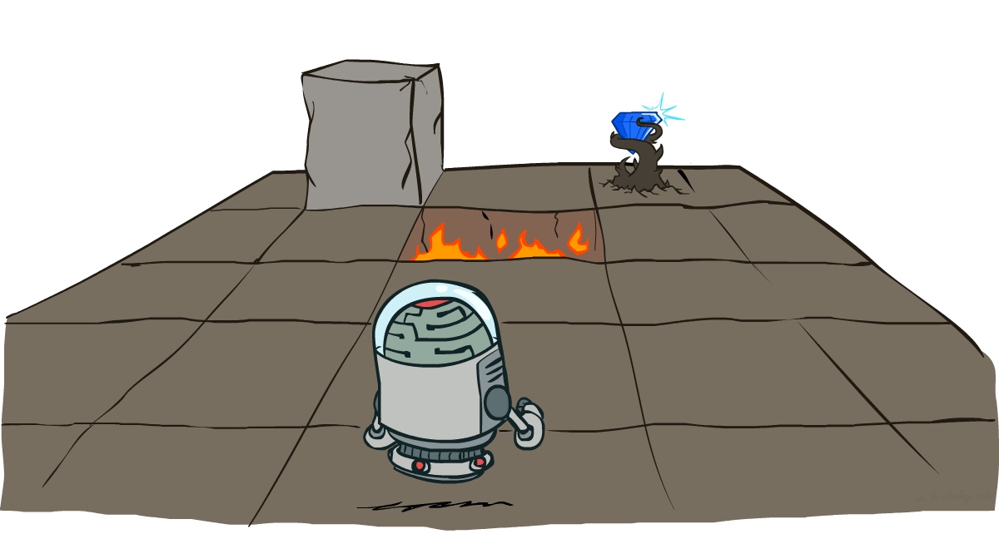
COE 4213564 Introduction to Artificial Intelligence
Markov Decision Processes
Many slides are adapted from CS 188 (http://ai.berkeley.edu), CS 322, CIS 521, CS 221, CS182, CS4420.
Notes:
Please retain proper attribution, including the reference to ai.berkeley.edu. Thanks!

Slide 2
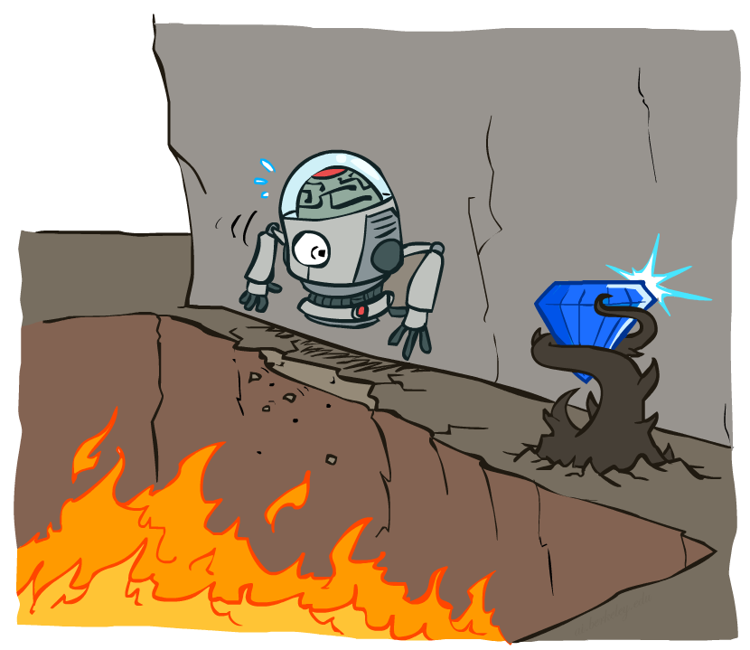
Non-Deterministic Search
Chapter 16 focuses on the computational issues involved in making decisions in a stochastic Environment.
It works on sequential decision problems that incorporate utilities, uncertainty, and sensing, and include search and planning problems as special cases.
A sequential decision problem for a fully observable, stochastic environment with a Markovian transition model and additive rewards is called a Markov decision process.
Markov decision Process (MDP) consists of a set of states (with an initial state s₀); a set ACTIONS(s) of actions in each state; a transition model P(s’ | s;a); and a reward function R(s,a, s’).
Transitions are Markovian that means the probability of reaching state s’ from s depends only on s and not on the history of earlier states.
MDPs are non-deterministic search problems.

Slide 3
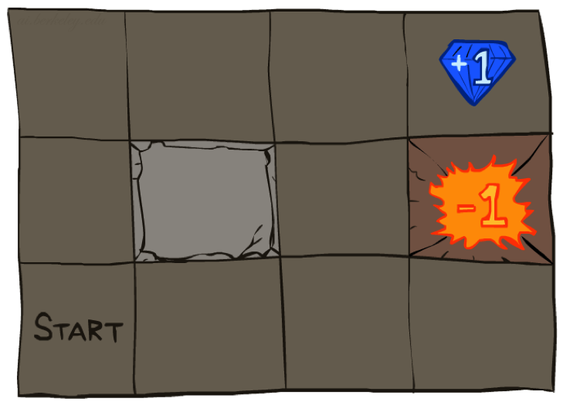




Example: Grid World
A maze-like problem
The agent lives in a grid
Walls block the agent’s path
The interaction with the environment terminates when the agent reaches one of the goal states, marked +1 or –1.
The actions available to the agent in each state are given by ACTIONS(s), sometimes abbreviated to A(s).
In the 4x3 environment, the actions in every state are Up (North), Down (South), Left (West), and Right (East).
If the environment were deterministic, a solution would be easy:
[Up, Up, Right, Right, Right].
Unfortunately, the environment won’t always go along with this solution, because the actions are unreliable (non-deterministic)
Notes:
[cut demo of moving around in grid world program]

Slide 4
Example: Grid World
We are in a non-deterministic, stochastic or noisy environment.
Noisy movement: actions do not always go as planned
With 80% of the time, the action Up (North) takes place (if there is no wall there)
With 10% of the time, the agent moves Left (West) or Right (East)
If there is a wall in the direction the agent would have been taken, the agent stays there
The transition model (or just “model,” when the meaning is clear) describes the outcome of each action in each state.
Here, the outcome is stochastic, so we write transition functions P(s’ | s, a) (or T(s ,a, s’)) for the probability of reaching state s’ if action a is done in state s.
We will assume that transitions are Markovian: the probability of reaching s’ from s depends only on s and not on the history of earlier states.
Notes:
[cut demo of moving around in grid world program]

Slide 5
Example: Grid World
The agent receives rewards each time step
Small “living” reward each step (can be negative)
Big rewards come at the end (good or bad)
To complete the definition of the task environment, we must specify the utility function for the agent. Because the decision problem is sequential, the utility (reward) function will depend on a sequence of states and actions.
For every transition from s to s’ via action a, the agent receives a reward Reward R(s, a, s’). The rewards may be positive or negative, but they are bounded by -Rmax and +Rmax.
For our particular example, the reward is -0.04 for all transitions except those entering terminal states (which have rewards +1 and –1). The utility of an environment history is just (for now) the sum of the rewards received.
For example, if the agent reaches the +1 state after 10 steps, its total utility will be (9 x -0.04)+1=0.64. The negative reward of –0.04 gives the agent an incentive to reach (4,3) quickly, so our environment is a stochastic generalization of the search problems of Chapter 3.
Goal: maximize sum of rewards
Notes:
[cut demo of moving around in grid world program]

Slide 6
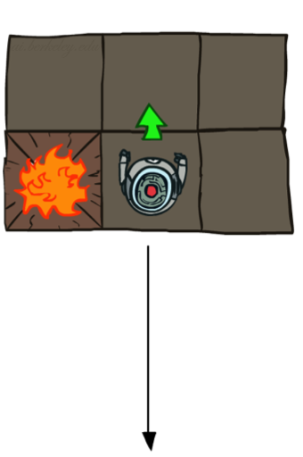
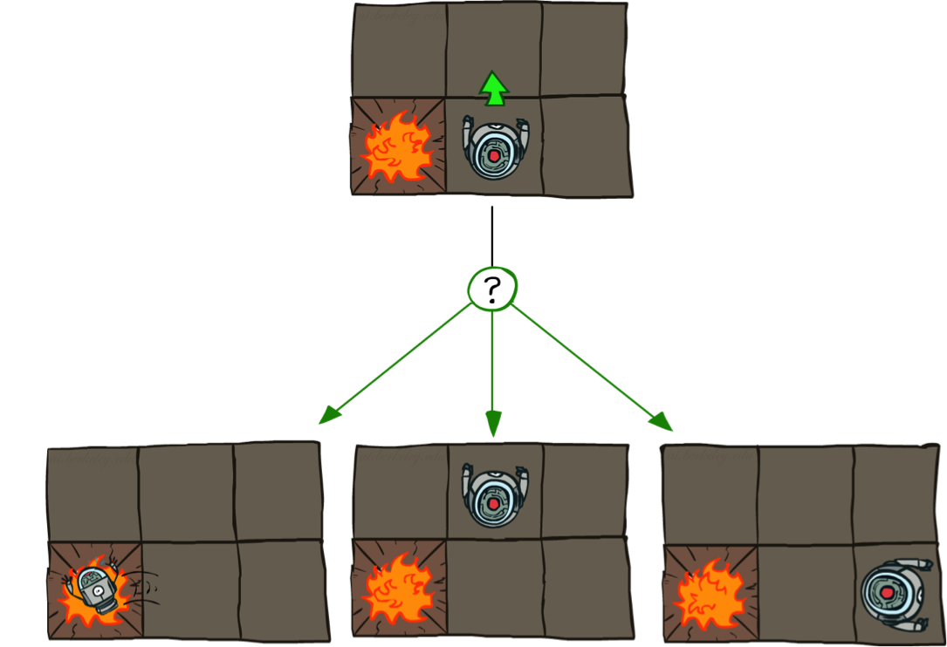
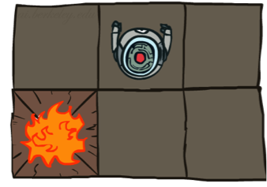
Grid World Actions
Deterministic Grid World
Stochastic Grid World

Slide 7
Markov Decision Processes
An MDP is defined by:
A set of states s ∈ S
A set of actions a ∈ A
A transition function T(s, a, s’)
Probability that a from s leads to s’, i.e., P(s’| s, a)
Also called the model or the dynamics
A reward function R(s, a, s’)
Sometimes just R(s) or R(s’)
A start state
Maybe a terminal state
MDPs are non-deterministic search problems
One way to solve them is with expectimax search
We’ll have a new tool soon
[Demo – gridworld manual intro (L8D1)]
Notes:
In search problems: did not talk about actions, but about successor functions --- now the information inside the successor function is unpacked into actions, transitions and reward
Write out S, A, example entry in T, entry in R
Reward function different from the book : R(s,a,s’)
In book simpler for equations, but not useful for the projects.
Need to modify expectimax a tiny little bit to account for rewards along the way, but that’s something you should be able to do, and so you can already solve MDP’s (not in most efficient way)

Slide 8

Video of Demo Gridworld Manual Intro

Slide 9
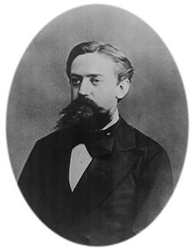

What is Markov about MDPs?
“Markov” generally means that given the present state, the future and the past are independent
For Markov decision processes, “Markov” means action outcomes depend only on the current state
This is just like search, where the successor function could only depend on the current state (not the history)
Andrey Markov (1856-1922)
Notes:
Like search: successor function only depended on current state
Can make this happen by stuffing more into the state;
Very similar to search problems: when solving a maze with food pellets, we stored which food pellets were eaten

Slide 10
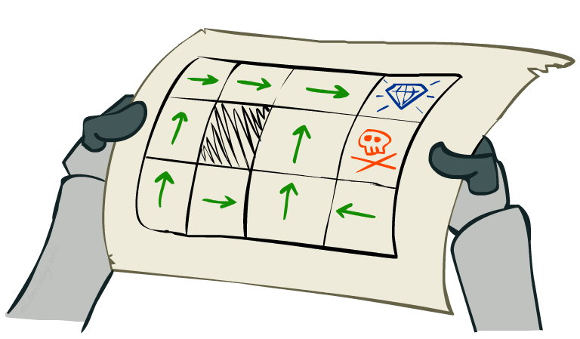
Policies
In deterministic single-agent search problems, we wanted an optimal plan, or sequence of actions, from start to a goal as a solution.
In MDPs, a solution is called a policy that will take the agent from start state to goal state.
It is traditional to denote a policy by π,
and π (s) is the action recommended by the policy π for state s.
For MDPs, we want an optimal policy π*: S → A
A policy π gives an action for each state
An optimal policy is one that maximizes expected utility if followed.
An explicit policy defines a reflex agent
Expectimax didn’t compute entire policies
It computed the action for a single state only
Optimal policy when R(s, a, s’) = -0.03 for all non-terminals s
Notes:
Dan has a DEMO for this.

Slide 11
Optimal Policies
R(s) = -0.01
R(s) = -0.03
R(s) = -0.4
R(s) = -2.0
Notes:
R(s) = the “living reward”

Slide 12
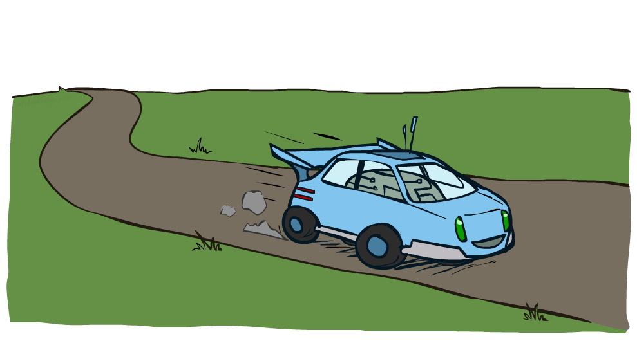
Example: Racing

Slide 13
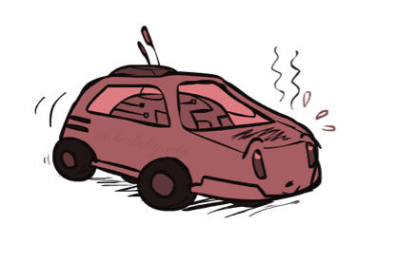
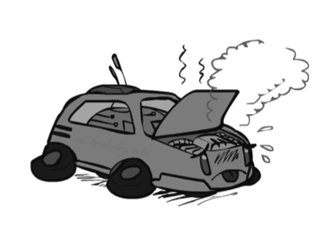
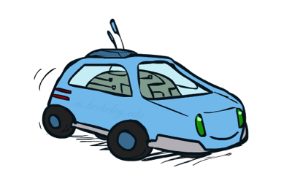
Example: Racing
A robot car wants to travel far, quickly
Three states: Cool, Warm, Overheated
Two actions: Slow, Fast
Going faster gets double reward
0.5
+1
1.0
Fast
Slow
-10
+1
0.5
Warm
Slow
Fast
0.5
+2
Cool
0.5
Overheated
+1
1.0
+2

Slide 14


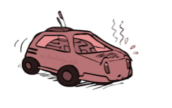
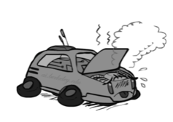
Racing Search Tree

Slide 15
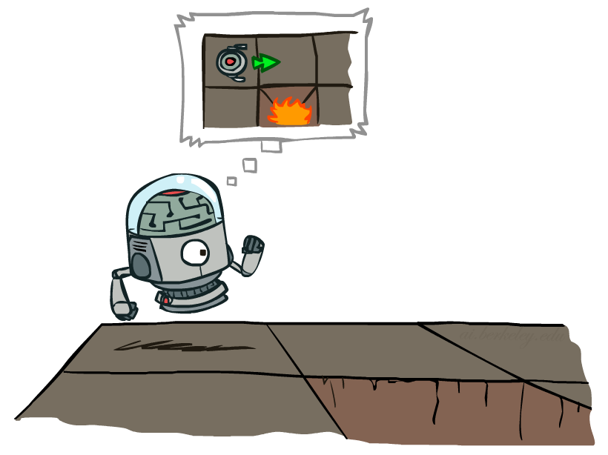

MDP Search Trees
Each MDP state projects an expectimax-like search tree
s
s is a state
a
(s,a) is
a q-state
(s, a) is a q-state
s, a
(s,a,s’) called a transition
T(s,a,s’) = P(s’|s,a)
R(s,a,s’)
s,a,s’
s’
We have rewards associated with transitions.
You sum the rewards as you go along the path
Notes:
In MDP chance node represents uncertainty about what might happen based on (s,a) [as opposed to being a random adversary]
Q-state (s,a) is when you were in a state and took an action

Slide 16
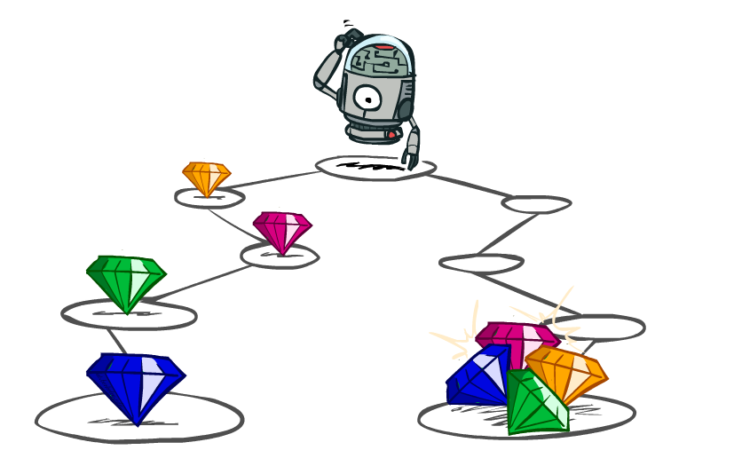
Utilities of Sequences

Slide 17
Utilities of Sequences
What preferences should an agent have over reward sequences?
More or less?
Now or later?
Sooner is better
[1, 2, 2]
or
[2, 3, 4]
[0, 0, 1]
or
[1, 0, 0]

Slide 18
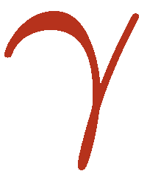
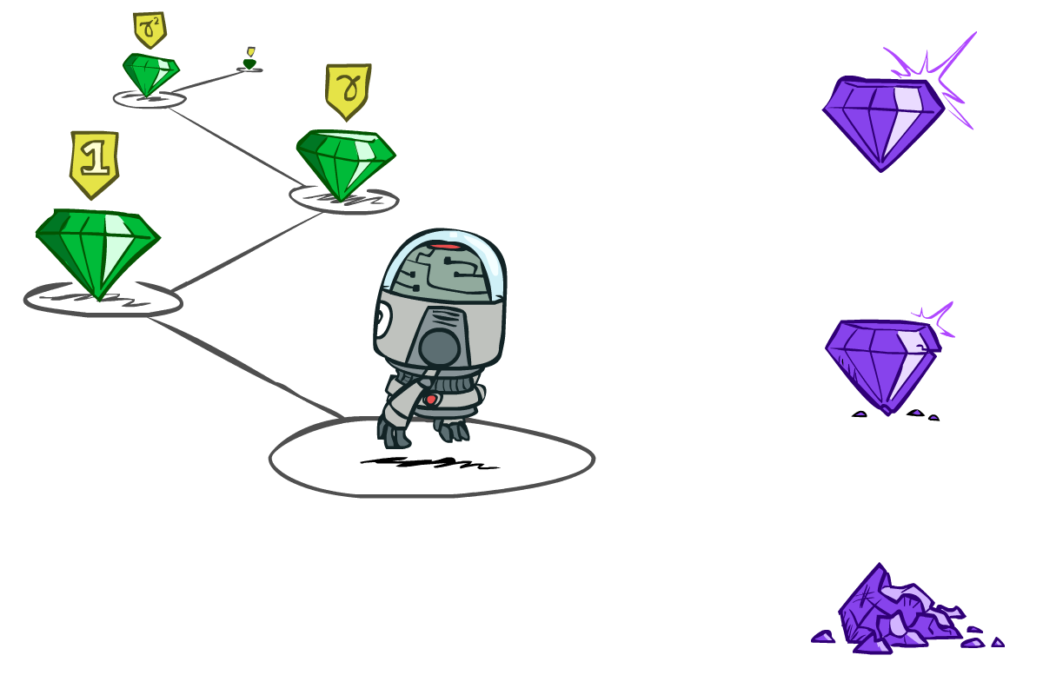

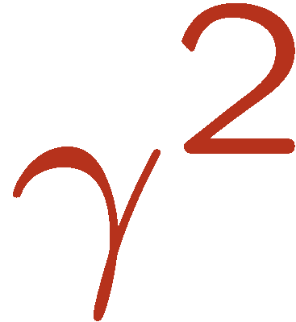
Discounting
It’s reasonable to maximize the sum of rewards
It’s also reasonable to prefer rewards now to rewards later. We use a discount factor which is a number between 0 and 1.
One solution: values of rewards decay exponentially
Worth Now
Worth Next Step
Worth In Two Steps

Slide 19

Discounting
How to discount?
Each time we descend a level, we multiply in the discount once
Why discount?
Sooner rewards probably do have higher utility than later rewards
Also helps our algorithms converge
Example: discount of 0.5
Reward 1 at 1st step, 2 at the 2nd, 3 at the 3rd steps
U([1,2,3]) = 1*1 + 0.5*2 + 0.25*3
U([1,2,3]) < U([3,2,1])
Notes:
Rewards in the future (deeper in the tree) matter less
Interesting: running expectimax, if having to truncate the search, then not losing much; e.g., less then \gamma^d / (1-\gamma)

Slide 20
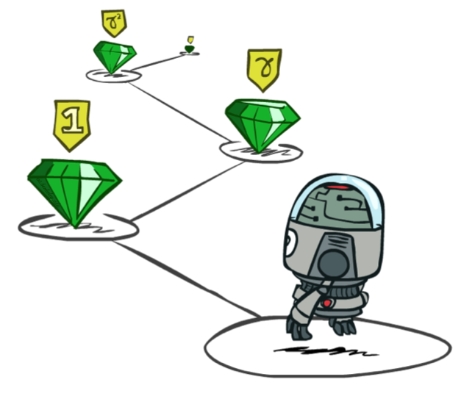
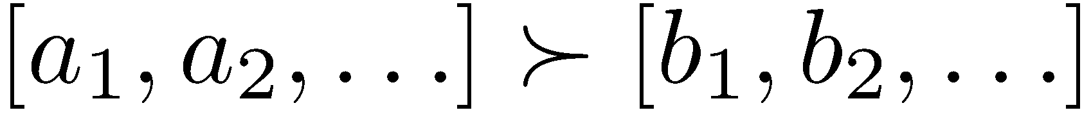
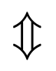
Stationary Preferences
A policy that depends on the time is called nonstationary.
An optimal action depends only on the current state, and then an the optimal policy is stationary.
Theorem: if we assume stationary preferences over a sequence of rewards:
Where r is the additional reward
Then: there are only two ways to define utilities
Additive utility:
Discounted utility:
Reward sequences of a’s are better sequences of b’s.
Add a new reward r to sequences

Slide 21


Quiz: Discounting
Given:
Actions: East, West, and Exit (only available in exit states a, e)
There is a reward of 10 at state a and 1 at state.
Transitions: deterministic
Quiz 1: For γ = 1, what is the optimal policy?
Quiz 2: For γ = 0.1, what is the optimal policy?
Quiz 3: For which γ are West and East equally good when in state d? γ = 1 / sqrt(10)
For Quiz 2 on state d:
Sum rewards
Go to east : 0 + γ * 1 = 0.1 from d.
Go to west : 0 + γ * 0 + γ² * 0 + γ³ * 10 = 0.01 from d.
So it is better to go to east in you are in state d
In other states b and c, go to west

Slide 22
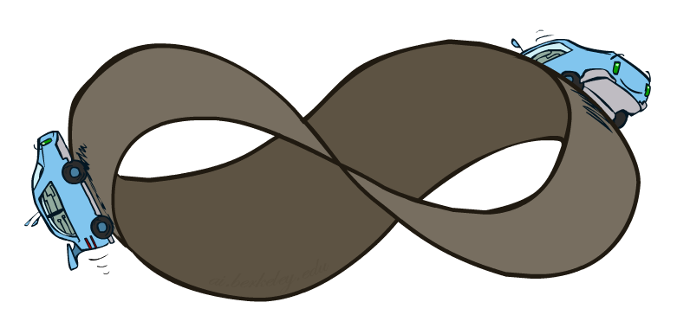
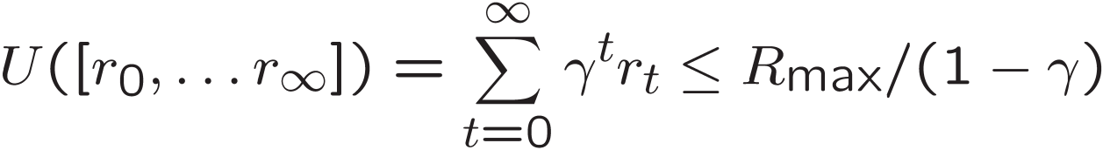
Infinite Utilities?!
Problem: What if the game lasts forever? Do we get infinite rewards?
if the environment does not contain a terminal state, or if the agent never reaches one, then all environment histories will be infinitely long, and utilities with additive undiscounted rewards will generally be infifinite
3 Solutions:
Finite horizon: (similar to depth-limited search)
Terminate episodes after a fixed T steps (e.g. life)
Gives nonstationary policies (π depends on time left)
Discounting: use 0 < γ < 1
Sum of rewards are bounded (R_{max} : Maximum reward)
Smaller γ means smaller “horizon” – shorter term focus
Absorbing state: guarantee that for every policy, a terminal state will eventually be reached (like “overheated” for racing)

Slide 23
Recap: Defining MDPs
Markov decision processes:
Set of states S
Start state s₀
Set of actions A
Transitions P(s’|s,a) (or T(s,a,s’))
Rewards R(s,a,s’) (and discount γ)
MDP quantities so far:
Policy = Choice of action for each state
Utility = sum of (discounted) rewards
s
a
s, a
s,a,s’
s’

Slide 24
Solving MDPs
In this section, we present two different algorithms for solving MDPs:
- value iteration, and
- policy iteration.

Slide 25
Optimal Quantities
The value (utility) of a state s:
V*(s) = expected utility starting in s and acting optimally
The value (utility) of a q-state (s,a):
Q*(s,a) = expected utility starting out having taken action a from state s and (thereafter) acting optimally
The optimal policy:
π*(s) = optimal action from state s
s
s is a state
a
(s, a) is a q-state
s, a
s,a,s’
(s,a,s’) is a transition
s’
[Demo – gridworld values (L8D4)]
Notes:
[Note: this demo doesn’t show anything in action, just pops up V and Q values.]

Slide 26
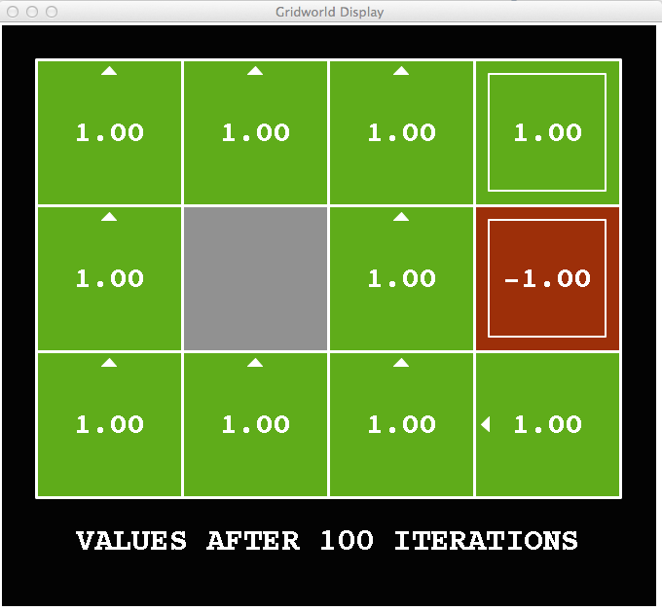
Snapshot of Demo – Gridworld V Values
Noise = 0
Discount = 1
Living reward = 0
Notes:
This demo doesn’t show anything in action, it just shows the V and Q values.

Slide 27
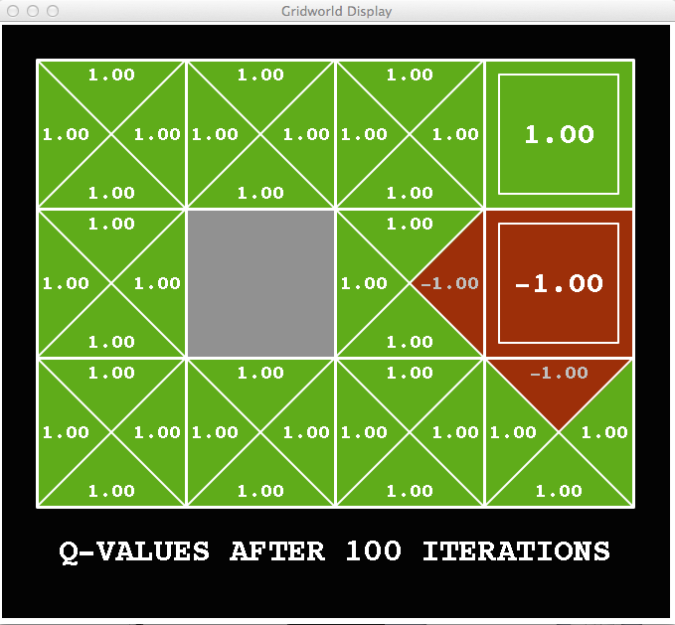
Snapshot of Demo – Gridworld Q Values
Noise = 0
Discount = 1
Living reward = 0
Notes:
This demo doesn’t show anything in action, it just shows the V and Q values.

Slide 28

Snapshot of Demo – Gridworld V Values
Noise = 0.2
Discount = 1
Living reward = 0
Notes:
This demo doesn’t show anything in action, it just shows the V and Q values.

Slide 29
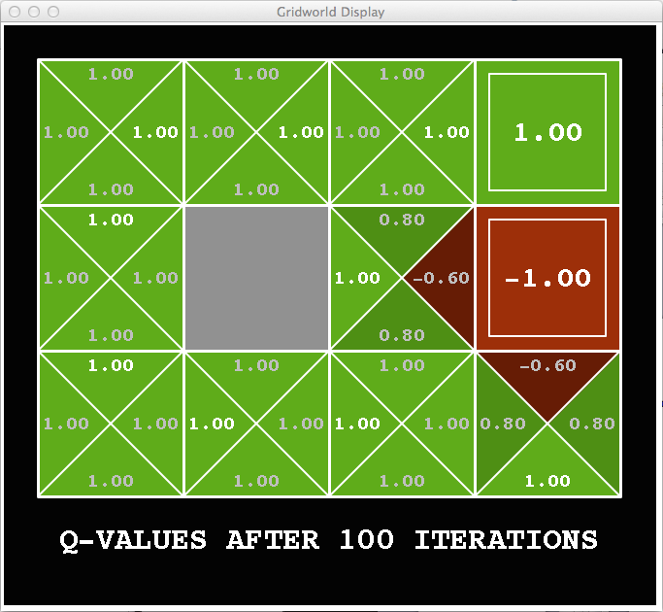
Snapshot of Demo – Gridworld Q Values
The values in triangles
Show Q-values for
going Up, Down,
Left and Right
Noise = 0.2
Discount = 1
Living reward = 0
Notes:
This demo doesn’t show anything in action, it just shows the V and Q values.

Slide 30
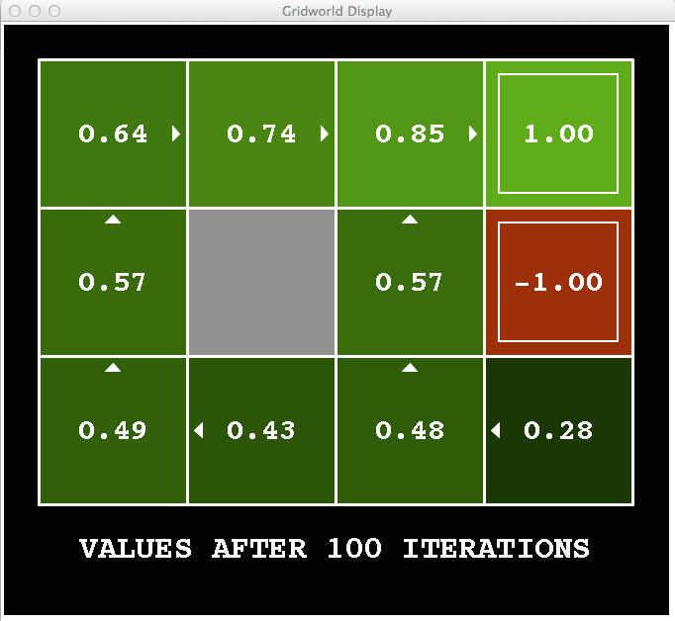
Snapshot of Demo – Gridworld V Values
Noise = 0.2
Discount = 0.9
Living reward = 0
Notes:
This demo doesn’t show anything in action, it just shows the V and Q values.

Slide 31
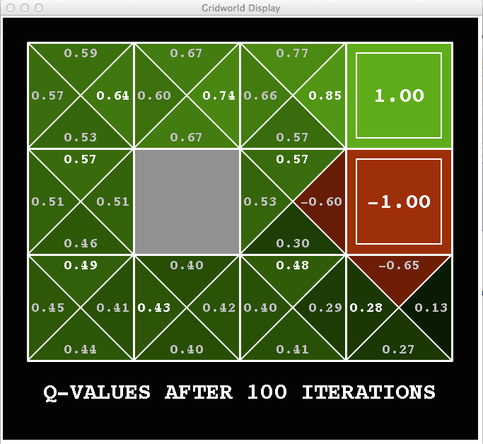
Snapshot of Demo – Gridworld Q Values
Noise = 0.2
Discount = 0.9
Living reward = 0
Notes:
This demo doesn’t show anything in action, it just shows the V and Q values.

Slide 32
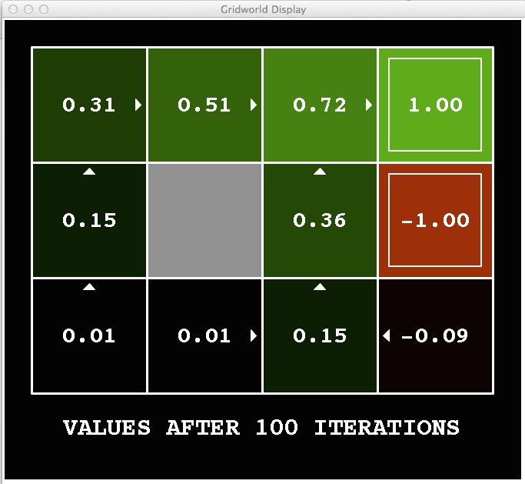
Snapshot of Demo – Gridworld V Values
Noise = 0.2
Discount = 0.9
Living reward = -0.1
Notes:
This demo doesn’t show anything in action, it just shows the V and Q values.

Slide 33
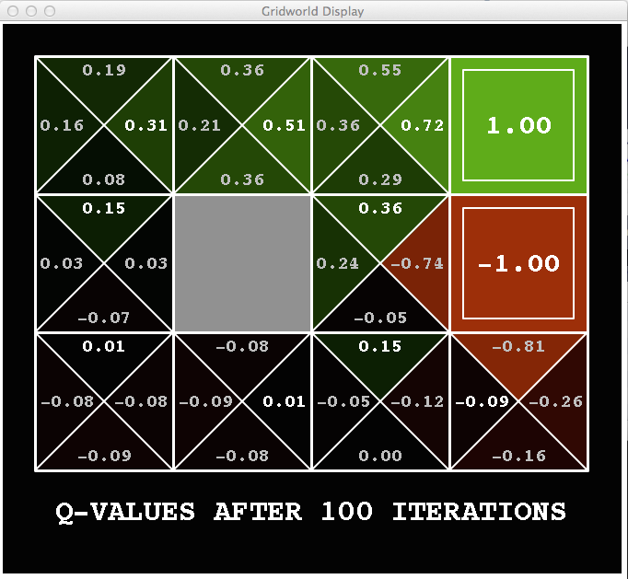
Snapshot of Demo – Gridworld Q Values
Noise = 0.2
Discount = 0.9
Living reward = -0.1
Notes:
This demo doesn’t show anything in action, it just shows the V and Q values.

Slide 34

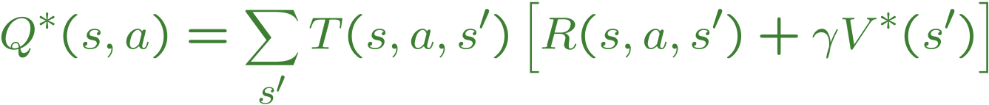
Values of States
Fundamental operation: compute the (expectimax) value of a state
Expected utility under optimal action
Average sum of (discounted) rewards
This is just what expectimax computed!
Recursive definition of value:
s
a
s, a
s,a,s’
s’

Slide 35
Racing Search Tree
- Search Tree with 2 iterations

Slide 36


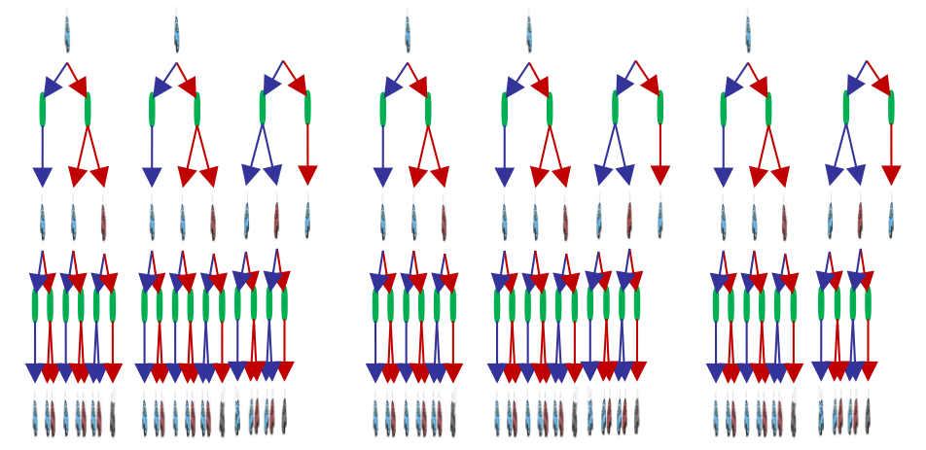

Racing Search Tree
We play the game long time, not stop after 2 iterations
Some branches are the same (repetitions)
Use caching or bottom-up dynamic programming
γ

Slide 37
Racing Search Tree
We’re doing way too much work with expectimax!
Problem: States are repeated
Idea: Only compute needed quantities once
Problem: Tree goes on forever
Idea: Do a depth-limited computation, but with increasing depths until change is small
Note: deep parts of the tree eventually don’t matter if γ < 1

Slide 38


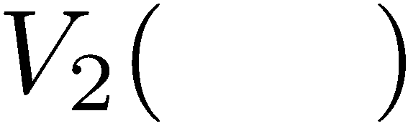


Time-Limited Values
Key idea: time-limited values
Define V_{k}(s) to be the optimal value of s if the game ends in k more time steps
Equivalently, it’s what a depth-k expectimax would give from s
[Demo – time-limited values (L8D6)]
Notes:
This demo generates the time-limited values for gridworld as snapshotted onto the next slides.

Slide 39
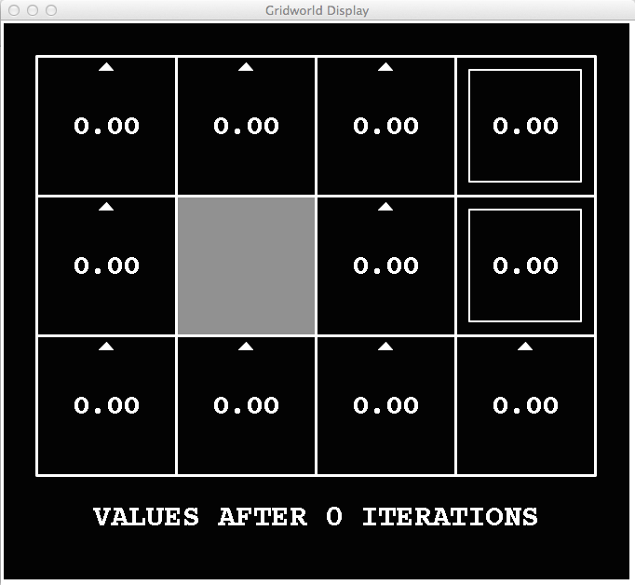
k=0
Noise = 0.2
Discount = 0.9
Living reward = 0
Notes:
Assuming zero living reward

Slide 40
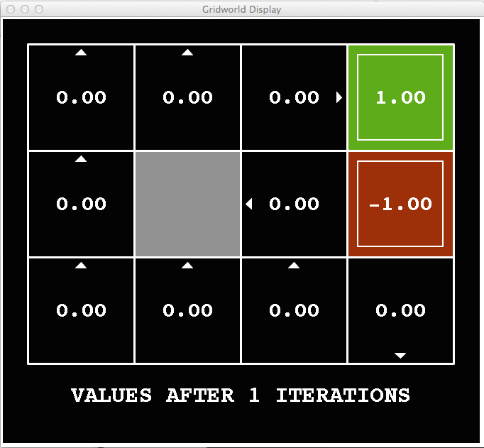
k=1
Noise = 0.2
Discount = 0.9
Living reward = 0
Notes:
Assuming zero living reward

Slide 41
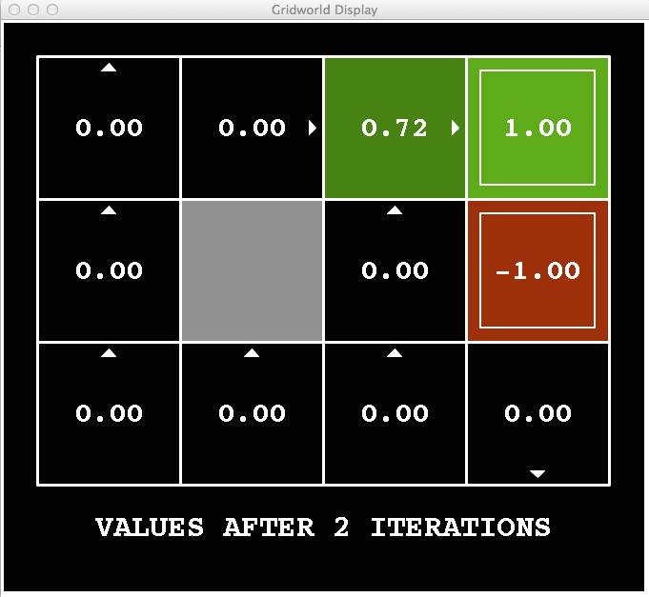
k=2
Noise = 0.2
Discount = 0.9
Living reward = 0
Notes:
Assuming zero living reward

Slide 42
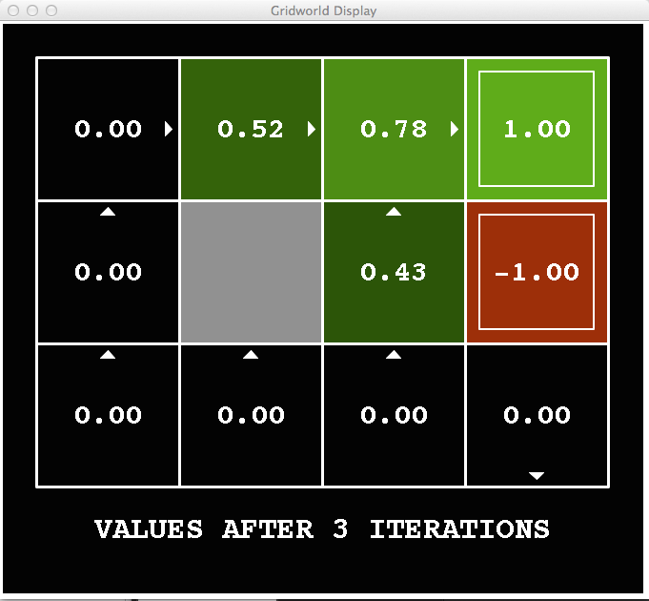
k=3
Noise = 0.2
Discount = 0.9
Living reward = 0
Notes:
Assuming zero living reward

Slide 43
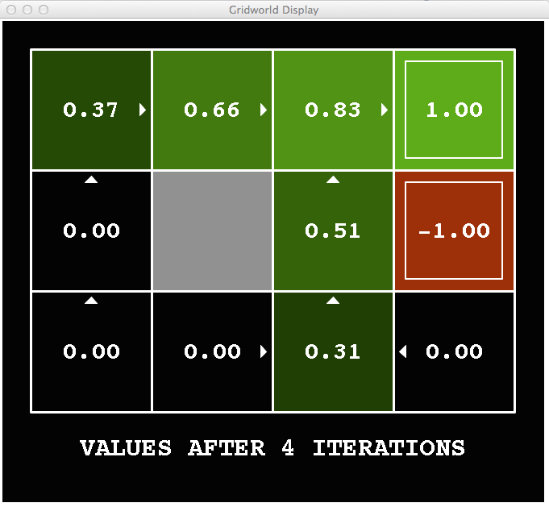
k=4
Noise = 0.2
Discount = 0.9
Living reward = 0
Notes:
Assuming zero living reward

Slide 44
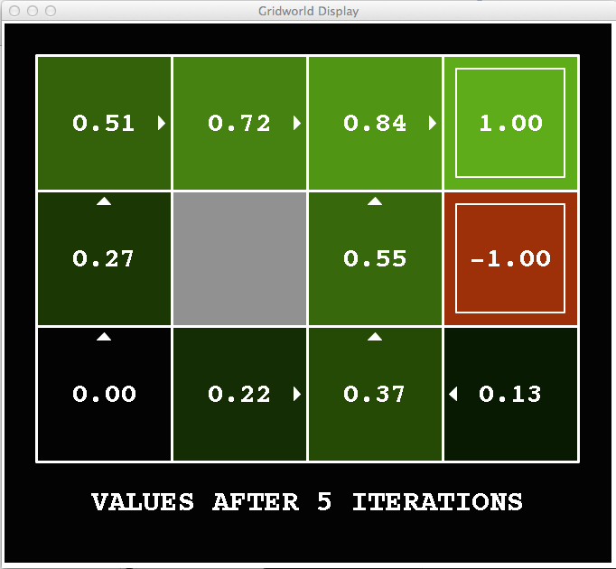
k=5
Noise = 0.2
Discount = 0.9
Living reward = 0
Notes:
Assuming zero living reward

Slide 45
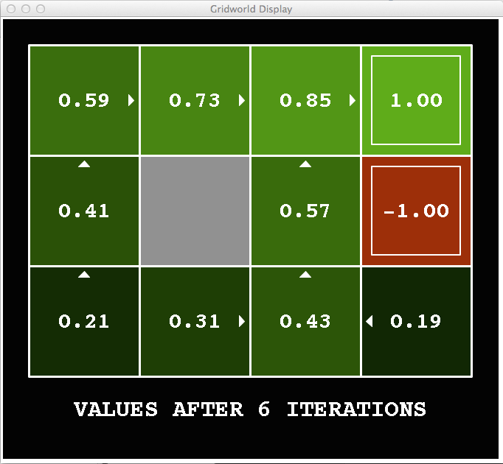
k=6
Noise = 0.2
Discount = 0.9
Living reward = 0
Notes:
Assuming zero living reward

Slide 46
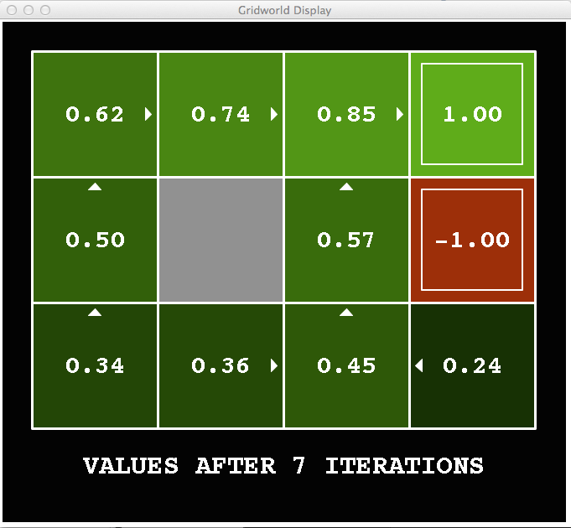
k=7
Noise = 0.2
Discount = 0.9
Living reward = 0
Notes:
Assuming zero living reward

Slide 47
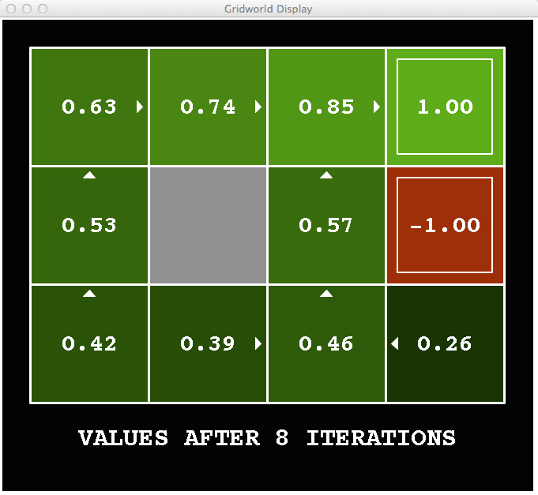
k=8
Noise = 0.2
Discount = 0.9
Living reward = 0
Notes:
Assuming zero living reward

Slide 48
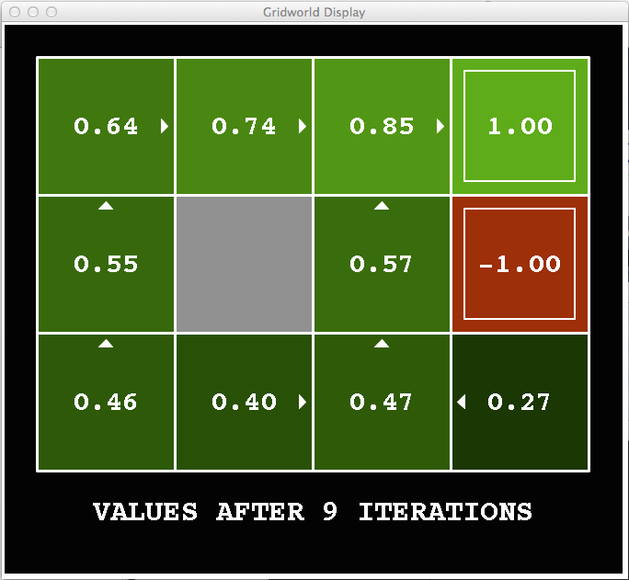
k=9
Noise = 0.2
Discount = 0.9
Living reward = 0
Notes:
Assuming zero living reward

Slide 49

k=10
Noise = 0.2
Discount = 0.9
Living reward = 0
Notes:
Assuming zero living reward

Slide 50

k=11
Noise = 0.2
Discount = 0.9
Living reward = 0
Notes:
Assuming zero living reward

Slide 51

k=12
Noise = 0.2
Discount = 0.9
Living reward = 0
Notes:
Assuming zero living reward

Slide 52

k=100
Values converge and
don’t change much after certain number of iterations
Noise = 0.2
Discount = 0.9
Living reward = 0
Notes:
Assuming zero living reward

Slide 53
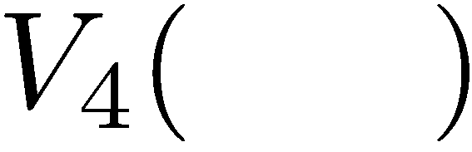

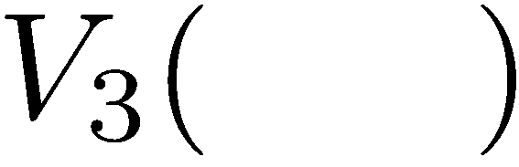
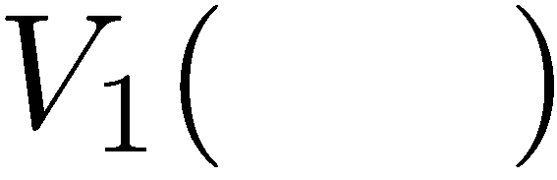
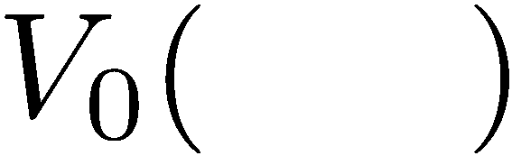
Computing Time-Limited Values (Compute v₀, v₁, v₂ , …)

Slide 54
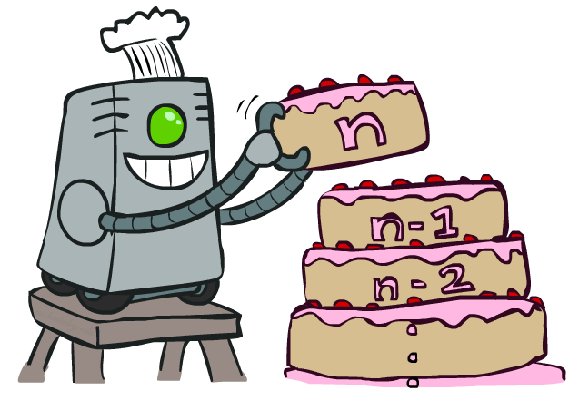
Value Iteration

Slide 55
Value Iteration
Start with V₀(s) = 0: no time steps left means an expected reward sum of zero
Given vector of V_{k}(s) values, do one ply of expectimax from each state:
Repeat until convergence
Complexity of each iteration: O(S²A)
Theorem: will converge to unique optimal values
Basic idea: approximations get refined towards optimal values
Policy may converge long before values do
V_{k+1}(s)
a
s, a
s,a,s’
V_{k}(s’)
Notes:
Discuss computational complexity: S * A * S times number of iterations
Note: updates not in place [if in place, it means something else and not even clear what it means]

Slide 56

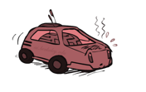





Example: Value Iteration
Max (Q2(cool, slow) = 1+2, Q2(cool,fast) = ((2+2)+(2+1))/2=3.5)
3.5 2.5 0
2 1 0
Assume no discount!
0 0 0
Max (Q1(cool, slow) = 1, Q1(cool,fast) = 2))
Max (Q1(warm, slow) = 1, Q1(warm,fast) = -10))

Slide 57

Example: Value Iteration

Slide 58

Example: Value Iteration

Slide 59


Slide 60
GridWorld: Dynamic Programming Demo
https://cs.stanford.edu/people/karpathy/reinforcejs/gridworld_dp.html

Slide 61

The Bellman Equations
How to be optimal:
Step 1: Take correct first action
Step 2: Keep being optimal

Slide 62

The Bellman Equations
Definition of “optimal utility” via expectimax recurrence gives a simple one-step lookahead relationship amongst optimal utility values
These are the Bellman equations, and they characterize optimal values in a way we’ll use over and over.
The Bellman equation is the basis of the value iteration algorithm for solving MDPs.
s
a
s, a
s,a,s’
s’
Notes:
Let’s start by equations that characterize these quantities through mutual recursions. [step through this by writing on slide, one step at a time]
Recursive characterization of V* in terms of V*; not necessarily helpful; but it is a characterization.
Note: this is a set of equations that needs to be satisfied; but it could have multiple solutions (it does not, but at this stage of our knowledge it could).

Slide 63
Value Iteration
Bellman equations characterize the optimal values:
Value iteration computes them:
Value iteration is just a fixed point solution method
… though the V_{k} vectors are also interpretable as time-limited values
V(s)
a
s, a
s,a,s’
V(s’)
Notes:
Discuss computational complexity: S * A * S times number of iterations
Note: updates not in place [if in place, it means something else and not even clear what it means]

Slide 64


Convergence*
How do we know the V_{k} vectors are going to converge?
Case 1: If the tree has maximum depth M, then V_{M} holds the actual untruncated values
Case 2: If the discount is less than 1
Sketch: For any state V_{k} and V_{k+1} can be viewed as depth k+1 expectimax results in nearly identical search trees
The difference is that on the bottom layer, V_{k+1} has actual rewards while V_{k} has zeros
That last layer is at best all R_{MAX}
It is at worst R_{MIN}
But everything is discounted by γ^{k} that far out
So V_{k} and V_{k+1} are at most (γ^{k} * max|R|) different
So as k increases, the values converge

Slide 65
Value iteration algorithm

Slide 66

Policy Methods

Slide 67

Policy Evaluation

Slide 68
Fixed Policies
Do the optimal action
Do what π says to do
s
s
a
π(s)
s, a
s, π(s)
s,a,s’
s, π(s),s’
s’
s’
Expectimax trees max over all actions to compute the optimal values
If we fixed some policy π(s), then the tree would be simpler – only one action per state
… though the tree’s value would depend on which policy we fixed

Slide 69
Utilities for a Fixed Policy
Another basic operation: compute the utility of a state s under a fixed (generally non-optimal) policy
Define the utility of a state s, under a fixed policy π:
V^{π}(s) = expected total discounted rewards starting in s and following π
Recursive relation (one-step look-ahead / Bellman equation):
s
π(s)
s, π(s)
s, π(s),s’
s’

Slide 70


Example: Policy Evaluation
Always Go Right
Always Go Forward

Slide 71


Example: Policy Evaluation
Always Go Right
Always Go Forward
Bad Policy
Good Policy

Slide 72

Policy Evaluation
s
How do we calculate the V’s for a fixed policy π?
Idea 1: Turn recursive Bellman equations into updates
(like value iteration)
Efficiency: O(S²) per iteration
Idea 2: Without the maxes, the Bellman equations are just a linear system
Solve with Matlab (or your favorite linear system solver)
π(s)
s, π(s)
s, π(s),s’
s’

Slide 73

Policy Extraction

Slide 74



Computing Actions from Values
Let’s imagine we have the optimal values V*(s)
How should we act?
It’s not obvious!
We need to do a mini-expectimax (one step)
This is called policy extraction, since it gets the policy implied by the values

Slide 75


Computing Actions from Q-Values
Let’s imagine we have the optimal q-values:
How should we act?
Completely trivial to decide!
Important lesson: actions are easier to select from q-values than values!

Slide 76

Policy Iteration

Slide 77
Problems with Value Iteration
Value iteration repeats the Bellman updates:
Problem 1: It’s slow – O(S²A) per iteration
Problem 2: The “max” at each state rarely changes
Problem 3: The policy often converges long before the values
s
a
s, a
s,a,s’
s’
[Demo: value iteration (L9D2)]
Notes:
Demo steps through value iteration; snapshots of values shown on next slides.

Slide 78
k=0
Noise = 0.2
Discount = 0.9
Living reward = 0
Notes:
Assuming zero living reward

Slide 79
k=1
Noise = 0.2
Discount = 0.9
Living reward = 0
Notes:
Assuming zero living reward

Slide 80
k=2
Noise = 0.2
Discount = 0.9
Living reward = 0
Notes:
Assuming zero living reward

Slide 81
k=3
Noise = 0.2
Discount = 0.9
Living reward = 0
Notes:
Assuming zero living reward

Slide 82
k=4
Noise = 0.2
Discount = 0.9
Living reward = 0
Notes:
Assuming zero living reward

Slide 83
k=5
Noise = 0.2
Discount = 0.9
Living reward = 0
Notes:
Assuming zero living reward

Slide 84
k=6
Noise = 0.2
Discount = 0.9
Living reward = 0
Notes:
Assuming zero living reward

Slide 85
k=7
Noise = 0.2
Discount = 0.9
Living reward = 0
Notes:
Assuming zero living reward

Slide 86
k=8
Noise = 0.2
Discount = 0.9
Living reward = 0
Notes:
Assuming zero living reward

Slide 87
k=9
Noise = 0.2
Discount = 0.9
Living reward = 0
Notes:
Assuming zero living reward

Slide 88
k=10
Noise = 0.2
Discount = 0.9
Living reward = 0
Notes:
Assuming zero living reward

Slide 89
k=11
Noise = 0.2
Discount = 0.9
Living reward = 0
Notes:
Assuming zero living reward

Slide 90
k=12
Noise = 0.2
Discount = 0.9
Living reward = 0
Notes:
Assuming zero living reward

Slide 91
k=100
Noise = 0.2
Discount = 0.9
Living reward = 0
Notes:
Assuming zero living reward

Slide 92
Policy Iteration
Alternative approach for optimal values:
Step 1: Policy evaluation: calculate utilities for some fixed policy (not optimal utilities!) until convergence
Step 2: Policy improvement: update policy using one-step look-ahead with resulting converged (but not optimal!) utilities as future values
Repeat steps until policy converges
This is policy iteration
It’s still optimal!
Can converge (much) faster under some conditions

Slide 93
Policy Iteration
Evaluation: For fixed current policy π, find values with policy evaluation:
Iterate until values converge:
Improvement: For fixed values, get a better policy using policy extraction
One-step look-ahead:

Slide 94
Policy iteration algorithm

Slide 95
Comparison
Both value iteration and policy iteration compute the same thing (all optimal values)
In value iteration:
Every iteration updates both the values and (implicitly) the policy
We don’t track the policy, but taking the max over actions implicitly recomputes it
In policy iteration:
We do several passes that update utilities with fixed policy (each pass is fast because we consider only one action, not all of them)
After the policy is evaluated, a new policy is chosen (slow like a value iteration pass)
The new policy will be better (or we’re done)
Both are dynamic programs for solving MDPs

Slide 96
Summary: MDP Algorithms
So you want to….
Compute optimal values: use value iteration or policy iteration
Compute values for a particular policy: use policy evaluation
Turn your values into a policy: use policy extraction (one-step lookahead)
These all look the same!
They basically are – they are all variations of Bellman updates
They all use one-step lookahead expectimax fragments
They differ only in whether we plug in a fixed policy or max over actions

Slide 97



Double Bandits
Blue slot machine gives you $1
when you pull the lever
Red slot machine gives you $0 or $2
when you pull the lever

Slide 98
Double-Bandit MDP
Actions: Blue, Red
States: Win, Lose
No discount
100 time steps
Both states have the same value
0.25 $0
0.75
$2
W
L
0.25
$0
$1
1.0
$1
1.0
0.75 $2

Slide 99
Offline Planning
Solving MDPs is offline planning
You determine all quantities through computation
You need to know the details of the MDP
You do not actually play the game!
No discount
100 time steps
Both states have the same value
0.25 $0
Value
0.75
$2
W
0.25
$0
Play Red
150
L
$1
1.0
$1
1.0
0.75 $2
Play Blue
100

Slide 100
Let’s Play!
$2
$2
$0
$2
$2
$2
$2
$0
$0
$0

Slide 101
Online Planning
Rules changed! Red’s win chance is different.
?? $0
??
$2
W
L
??
$0
$1
1.0
$1
1.0
?? $2

Slide 102
Let’s Play!
$0
$0
$0
$2
$0
$2
$0
$0
$0
$0

Slide 103
What Just Happened?
That wasn’t planning, it was learning!
Specifically, reinforcement learning
There was an MDP, but you couldn’t solve it with just computation
You needed to actually act to figure it out
Important ideas in reinforcement learning that came up
Exploration: you have to try unknown actions to get information
Exploitation: eventually, you have to use what you know
Regret: even if you learn intelligently, you make mistakes
Sampling: because of chance, you have to try things repeatedly
Difficulty: learning can be much harder than solving a known MDP

Slide 104
Next Time: Reinforcement Learning!

