Slide 1
COE 4213564
Introduction to Artificial Intelligence
SOLVING PROBLEMS BY SEARCHING
Chapter 3
Fall 2025
Many slides are adapted from CS 188 (http://ai.berkeley.edu), CIS 521, CS 221.
Notes:
Please retain proper attribution, including the reference to ai.berkeley.edu. Thanks!

Slide 2
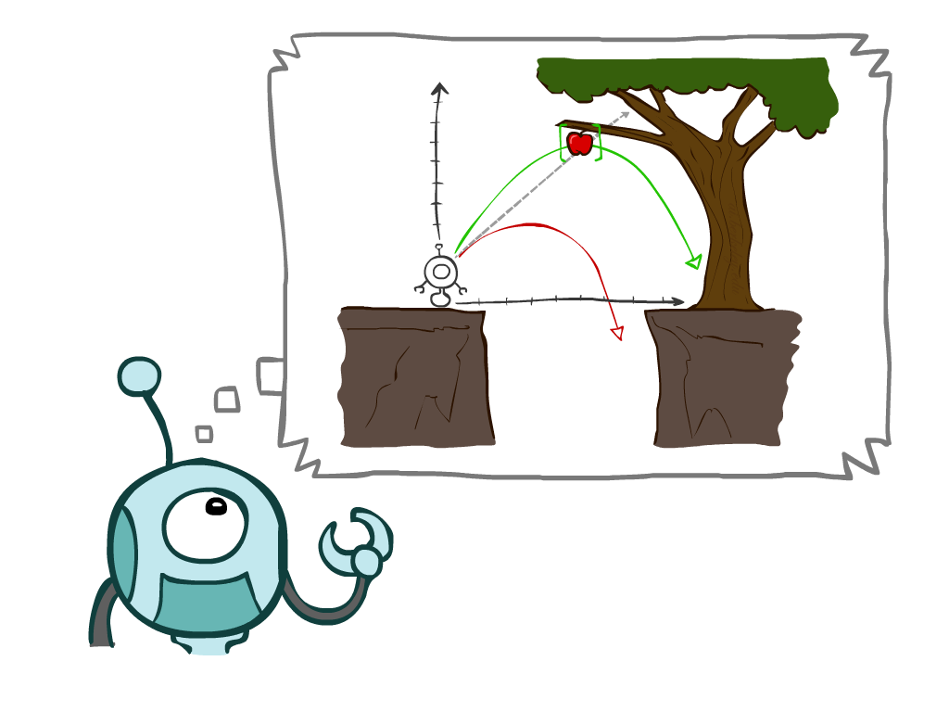
Problem solving agents and uninformed search methods
A simple reflex agent is one that selects an action based only on the current percept. It ignores the rest of the percept history.
A problem-solving agent must plan ahead.
Agents that Plan Ahead: When the correct action to take is not immediately obvious,
  an agent may need to plan ahead: to consider a sequence of actions that form a path to a goal state.
  Such an agent is called a problem-solving agent, and
  the computational process it undertakes is called search.
In this chapter, we consider only the simplest environments: episodic, single agent, fully observable, deterministic, static, discrete, and known.
Search Problems: We distinguish between
  informed algorithms, in which the agent can estimate how far it is from the goal, and
  uninformed algorithms, where no such estimate is available
Uninformed Search Methods
  Breadth-first search
  Uniform-cost search
  Depth-first search
  Depth-limited search
  Iterative deepening search
Notes:
General theme in the class:
A goal we have in mind.
A mathematical abstraction to formalize this
Algorithms that operate on these abstractions

Slide 3

Search Problems

Slide 4
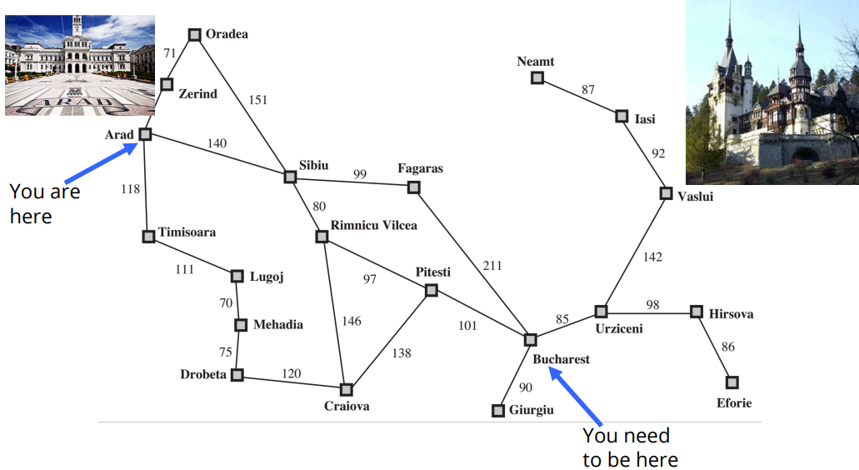
Example search problem: Holiday in Romania
Imagine an agent enjoying a touring vacation in Romania

Slide 5
Problem-Solving Agent follow four-phase problem-solving process
Goal formulation: The agent adopts the goal of reaching Bucharest. Goals organize behavior by limiting the objectives and hence the actions to be considered.
Problem formulation: The agent devises a description of the states and actions necessary to reach the goal—an abstract model of the relevant part of the world. For our agent, one good model is to consider the actions of traveling from one city to an adjacent city, and therefore the only fact about the state of the world that will change due to an action is the current city.
Search: Before taking any action in the real world, the agent simulates sequences of actions in its model, searching until it finds a sequence of actions that reaches the goal. Such a sequence is called a solution.
  The agent might have to simulate multiple sequences that do not reach the goal, but eventually it will find a solution (such as going from Arad to Sibiu to Fagaras to Bucharest), or it will find that no solution is possible.
Execution: The agent can now execute the actions in the solution, one at a time.

Slide 6
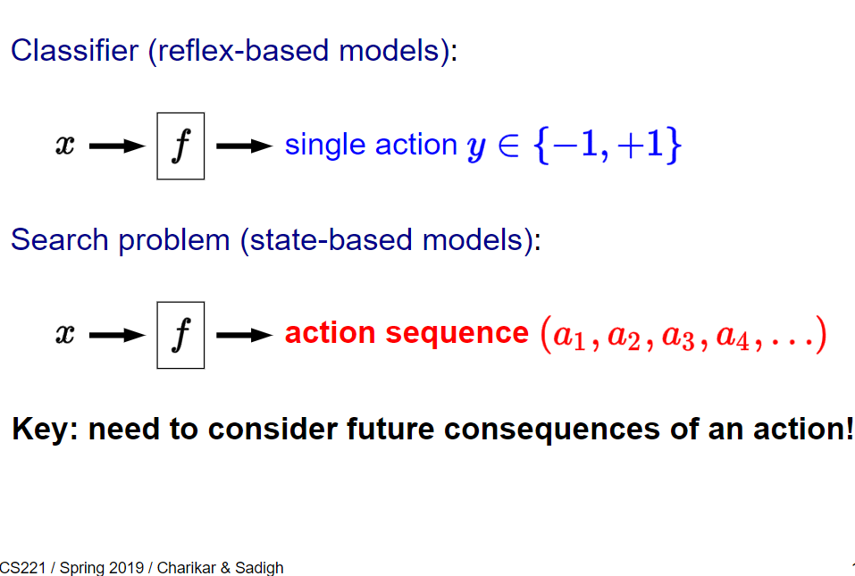
Search problems and solutions
Reflex-based models in machine learning (e.g., linear predictors and neural networks) that output either a or (for binary classification) or a real number (for regression).
While reflex-based models were appropriate for some applications such as sentiment classification or spam filtering, the applications we will look at today, such as solving puzzles, demand more.
To tackle these new problems, we will introduce search problems, our first instance of a state-based model.
In a search problem, in a sense, we are still building a predictor which takes an input , but will now return an entire action sequence, not just a single action.
Of course you should object: can't I just apply a reflex model iteratively to generate a sequence? While that is true, the search problems that we're trying to solve importantly require reasoning about the consequences of the entire action sequence, and cannot be tackled by myopically predicting one action at a time.
Of course, saying "cannot" is a bit strong, since sometimes a search problem can be solved by a reflex-based model. You could have a massive lookup table that told you what the best action was for any given situation.

Slide 7
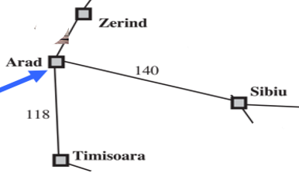
Search problems and solutions
A search problem can be defined formally as follows:
  A set of possible states that the environment can be in. We call this the state space.
  A set of one or more goal states. Sometimes there is one goal state (e.g., Bucharest), goal states sometimes, there is a small set of alternative goal states, and sometimes the goal is defined by a property that applies to many states.
  The actions available to the agent. Given a state s, ACTIONS(s) returns a finite set of Action actions that can be executed in s. We say that each of these actions is applicable in s. An example:
    ACTIONS(Arad) = {ToSibiu,ToTimisoara,ToZerind}.
  A transition model, which describes what each action does. RESULT(s, a) returns the Transition model state that results from doing action a in state s. For example,
    RESULT(Arad, ToZerind) = Zerind
  An action cost function, denoted by ACTION-COST(s,a,s’) when we are programming or c(s,a,s’) when we are doing math, that gives the numeric cost of applying action a in state s to reach state s’. . A problem-solving agent should use a cost function that reflects its own performance measure; for example, for route-finding agents, the cost of an action might be the length in miles (as seen in Figure 3.1), or it might be the time it takes to complete the action.
A sequence of actions forms a path, and a solution is a path from the initial state to a goal state. We assume that action costs are additive; that is, the total cost of a path is the sum of the individual action costs.
An optimal solution has the lowest path cost among all solutions.
The state space can be represented as a graph in which the vertices are states and the directed edges between them are actions.

Slide 8
Formal Definition

Slide 9
Abstraction: Formulating problems
Our formulation of the problem of getting to Bucharest is a model—an abstract mathematical description—and not the real thing.
  Compare the simple atomic state description Arad to an actual cross-country trip, where the state of the world includes so many things:
    the traveling companions,
    the current radio program,
    the scenery out of the window,
    the proximity of law enforcement officers,
    the distance to the next rest stop,
    the condition of the road,
    the weather,
    the traffic, and so on.
  All these considerations are left out of our model because they are irrelevant to the problem of finding a route to Bucharest.
The process of removing detail from a representation is called abstraction.
The abstraction is valid if we can elaborate any abstract solution into a solution in the more detailed world. The choice of a good abstraction thus involves removing as much detail as possible while retaining validity and ensuring that the abstract actions are easy to carry out.

Slide 10
Art: Formulating a Search Problem
Decide:
  Which properties matter & how to represent
    • Initial State, Goal State, Possible Intermediate States
  Which actions are possible & how to represent
    • Operator Set: Actions and Transition Model
  Which action is next
  • Path Cost Function
Formulation greatly affects combinatorics of search space and therefore speed of search.
Hard subtask: Selecting a state space
  Real world is absurdly complex
    State space must be abstracted for problem solving
  (abstract) State = set (equivalence class) of real-world states
  (abstract) Action = equivalence class of combinations of real-world action
    • e.g. Arad → Zerind represents a complex set of possible routes, detours, rest stops, etc
    • The abstraction is valid if the path between two states is reflected in the real world
Each abstract action should be “easier” than the real problem

Slide 11
Example: Traveling in Romania
State space:
  Cities
Successor function:
  Roads: Go to adjacent city with
  cost = distance
Start state:
  Arad
Goal test:
  Is state == Bucharest?
Solution?

Slide 12

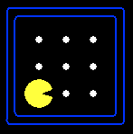
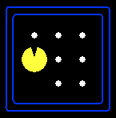
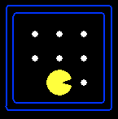



Example: Pac-Man Game
Pac-Man is an action^{[7]} maze chase video game;
the player controls the eponymous character through an enclosed maze.
The objective of the game is to eat all of the dots placed in the maze
while avoiding four colored ghosts — Blinky (red), Pinky (pink), Inky (cyan), and Clyde (orange)
A search problem consists of:
  A state space
  A successor function
  (with actions, costs)
  A start state and a goal test
A solution is a sequence of actions (a plan) which transforms the start state to a goal state
“N”, 1.0
“E”, 1.0
Notes:
Often comes back on exams
Goal test – sometimes more than one state that satisfies having achieved the goal, for example, “eat all the dots”
Abstraction

Slide 13
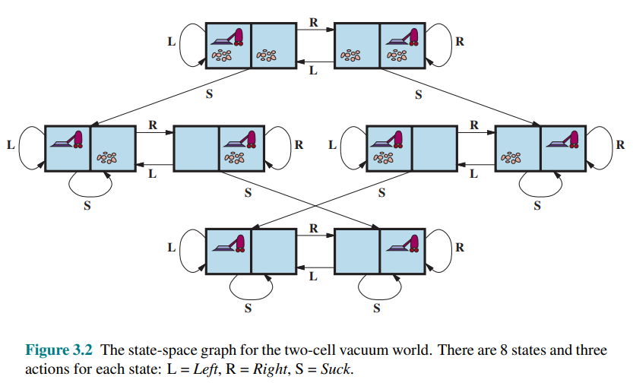
Another example: vacuum world
States: integer dirt and robot locations (ignore dirt amounts etc.)
Actions: Left, Right, Suck, NoOp
Goal test: no dirt
Path cost: 1 per action (0 for NoOp)
States: A state of the world says which objects are in which cells.
  In a simple two cell version,
  the agent can be in one cell at a time
  each cell can have dirt or not,
  2 positions for agent * 2² possibilities for dirt = 8 states.
With n cells, there are n*2^{n} states.

Slide 14
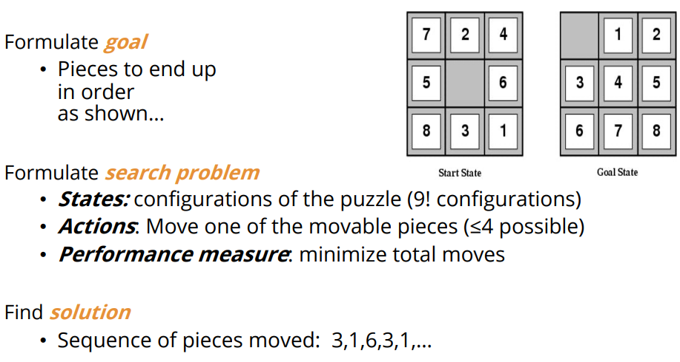
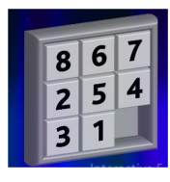
Example search problem: 8-puzzle

Slide 15
Other search problems
Route-finding problem is defined in terms of specified locations and transitions along edges between them.
Touring problems describe a set of locations that must be visited, rather than a single goal destination.
A VLSI layout problem requires positioning millions of components and connections on a chip to minimize area, minimize circuit delays, minimize stray capacitances, and maximize manufacturing yield.
Robot navigation is a generalization of the route-finding problem described earlier. Rather than following distinct paths (such as the roads in Romania), a robot can roam around, in effect making its own paths.
Automatic assembly sequencing of complex objects (such as electric motors) by a robot has been standard industry practice since the 1970s. Algorithms first find a feasible assembly sequence and then work to optimize the process. Minimizing the amount of manual human labor on the assembly line can produce significant savings in time and cost.

Slide 16

Search Problems Are (Absract) Models

Slide 17
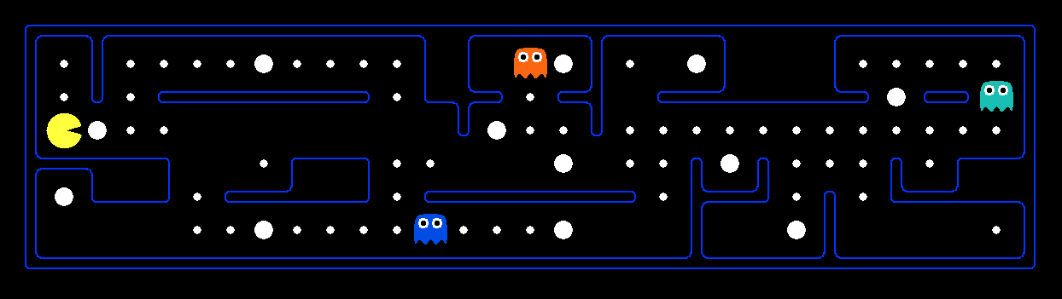
What’s in a State Space?
The world state includes every last detail of the environment
A search state keeps only the details needed for planning (abstraction)
Problem: Pathing
  States: (x,y) location
  Actions: NSEW
  Successor: update location only
  Goal test: is (x,y)=END
Problem: Eat-All-Dots
  States: {(x,y), dot booleans}
  Actions: NSEW
  Successor: update location and possibly a dot boolean
  Goal test: dots all false
Notes:
Wrong example for “eat-all-dots”: (x, y, dot count)

Slide 18
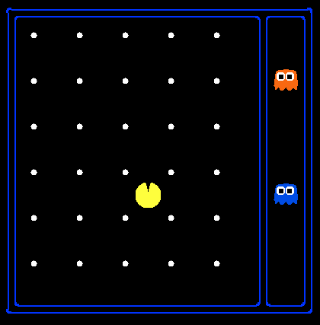
State Space Sizes?
World state:
  Agent positions: 120
  Food count: 30
  Ghost positions: 12
  Agent facing: NSEW
How many
  World states?
  120x(2³⁰)x(12²)x4
  States for pathing?
  120
  States for eat-all-dots?
  120x(2³⁰)
Notes:
90 * (2^30-1) + 30 * 2^29 = 145 billion
2^29 = 536 870 912

Slide 19
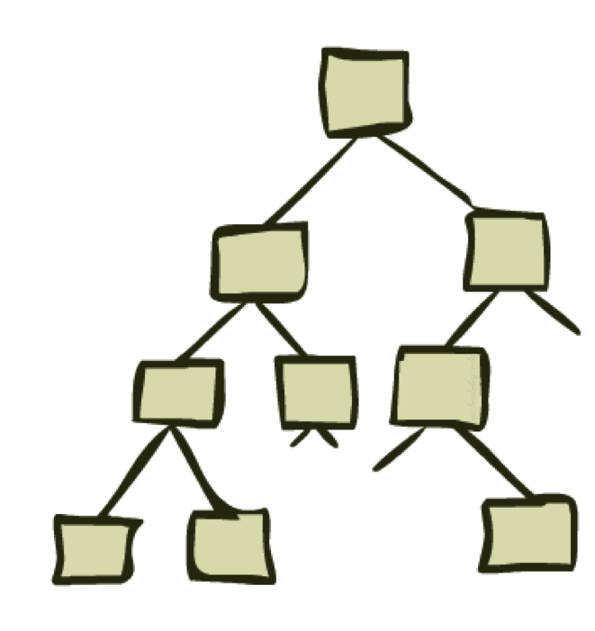
State Space Graphs and Search Trees

Slide 20
State Space Graphs
State space graph: A mathematical representation of a search problem
  Nodes are (abstracted) world configurations
  Arcs represent successors (action results)
  The goal test is a set of goal nodes (maybe only one)
In a state space graph, each state occurs only once!
We can rarely build this full graph in memory (it’s too big), but it’s a useful idea

Slide 21
State Space Graphs
State space graph: A mathematical representation of a search problem
  Nodes are (abstracted) world configurations
  Arcs represent successors (action results)
  The goal test is a set of goal nodes (maybe only one)
In a search graph, each state occurs only once!
We can rarely build this full graph in memory (it’s too big), but it’s a useful idea
a
G
b
c
e
d
f
S
h
p
q
r
Tiny search graph for a tiny search problem

Slide 22
Search Trees
This is now / start
“N”, 1.0
“E”, 1.0
Possible futures
A search tree:
  A “what if” tree of plans and their outcomes
  The start state is the root node
  Children correspond to successors
  Nodes show states, but correspond to PLANS that achieve those states
  For most problems, we can never actually build the whole tree
Notes:
Different plans that achieve the same state, will be different nodes in the tree.

Slide 23
State Space Graphs vs. Search Trees
State Space Graph
Each NODE in in the search tree is an entire PATH in the state space graph.
Search Tree
S
a
G
d
e
p
b
c
q
b
c
e
h
r
d
e
f
a
a
h
r
p
q
f
S
h
We construct both on demand – and we construct as little as possible.
p
q
f
q
c
G
p
q
r
q
c
G
a
a

Slide 24
State Space Graphs vs. Search Trees
It is important to understand the distinction between the state space and the search tree.
The state space describes the (possibly infinite) set of states in the world, and the actions that allow transitions from one state to another.
The search tree describes paths between these states, reaching towards the goal.
The search tree may have multiple paths to (and thus multiple nodes for) any given state, but each node in the tree has a unique path back to the root (as in all trees).

Slide 25
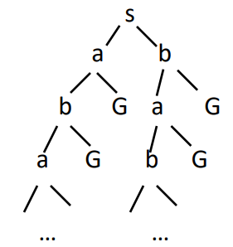

Quiz: State Space Graphs vs. Search Trees
Consider this 4-state graph:
How big is its search tree (from S)?
a
S
G
b
Important: Lots of repeated structure in the search tree!

Slide 26
Tree Search

Slide 27
Search Example: Romania

Slide 28
Three partial search trees for finding a route from Arad to Bucharest
Expand out potential plans (tree nodes)
Nodes that have been expanded are lavender with bold letters;
nodes on the frontier that have been generated but not yet expanded are in green;
the set of states corresponding to these two types of nodes are said to have been reached. Nodes that could be generated next are shown in faint dashed lines.
Notice in the bottom tree there is a cycle from Arad to Sibiu to Arad; That can’t be an optimal path, so search should not continue from there.

Slide 29
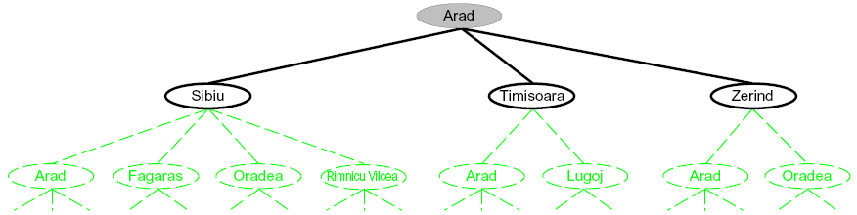
Searching with a Search Tree
We can expand the node, by considering the available
  ACTIONS for that state,
  using the RESULT function
to see where those actions lead to, and generating a new node (called a child node or successor node) for each of the resulting states.
Each child node has Arad as its parent node.
Search:
  Expand out potential plans (tree nodes)
  Maintain a fringe (frontier) of partial plans under consideration
  Try to expand as few tree nodes as possible
Remember functions:
  ACTIONS(Arad) = {ToSibiu,ToTimisoara,ToZerind}
  RESULT(Arad, ToZerind) = Zerind

Slide 30
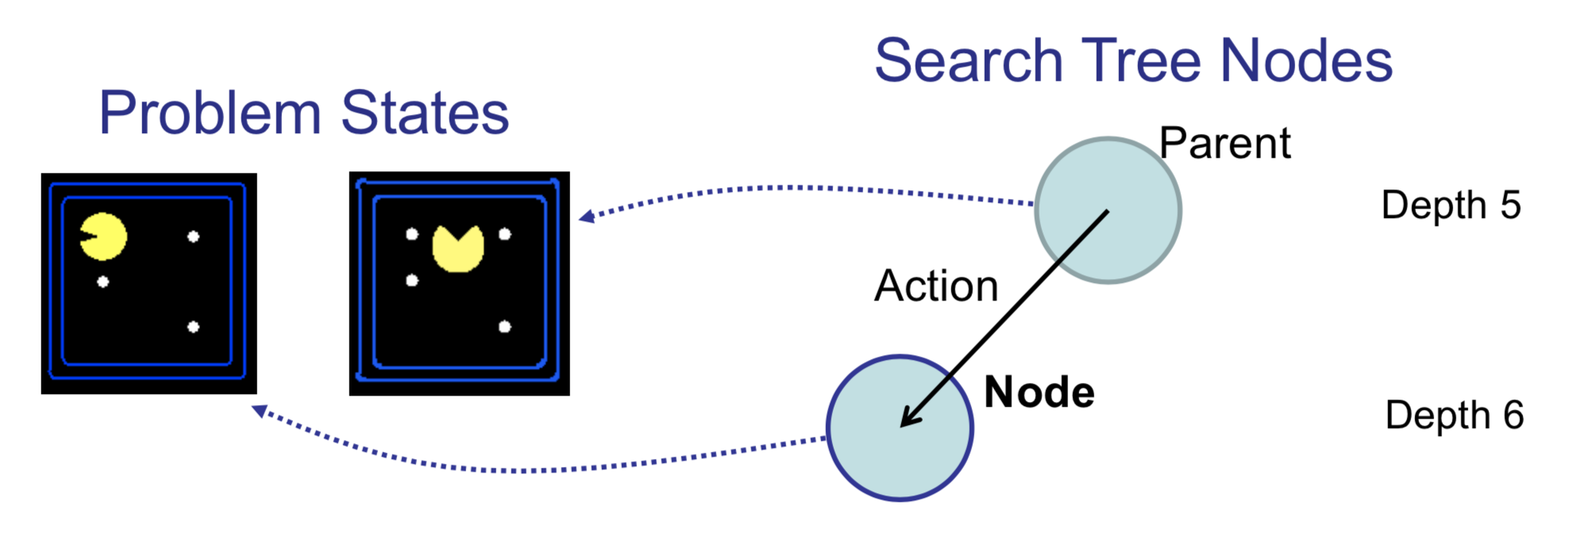
States vs. Nodes
Vertices in state space graphs are problem states
  Represent an abstracted state of the world
  Have successors, can be goal / non-goal, have multiple predecessors
Vertices in search trees (“Nodes”) are plans
  Contain a problem state and one parent, a path length, a depth, and a cost
  Represent a plan (sequence of actions) which results in the node’s state
The same problem state may be achieved by multiple search tree nodes

Slide 31
General Tree Search
Important ideas:
  Fringe (data structure: queue, stack or priority queue)
  Expansion
  Exploration strategy
Main question: which fringe nodes to explore?

Slide 32
Search Strategies
A strategy is defined by picking the order of node expansion
Strategies are evaluated along the following dimensions:
  completeness: does it always find a solution if one exists?
  time complexity: number of nodes generated/expanded
  space complexity: maximum number of nodes in memory
  optimality: does it always find a least-cost solution?
Time and space complexity are measured in terms of
  b: maximum branching factor of the search tree
  d: depth of the least-cost solution
  m: maximum depth of the state space (may be ∞)

Slide 33
Best-first search
How do we decide which node from the frontier to expand next?
A very general approach is called best-first search, in which we choose a node, n, with minimum value of some evaluation function, f(n).
On each iteration we choose a node on the frontier with minimum f (n) value, return it if its state is a goal state, and otherwise apply EXPAND to generate child nodes.
Each child node is added to the frontier if it has not been reached before, or is re-added if it is now being reached with a path that has a lower path cost than any previous path.

Slide 34
Search data structures
Search algorithms require a data structure to keep track of the search tree. A node in the tree is represented by a data structure with four components:
  node.STATE: the state to which the node corresponds;
  node.PARENT: the node in the tree that generated this node;
  node.ACTION: the action that was applied to the parent’s state to generate this node;
  node.PATH-COST: the total cost of the path from the initial state to this node. In mathematical formulas, we use g(node) as a synonym for PATH-COST.
We need a data structure to store the frontier. The appropriate choice is a queue of some kind, because the operations on a frontier are:
  IS-EMPTY(frontier) returns true only if there are no nodes in the frontier.
  POP(frontier) removes the top node from the frontier and returns it.
  TOP(frontier) returns (but does not remove) the top node of the frontier.
  ADD(node, frontier) inserts node into its proper place in the queue.

Slide 35
Search data structures
Three kinds of queues are used in search algorithms:
  A priority queue first pops the node with the minimum cost according to some evaluation function, f . It is used in best-first search.
  A FIFO queue or first-in-first-out queue first pops the node that was added to the queue first; we shall see it is used in breadth-first search.
  A LIFO queue or last-in-first-out queue (also known as a stack) pops first the most Stack recently added node; we shall see it is used in depth-first search.
The reached states can be stored as a lookup table (e.g. a hash table) where each key is a state and each value is the node for that state.

Slide 36
Uninformed Search Strategies
Uninformed strategies use only the information available in the problem definition
Breadth-first search
Depth-first search
Uniform-cost search
Depth-limited search
Iterative deepening search

Slide 37
Example: Tree Search
a
G
b
c
d
e
f
S
h
p
q
r
Notes:
Left: show tree
Right: fringe

Slide 38
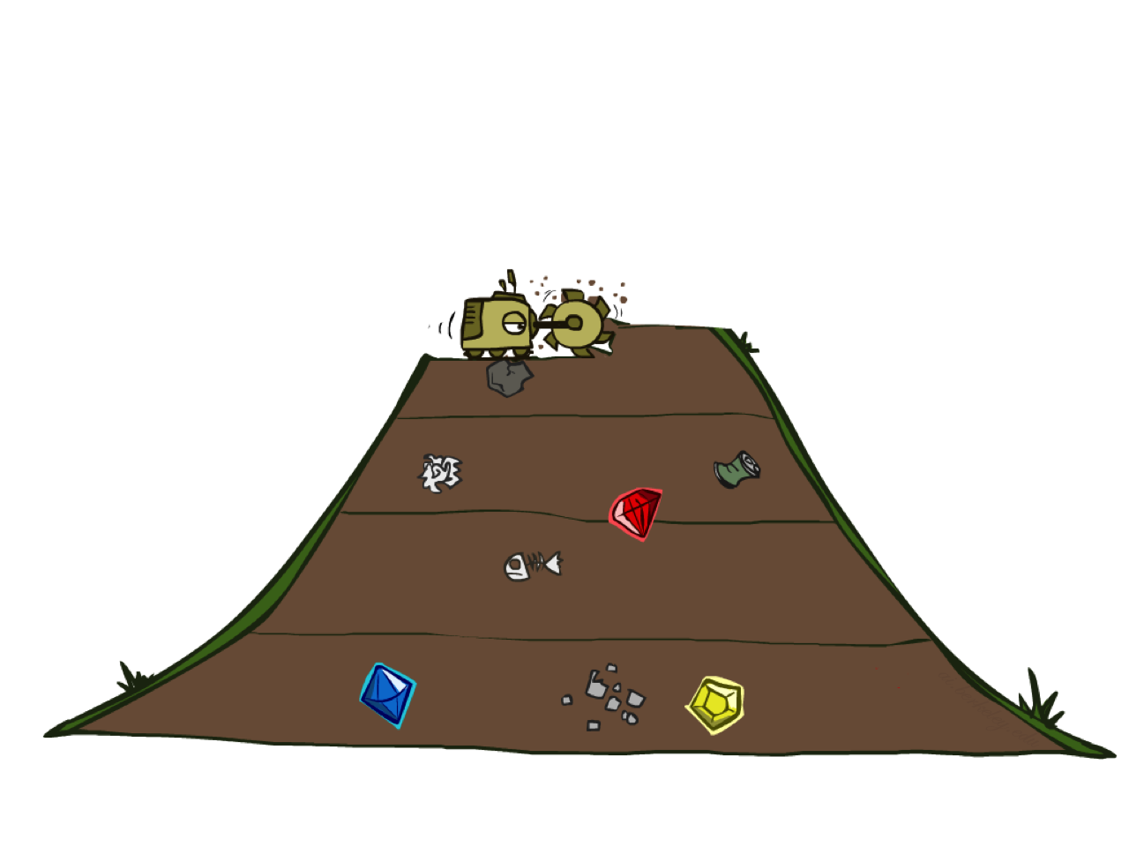
Breadth-First Search
When all actions have the same cost, an appropriate strategy is breadth-first search,
in which the root node is expanded first, then all the successors of the root node are expanded next, then their successors, and so on.

Slide 39
Breadth-first search on a simple binary tree

Slide 40
Breadth-First Search
Strategy: expand a shallowest node first
Implementation: Fringe is a FIFO queue
a
G
b
c
d
e
f
S
h
p
q
r
S
d
e
p
Search
Tiers
b
c
e
h
r
q
a
a
h
r
p
q
f
p
q
f
q
c
G
q
c
G
a
a

Slide 41
Breadth-First Search (BFS) Properties
What nodes does BFS expand?
  Processes all nodes above shallowest solution
  Let depth of shallowest solution be s
  Search takes time O(b^{s})
How much space does the fringe take?
  Has roughly the last tier, so O(b^{s})
  keeps every node in memory
Is it complete?
  s must be finite if a solution exists, so yes!
Is it optimal?
  Only if costs are all 1 (more on costs later)
1 node
b
…
b nodes
s tiers
b² nodes
b^{s} nodes
b^{m} nodes

Slide 42
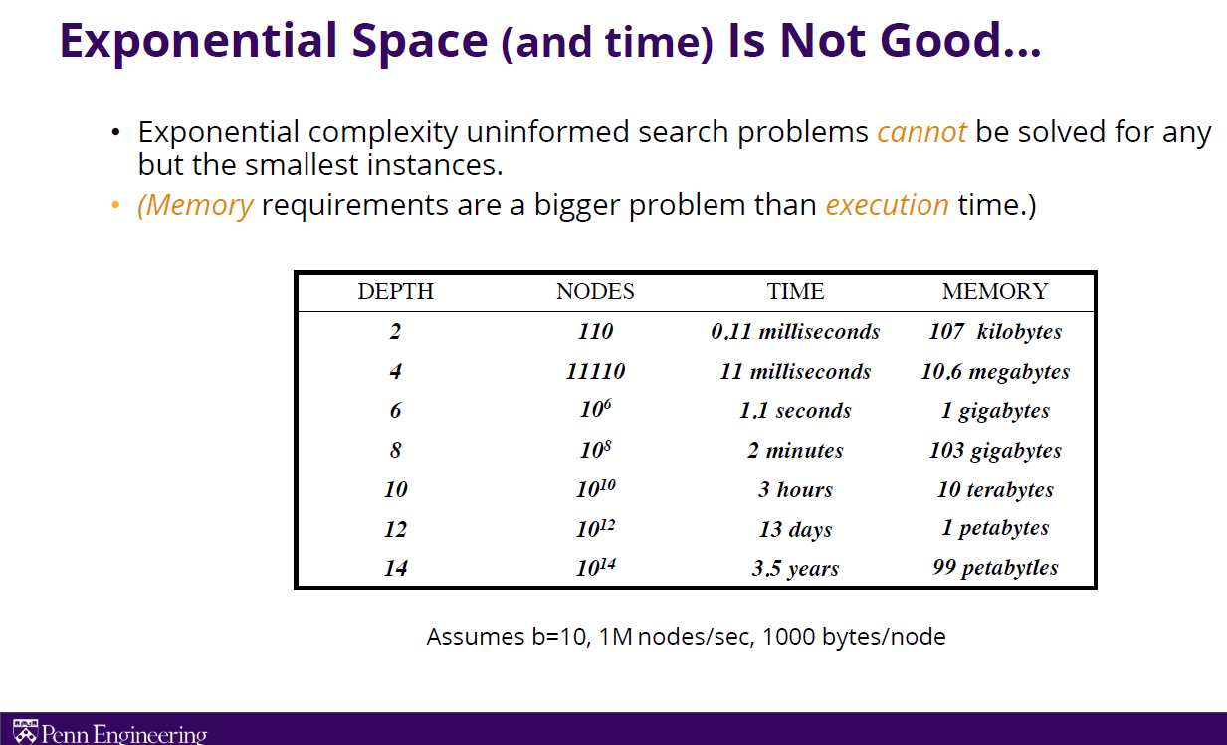
Exponential time and space

Slide 43
Breadth-first search algorithm

Slide 44
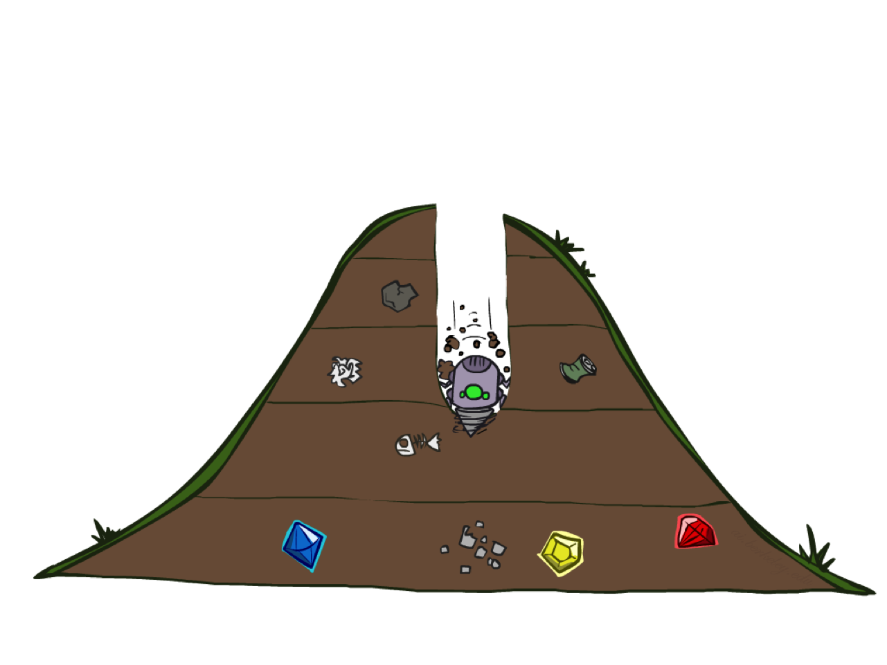
Depth-First Search
Depth-first search always expands the deepest node in the frontier first.
The algorithm starts at the root (top) node of a tree and goes as far as it can down a given branch (path), then backtracks until it finds an unexplored path, and then explores it.

Slide 45
Depth-first search on a binary tree

Slide 46
Depth-First Search
Strategy: expand a deepest node first
Implementation: Fringe is a LIFO stack
a
G
a
c
b
c
b
e
d
e
d
f
f
S
h
h
p
p
r
q
r
q
S
d
e
p
b
c
e
h
r
q
a
a
h
r
p
q
f
p
q
f
q
c
G
q
c
G
a
a

Slide 47
Depth-first search implementation
Depth-first search could be implemented as a call to BEST-FIRST-SEARCH where the evaluation function f is the negative of the depth.

Slide 48
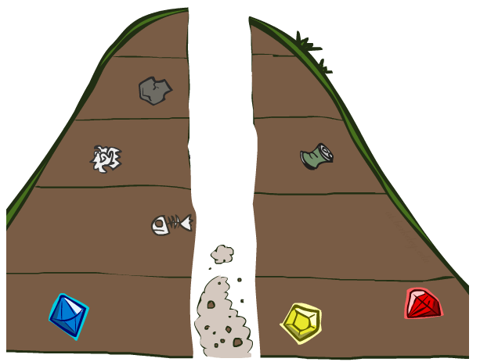
Search Algorithm Properties

Slide 49
Search Algorithm Properties
Complete: Guaranteed to find a solution if one exists?
Optimal: Guaranteed to find the least cost path?
Time complexity?
Space complexity?
Cartoon of search tree:
  b is the branching factor
  m is the maximum depth
  solutions at various depths
Number of nodes in entire tree?
  1 + b + b² + …. b^{m} = O(b^{m})
1 node
b
…
b nodes
b² nodes
m tiers
b^{m} nodes

Slide 50
Depth-First Search (DFS) Properties
What nodes DFS expand?
  Some left prefix of the tree.
  Could process the whole tree!
  If m is finite, takes time O(b^{m})
How much space does the fringe take?
  Only has siblings on path to root, so O(bm)
Is it complete?
  No.
  m could be infinite, so only if we prevent cycles (more later). fails in infinite-depth spaces, spaces with loops
Is it optimal?
  No, it finds the “leftmost” solution, regardless of depth or cost
1 node
b
…
b nodes
b² nodes
m tiers
b^{m} nodes

Slide 51
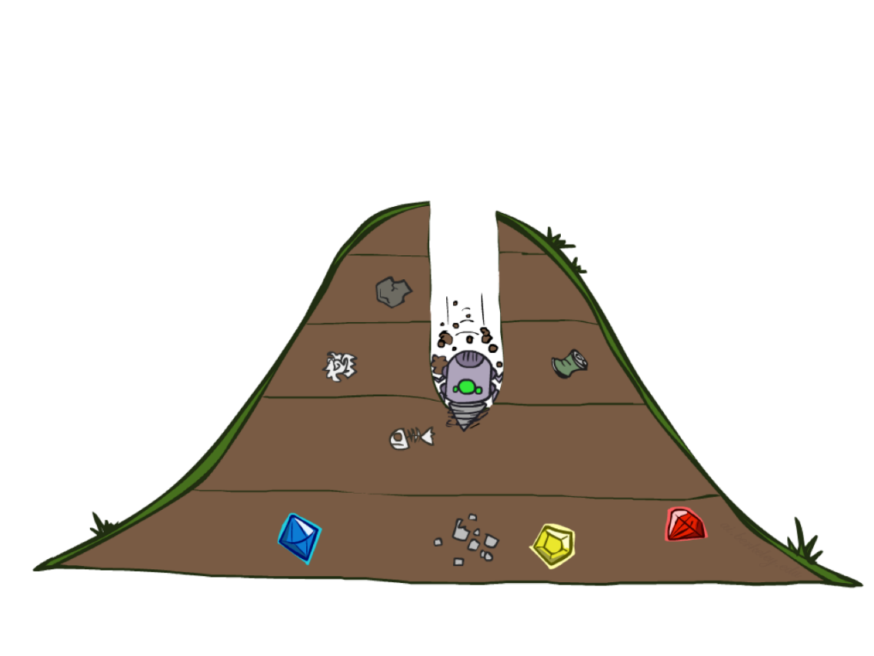
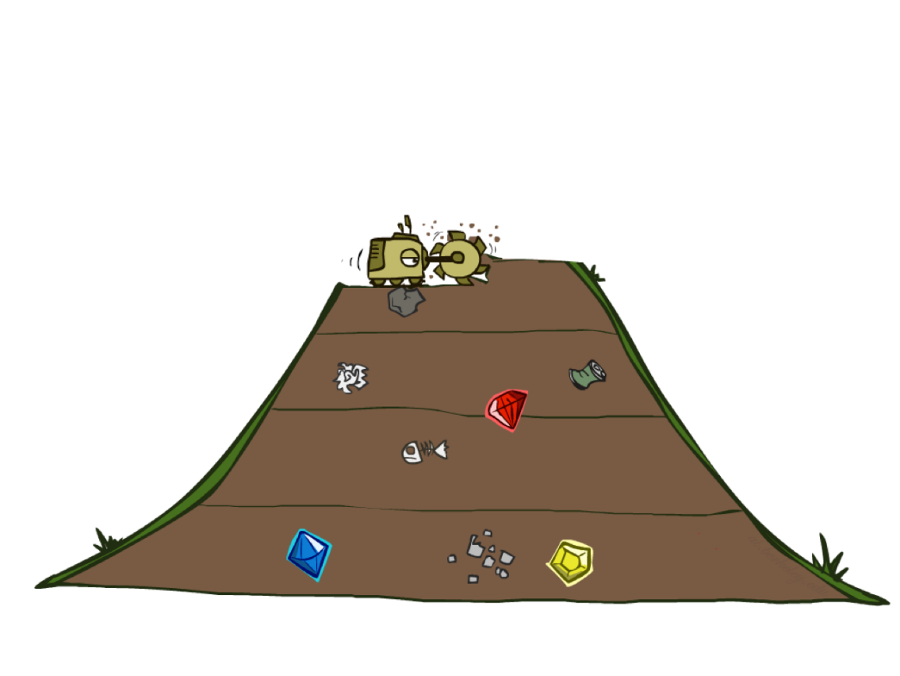
Quiz: DFS vs BFS

Slide 52
Quiz: DFS vs BFS
When will BFS outperform DFS?
When will DFS outperform BFS?
Use depth-first if
  • Space is restricted
  • There are many possible solutions with long paths and wrong paths are usually terminated quickly
  • Search can be fine-tuned quickly
Use breadth-first if
  • Possible infinite paths
  • Some solutions have short paths
  • Can quickly discard unlikely paths
48
Time and space complexity are measured in terms of
b: maximum branching factor of the search tree
d: depth of the least-cost solution
m: maximum depth of the state space (may be ∞)
[Demo: dfs/bfs maze water (L2D6)]

Slide 53

Video of Demo Maze Water DFS/BFS (part 1)
BFS

Slide 54
Video of Demo Maze Water DFS/BFS (part 2)
DFS

Slide 55
Combining BFS and DFS?
DFS is efficient in space complexity
BFS is better in time complexity
How can we combine strength of both in a method?

Slide 56
Depth-limited search
To keep depth-first search from wandering down an infinite path, we can use depth-limited search, a version of depth-first search in which we supply a depth limit, l, and treat all nodes at depth l as if they had no successors.
The time complexity is O(b^{l}) and the space complexity is O(bl).
Unfortunately, if we make a poor choice for l the algorithm will fail to reach the solution, making it incomplete again.
Sometimes a good depth limit can be chosen based on knowledge of the problem. For example, on the map of Romania there are 20 cities. Therefore, l =19 is a valid limit. But if we studied the map carefully, we would discover that any city can be reached from any other city in at most 9 actions.
This number, known as the diameter of the state-space graph, gives us a better depth limit, which leads to a more efficient depth-limited search.

Slide 57
Iterative Deepening
Idea: get DFS’s space advantage with BFS’s time / shallow-solution advantages
Iterative deepening search solves the problem of picking a good value for depth limit, l, by trying all values: first 0, then 1, then 2, and so on—until either a solution is found, or the depth-limited search returns the failure value rather than the cutoff value.
  Run a DFS with depth limit 1. If no solution…
  Run a DFS with depth limit 2. If no solution…
  Run a DFS with depth limit 3. …..
Isn’t that wastefully redundant?
  Generally most work happens in the lowest level searched, so not so bad!
b
…

Slide 58
Four iterations of iterative deepening search for goal M on a binary tree
Figure 3.13 Four iterations of iterative deepening search for goal M on a binary tree, with the depth limit varying from 0 to 3.
Note the interior nodes form a single path.
The triangle marks the node to expand next; green nodes with dark outlines are on the frontier; the very faint nodes provably can’t be part of a solution with this depth limit.

Slide 59
Iterative deepening and depth-limited tree-like search

Slide 60
Properties of iterative deepening search
Complete:
  Yes
Time:
  (d+1)b⁰ +db¹ +(d−1)b² +...+b^{d} =O(b^{d})
  or more precisely O(b^{d}(1 – 1/b)⁻²)
Space:
  O(bd)
Optimal:
  Yes, if step cost = 1
  Can be modified to explore uniform-cost tree
Notes:
Since iterative deepening visits states multiple times, it may seem wasteful, but it turns out to be not so costly, since in a tree most of the nodes are in the bottom level, so it does not matter much if the upper levels are visited multiple times.

Slide 61
Properties of iterative deepening search (cont.)
Numerical comparison for b = 10 and d = 5, solution at far right leaf:
  N(IDS) = 6+50+400+3,000+20,000+100,000=123,456
  N(BFS) = 10+100+1,000+10,000+100,000+999,990=1,111,100
IDS does better because other nodes at depth d are not expanded
BFS can be modified to apply goal test when a node is generated

Slide 62
Cost-Sensitive Search
a
GOAL
2
2
b
c
3
2
1
8
2
e
d
f
3
9
8
2
START
h
1
4
2
p
4
r
15
q
BFS finds the shortest path in terms of number of actions.
It does not find the least-cost path. We will now cover
a similar algorithm which does find the least-cost path.

Slide 63
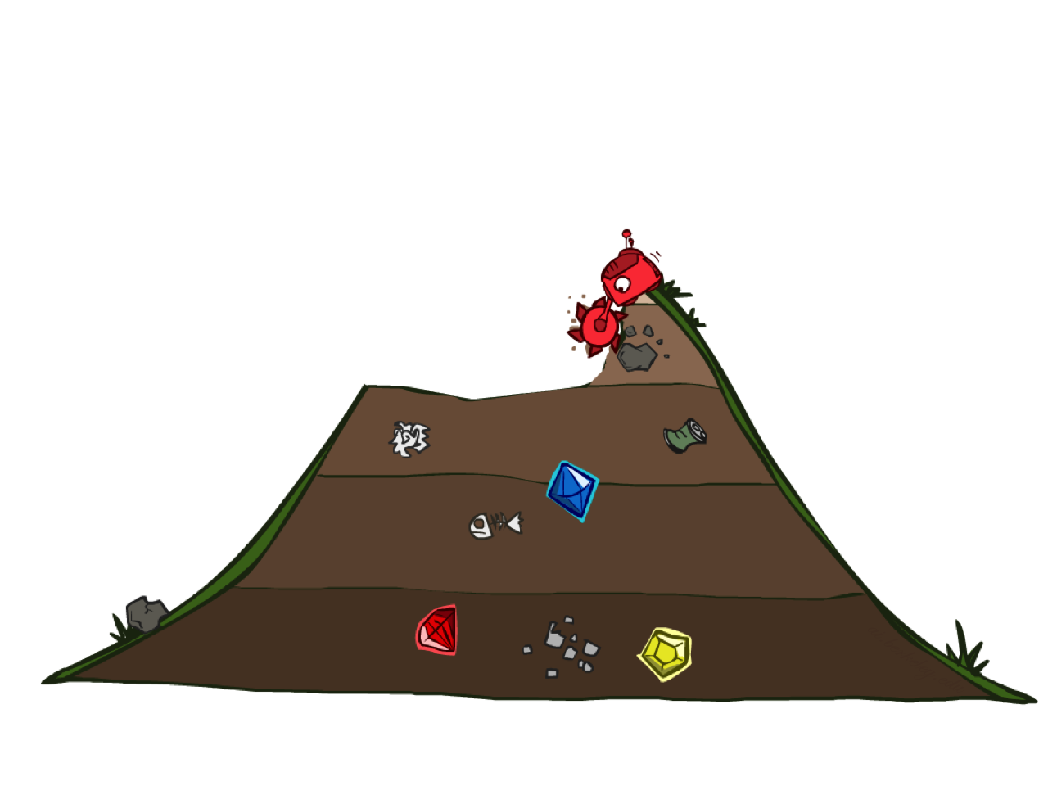
Uniform Cost Search (Dijkstra's algorithm)
When actions have different costs, an obvious choice is to use best-first search where the evaluation function is the cost of the path from the root to the current node.
This is called
  Dijkstra’s algorithm by the theoretical computer science community, and
  uniform-cost search by the AI community.

Slide 64
Part of the Romania state space, selected to illustrate uniform-cost search.
The problem is to get from Sibiu to Bucharest.
The successors of Sibiu are Rimnicu Vilcea and Fagaras, with costs 80 and 99, respectively.
The least cost node, Rimnicu Vilcea, is expanded next, adding Pitesti with cost 80+97=177.
The least-cost node is now Fagaras, so it is expanded, adding Bucharest with cost 99+211=310.
Bucharest is the goal, but the algorithm tests for goals only when it expands a node, not when it generates a node, so it has not yet detected that this is a path to the goal.
The algorithm continues on, choosing Pitesti for expansion next and adding a second path to Bucharest with cost 80+97+101=278.
It has a lower cost, so it replaces the previous path in reached and is added to the frontier.
Note that if we had checked for a goal upon generating a node rather than when expanding the lowest-cost node, then we would have returned a higher-cost path (the one through Fagaras).

Slide 65
Uniform Cost Search
2
G
a
Strategy: expand a cheapest node first:
Fringe is a priority queue (priority: cumulative cost)
b
c
1
8
2
2
e
3
d
f
9
8
2
S
h
1
1
p
q
r
15
0
S
d
3
e
9
p
1
b
4
e
5
h
17
r
11
q
16
c
11
Cost contours
a
6
a
h
13
r
7
p
q
f
p
q
f
8
q
c
G
q
c
a
11
G
10
a

Slide 66
Uniform-cost search implementation
The idea is that while breadth-first search spreads out in waves of uniform depth—first depth 1, then depth 2, and so on
uniform-cost search spreads out in waves of uniform path-cost. The algorithm can be implemented as a call to BEST-FIRST-SEARCH with PATH-COST as the evaluation function,

Slide 67
Uniform Cost Search (UCS) Properties
What nodes does UCS expand?
  Processes all nodes with cost less than cheapest solution!
  If that solution costs C* and arcs cost at least ε , then the “effective depth” is roughly C*/ε
  Takes time O(b^{C*/ε}) (exponential in effective depth)
How much space does the fringe take?
  Has roughly the last tier, so O(b^{C*/ε})
Is it complete?
  Assuming best solution has a finite cost and minimum arc cost is positive, yes!
Is it optimal?
  Yes! (Proof next lecture via A*)
b
c ≤ 1
…
C*/ε “tiers”
c ≤ 2
c ≤ 3

Slide 68
Uniform Cost Issues
Remember: UCS explores increasing cost contours
The good: UCS is complete and optimal! because the first solution it finds will have a cost that is at least as low as the cost of any other node in the frontier.
Uniformcost search considers all paths systematically in order of increasing cost, never getting caught going down a single infinite path.
The bad:
  Explores options in every “direction”
  No information about goal location
…
c ≤ 1
c ≤ 2
c ≤ 3
Start
Goal
[Demo: empty grid UCS (L2D5)]
[Demo: maze with deep/shallow water DFS/BFS/UCS (L2D7)]

Slide 69
Video of Demo Empty UCS

Slide 70
Video of Demo Maze with Deep/Shallow Water --- DFS, BFS, or UCS? (part 1)
(This is BFS.)
Notes:
Let students guess which one of the three it is. (This is BFS.)

Slide 71
Video of Demo Maze with Deep/Shallow Water --- DFS, BFS, or UCS? (part 2)
(This is UCS.)
Notes:
Let students guess which one of the three it is. (This is UCS.)

Slide 72
Video of Demo Maze with Deep/Shallow Water --- DFS, BFS, or UCS? (part 3)
This is DFS
Notes:
Let students guess which one of the three it is. (This is DFS.)

Slide 73
Bidirectional search
The algorithms we have covered so far start at an initial state and can reach any one of multiple possible goal states.
An alternative approach called bidirectional search simultaneously searches forward from the initial state and backwards from the goal state(s), hoping that the two searches will meet.

Slide 74
Comparing uninformed search algorithms

Slide 75
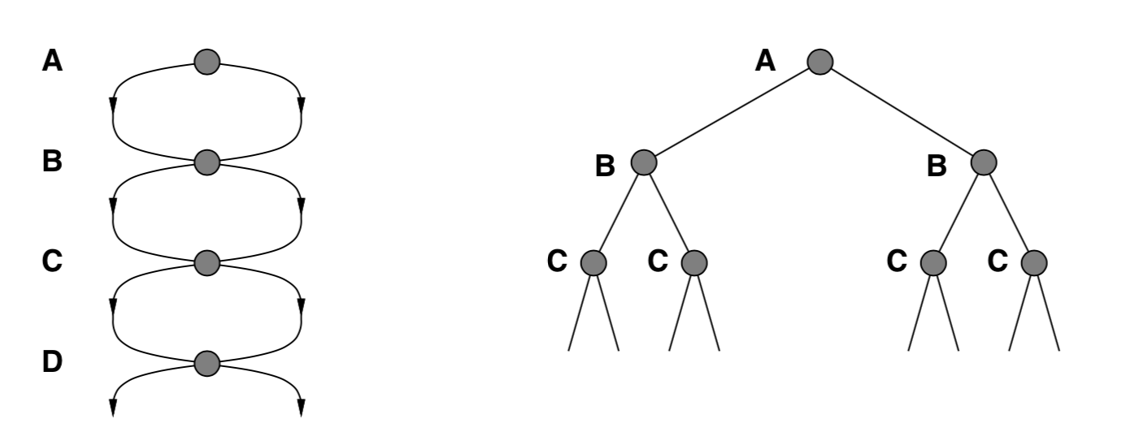

Repeated states
Failure to detect repeated states can turn a linear problem into an exponential one!

Slide 76
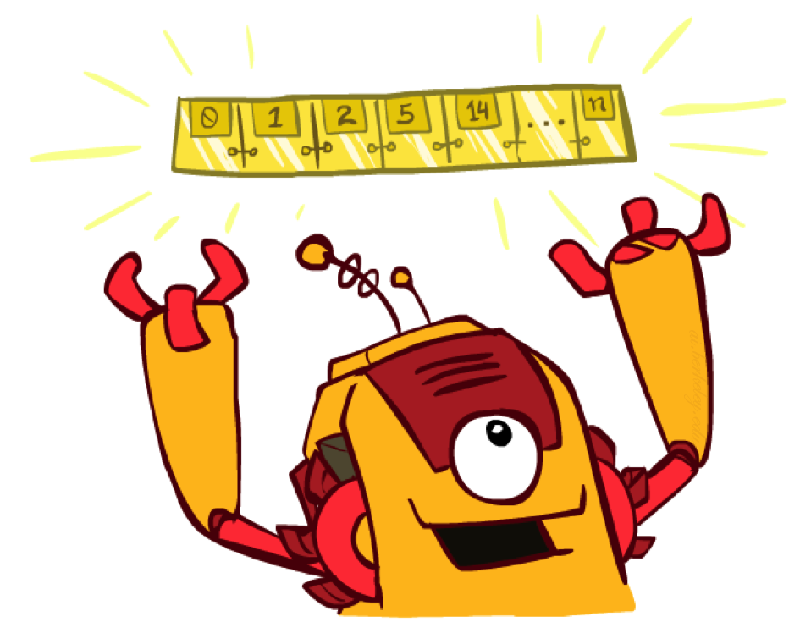
The One Queue
All these search algorithms are the same except for fringe strategies
  Conceptually, all fringes are priority queues (i.e. collections of nodes with attached priorities)
  Practically, for DFS and BFS, you can avoid the log(n) overhead from an actual priority queue, by using stacks and queues
  Can even code one implementation that takes a variable queuing object

Slide 77
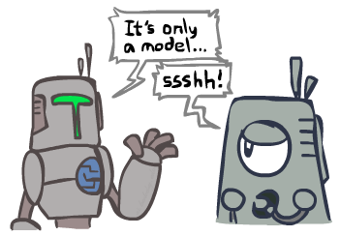
Search and Models
Search operates over models of the world
  The agent doesn’t actually try all the plans out in the real world!
  Planning is all “in simulation”
  Your search is only as good as your models…

Slide 78
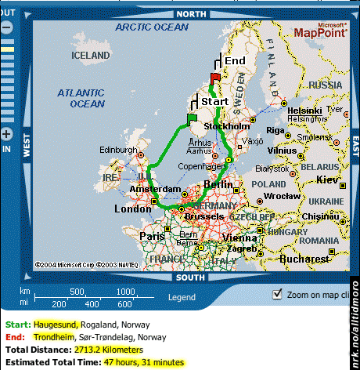
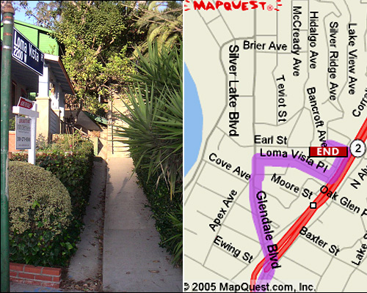

Search Gone Wrong?

