Slide 1
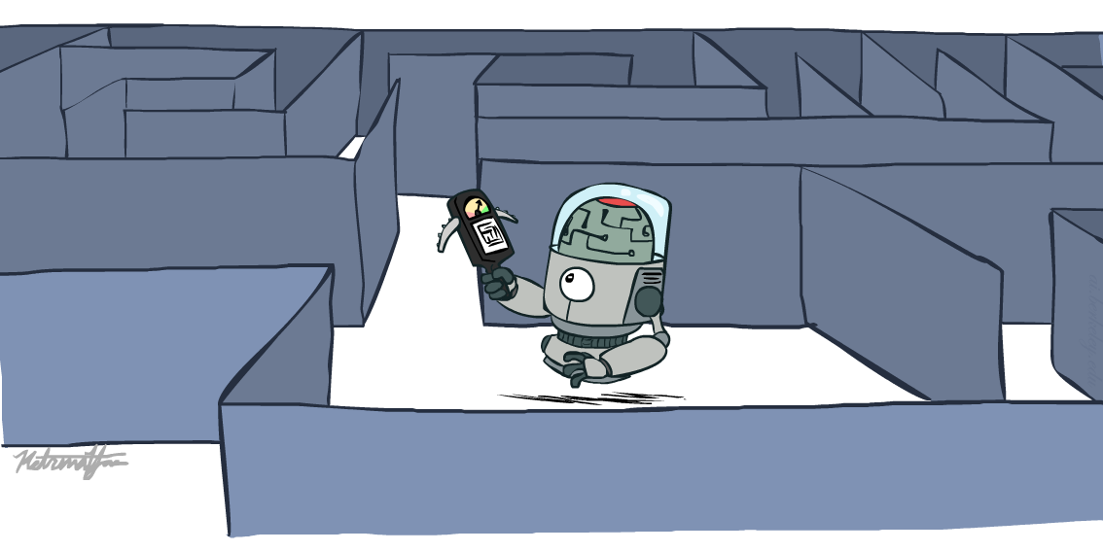
COE 4213564 Introduction to Artificial Intelligence
Informed Search
Many slides are adapted from CS 188 (http://ai.berkeley.edu), CIS 521, CS 221, CS182, CS4420.
Notes:
Please retain proper attribution, including the reference to ai.berkeley.edu. Thanks!

Slide 2

Outline
Informed Search
Heuristics
Greedy Search
A* Search
Graph Search

Slide 3
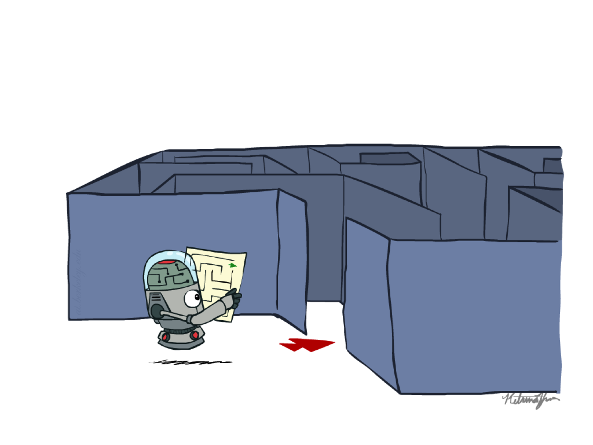
Recap: Search

Slide 4
Recap: Search
Search problem:
States (configurations of the world)
Actions and costs
Successor function (world dynamics)
Start state and goal test
Search tree:
Nodes: represent plans for reaching states
Plans have costs (sum of action costs)
Search algorithm:
Systematically builds a search tree
Chooses an ordering of the fringe (unexplored nodes)
Optimal: finds least-cost plans

Slide 5
Example: Pancake Problem
Pancake Sorting Problem: We are given a stack of n pancakes, each of different size. Our goal is to sort this stack from smallest to largest (largest being on the bottom of the stack).
The only thing we are allowed to do is to insert the spatula in between two pancakes (or between the bottom pancake and the plate), and flip over all the pancakes that are on top of the spatula.
Cost: Number of pancakes flipped
Notes:
Gates, W. and Papadimitriou, C., "Bounds for Sorting by Prefix Reversal.", Discrete Mathematics. 27, 47-57, 1979.

Slide 6
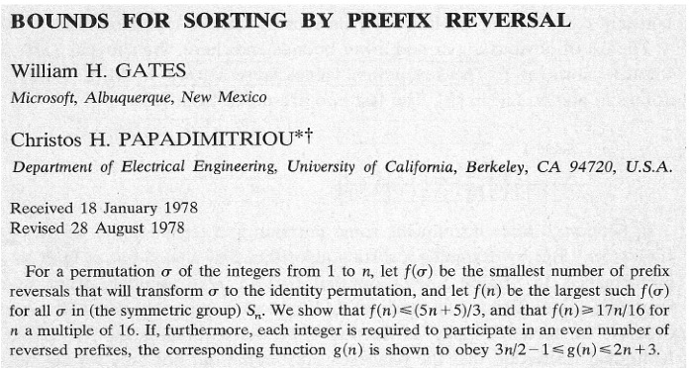
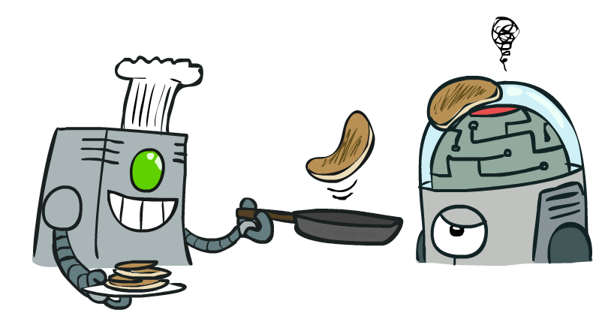
Example: Pancake Problem
Notes:
Gates, W. and Papadimitriou, C., "Bounds for Sorting by Prefix Reversal.", Discrete Mathematics. 27, 47-57, 1979.

Slide 7
Example: Pancake Problem
State space graph with costs as weights
4
2
3
2
3
4
3
4
2
3
2
2
4
3
Notes:
A* expanded 8100 ; Path cost = 33
UCS expanded 25263 . Path cost = 33
Greedy expanded 10 . Path cost = 41
[0, 7, 5, 3, 2, 1, 4, 6]
(7, 0, 5, 3, 2, 1, 4, 6)
(6, 4, 1, 2, 3, 5, 0, 7)
(3, 2, 1, 4, 6, 5, 0, 7)
(1, 2, 3, 4, 6, 5, 0, 7)
(5, 6, 4, 3, 2, 1, 0, 7)
(6, 5, 4, 3, 2, 1, 0, 7)
(0, 1, 2, 3, 4, 5, 6, 7)

Slide 8
General Tree Search
Action: flip top two Cost: 2
Action: flip all four Cost: 4
Path to reach goal:
Flip four, flip three
Total cost: 7
Notes:
You know exactly where you came from and how you got there, but you have no idea where you’re going. But, you’ll know it when you see it.

Slide 9
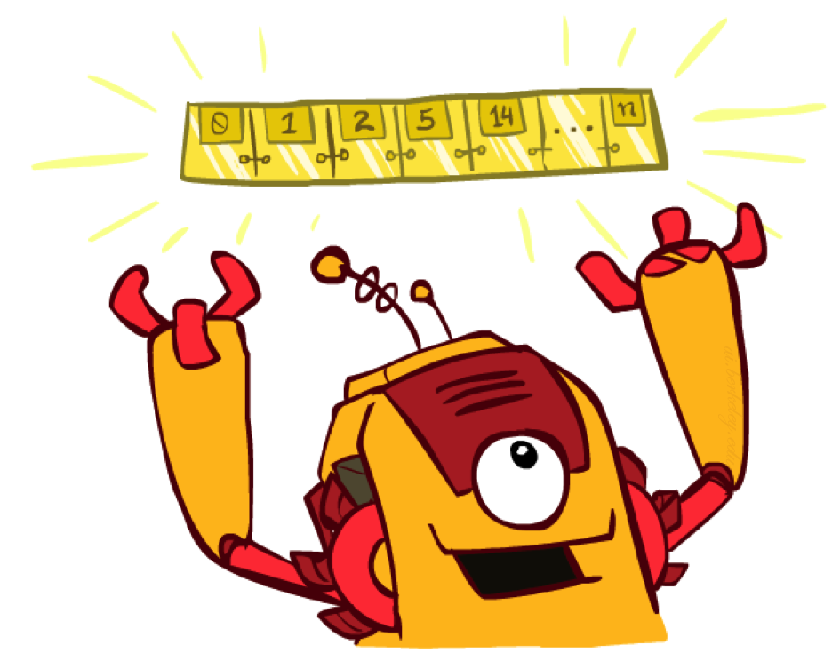
The One Queue
All these search algorithms are the same except for fringe strategies
Conceptually, all fringes are priority queues (i.e. collections of nodes with attached priorities)
Practically, for DFS and BFS, you can avoid the log(n) overhead from an actual priority queue, by using stacks and queues
Can even code one implementation that takes a variable queuing object

Slide 10
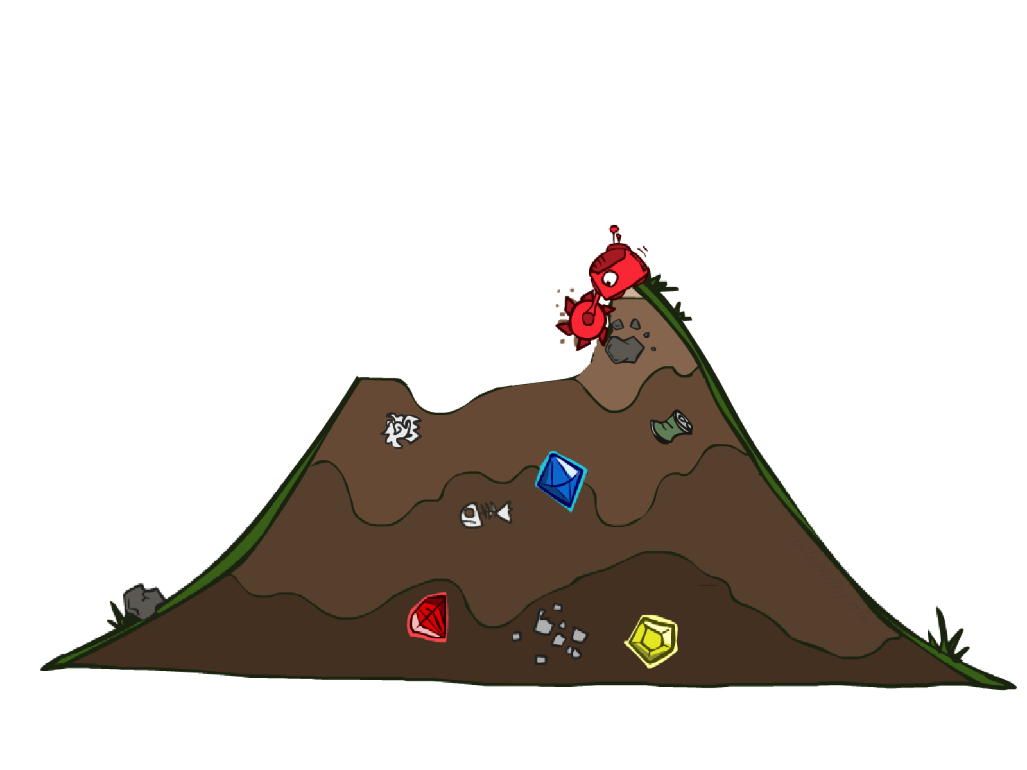
Uninformed Search

Slide 11
Uniform Cost Search
2
G
a
Strategy: expand a cheapest node first from the root:
Fringe is a priority queue (priority: cumulative cost)
b
c
1
8
2
2
e
3
d
f
9
8
2
S
h
1
1
p
q
r
15
0
S
d
3
e
9
p
1
b
4
e
5
h
17
r
11
q
16
c
11
Cost contours
a
6
a
h
13
r
7
p
q
f
p
q
f
8
q
c
G
q
c
a
11
G
10
a

Slide 12
Uniform Cost Search
Strategy: expand lowest path cost cost of the path from the root to the current node
The good: UCS is complete and optimal!
The bad:
Explores options in every “direction”
No information about goal location
c ≤ 1
…
c ≤ 2
c ≤ 3
Start
Goal
[Demo: contours UCS empty (L3D1)]
[Demo: contours UCS pacman small maze (L3D3)]

Slide 13

Video of Demo Contours UCS Empty

Slide 14
Video of Demo Contours UCS Pacman Small Maze

Slide 15
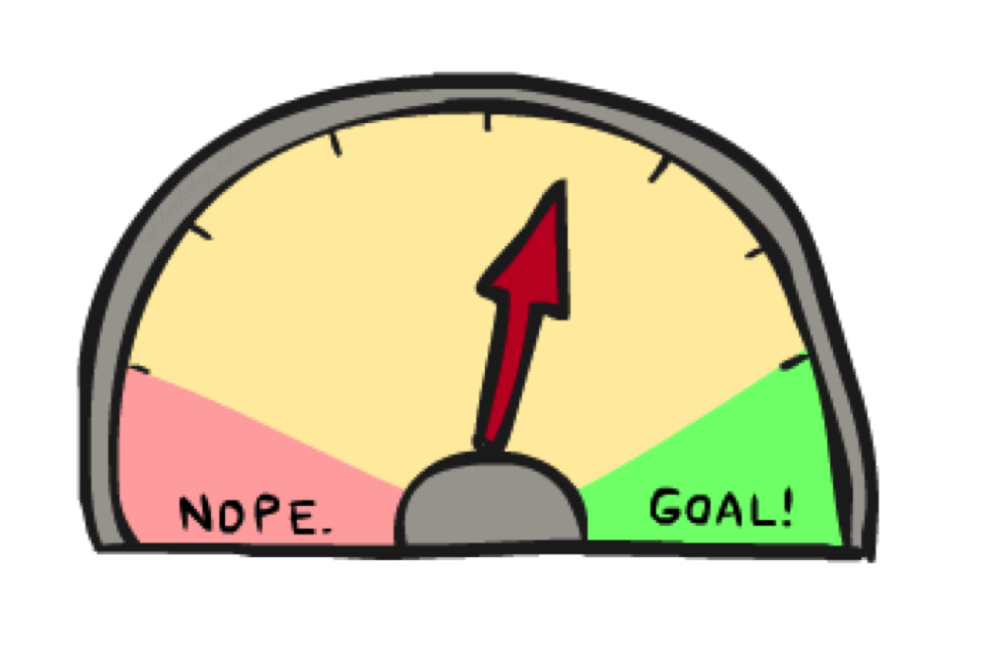
Informed Search

Slide 16
Informed Search Strategies
Uninformed search strategies look for solutions by systematically generating new states and checking each of them against the goal
This approach is very inefficient in most cases
Most successor states are “obviously” a bad choice
Such strategies do not know that because they have minimal problem-specific knowledge
Informed search strategies exploit problem-specific knowledge as much as possible to drive the search
They are almost always more efficient than uninformed searches and often also optimal

Slide 17
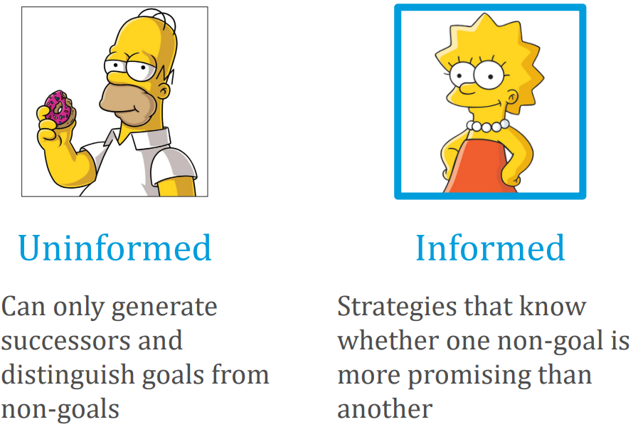
UNINFORMED VS. INFORMED

Slide 18
Informed Search Strategies
Use the knowledge of the problem domain to build an evaluation function h
For every node n in the search space, h(n) quantifies the desirability of expanding n in order to reach the goal
Then use the desirability value of the nodes in the fringe to decide which node to expand next
The evaluation function h is typically an imperfect measure of the goodness of the node
i.e., the right choice of nodes is not always the one suggested by h
The evaluation function is usually called heuristic function.

Slide 19
Heuristic
Merriam-Webster's Online Dictionary
Heuristic (pron. \hyu-ʼris-tik\): adj. [from Greek heuriskein to discover.] involving or serving as an aid to learning, discovery, or problemsolving by experimental and especially trial-and-error methods
The Free On-line Dictionary of Computing
heuristic 1. A rule of thumb, simplification or educated guess that reduces or limits the search for solutions in domains that are difficult and poorly understood. Unlike algorithms, heuristics do not guarantee feasible solutions and are often used with no theoretical guarantee. 2. approximation algorithm.
From WordNet (r) 1.6
heuristic adj 1: (computer science) relating to or using a heuristic rule 2: of or relating to a general formulation that serves to guide investigation [ant: algorithmic] n : a commonsense rule (or set of rules) intended to increase the probability of solving some problem [syn: heuristic rule, heuristic program]

Slide 20
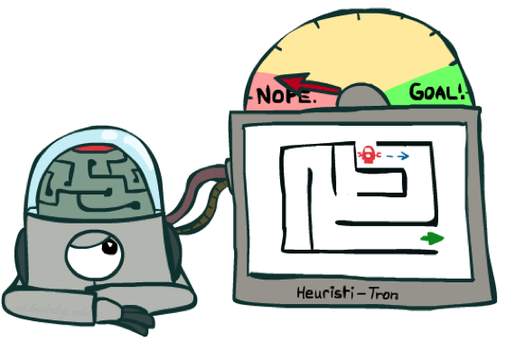
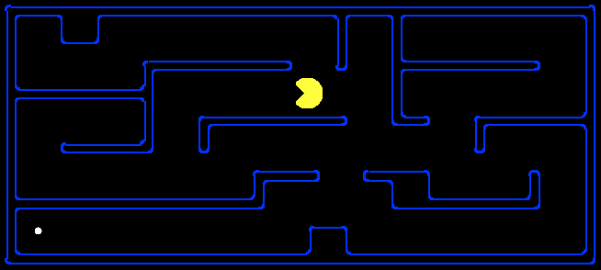
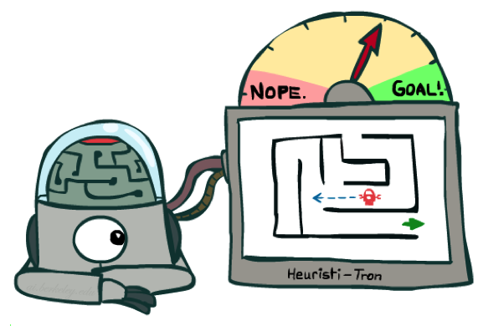
Search Heuristics
A heuristic is:
A function that estimates how close a state is to a goal
Designed for a particular search problem
Examples: Manhattan distance, Euclidean distance for pathing
10
5
11.2

Slide 21
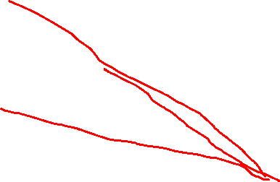
Example: Heuristic Function
in route-finding problems, we can estimate the distance from the current state to a goal by computing the straight-line distance on the map between the two points.
h(n) = estimated cost of the cheapest path from the state at node n to a goal state.
h(x)

Slide 22
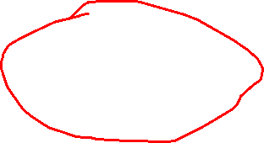
Example: Heuristic Function
Heuristic: the number of the largest pancake that is still out of place
3
h(x)
4
3
4
3
0
4
4
3
4
4
2
3
Notes:
A* expanded 8100 ; Path cost = 33
UCS expanded 25263 . Path cost = 33
Greedy expanded 10 . Path cost = 41
[0, 7, 5, 3, 2, 1, 4, 6]
(7, 0, 5, 3, 2, 1, 4, 6)
(6, 4, 1, 2, 3, 5, 0, 7)
(3, 2, 1, 4, 6, 5, 0, 7)
(1, 2, 3, 4, 6, 5, 0, 7)
(5, 6, 4, 3, 2, 1, 0, 7)
(6, 5, 4, 3, 2, 1, 0, 7)
(0, 1, 2, 3, 4, 5, 6, 7)

Slide 23
Heuristics for 8-puzzle
Misplaced Tiles
Heuristic
3
2
8
Current State
4
5
6
7
1
3
2
8
(not including the blank)
4
5
6
1
2
3
7
1
Goal State
4
5
6
3 tiles are not where they need to be
7
8
Three tiles are misplaced (the 3, 8, and 1) so heuristic function evaluates to 3
Heuristic says that it thinks a solution may be available in 3 or more moves
Very rough estimate, but easy to calculate
h = 3

Slide 24
Heuristics for 8-puzzle
3
2
8
3
3
Manhattan Distance
Heuristic
Current State
2 steps
4
5
6
7
1
(not including the blank)
8
1
2
3
Goal State
3 steps
4
5
6
8
7
8
1
The 3, 8, and 1 tiles misplaced by 2, 3, and 3 steps, so heuristic function evaluates to 8
Heuristic says that it thinks a solution may be available in 8 or more moves
More accurate than the misplaced heuristic, but slightly more expensive to compute
3 steps
1
h = 8

Slide 25

Best-First Search
Idea: use an evaluation function estimating the desirability of each node
Strategy: Always expand the most desirable unexpanded node
Implementation: the fringe is a priority queue sorted in decreasing order of desirability
Special cases:
Greedy search
A* search

Slide 26
Best-first Search Strategies
Best-first is a family of search strategies, each with a different evaluation function
Typically, strategies use estimates of the cost of reaching the goal and try to minimize it
Uniform Search also tries to minimize a cost measure. Is it then a best-first search strategy?
Not in spirit, because the evaluation function should incorporate a cost estimate of going from the current state to the closest goal state

Slide 27
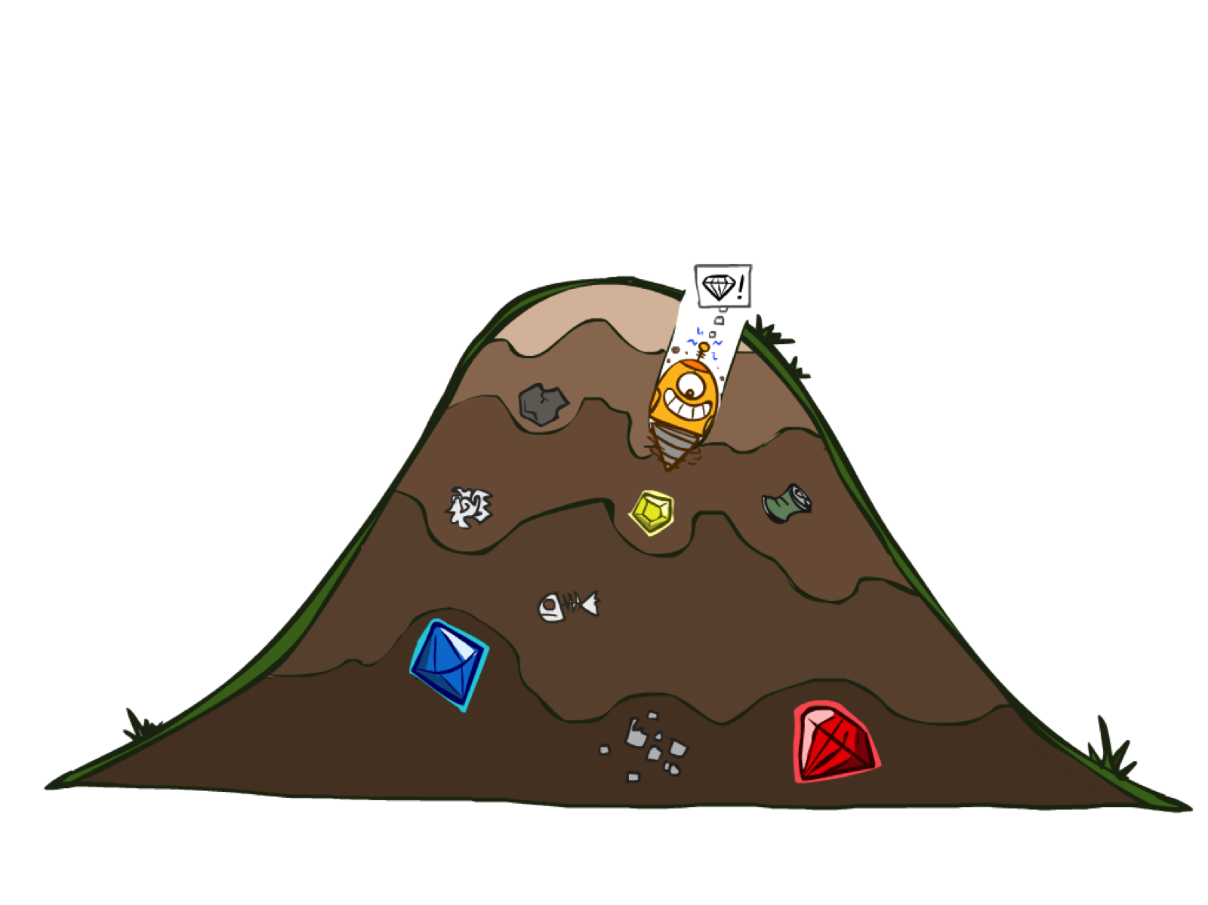
Greedy Search

Slide 28
Greedy best-first search
Greedy best-first search is a form of best-first search that expands first the node with the lowest h(n) value—the node that appears to be closest to the goal—on the grounds that this is likely to lead to a solution quickly.
So the evaluation function f (n) = h(n).
Implementation: Order the nodes in fringe in decreasing order of desirability

Slide 29
Example: Heuristic Function
Evaluation ( heuristics) function h(n) = estimate cost of cheapest path from node n to closest goal.
We use the straight-line distance heuristic here.
E.g., h_{SLD} (n) = straight-line distance from n to Bucharest
Greedy search expands the node that appears to be closest to goal
h_{SLD}(n)

Slide 30
Route-finding in Romania

Slide 31


Greedy Search
Expand the node that seems closest…
What can go wrong?
For this particular problem, greedy best-first search using h_{SLD} finds a solution without ever expanding a node that is not on the solution path; hence, its search cost is minimal.
It is not optimal, however.
The path via Sibiu and Fagaras to Bucharest is 32 kilometers longer than the path through Rimnicu Vilcea and Pitesti.

Slide 32
Greedy Search
b
Strategy: expand a node that you think is closest to a goal state
Heuristic: estimate of distance to nearest goal for each state
A common case:
Best-first takes you straight to the (wrong) goal
Worst-case: like a badly-guided DFS
…
b
…
[Demo: contours greedy empty (L3D1)]
[Demo: contours greedy pacman small maze (L3D4)]
Notes:
For any search problem, you know the goal. Now, you have an idea of how far away you are from the goal.

Slide 33
Video of Demo Contours Greedy (Empty)

Slide 34
Video of Demo Contours Greedy (Pacman Small Maze)

Slide 35
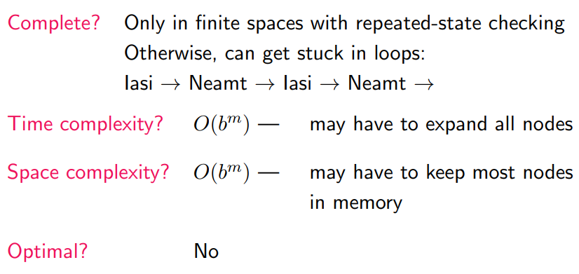
Properties of Greedy Best-First Search
A good heuristic can nonetheless produce dramatic time/space improvements in practice.

Slide 36
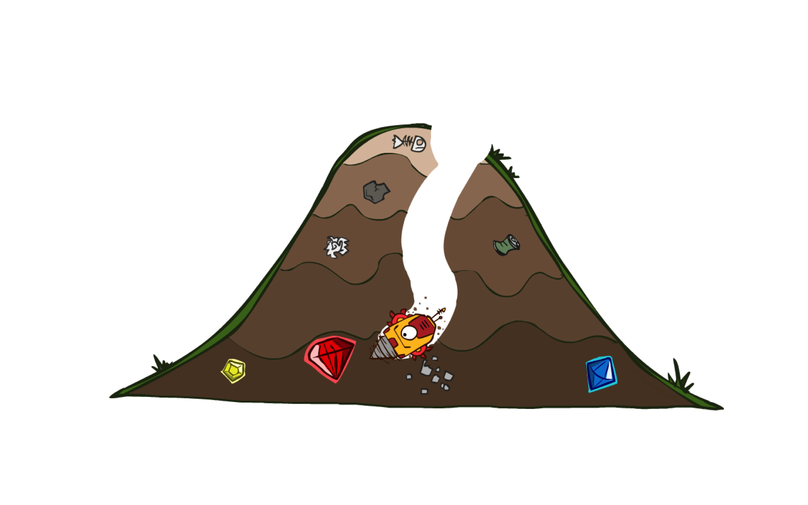
A* Search

Slide 37

A* search
The most common informed search algorithm is A* search (pronounced “A-star search”),
A best-first search strategy that uses the evaluation function
f (n) = g(n)+h(n)
where
g(n) is the path cost from the initial state to node n, and
h(n) is the estimated cost of the shortest path from node n to a goal state,
so we have
f (n) = estimated cost of the best path that continues from n to a goal.

Slide 38
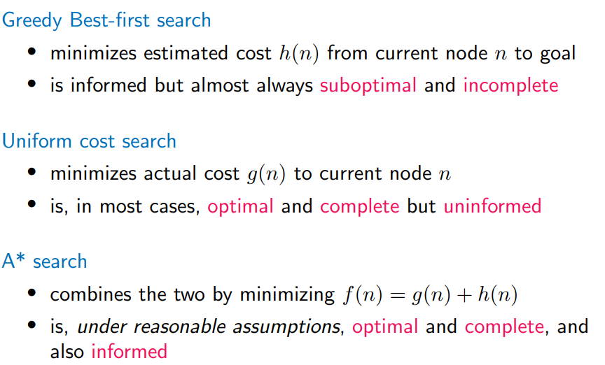
Combining UCS and Greedy
A* — A Better Best-First Strategy by combining UCS and Greedy

Slide 39
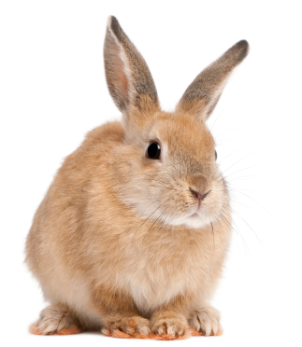
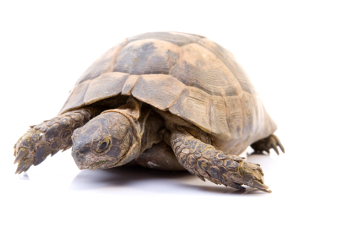

A* Search (turtle & rabbit analogy)
UCS
Greedy
A*
Notes:
Notes: these images licensed from iStockphoto for UC Berkeley use.

Slide 40
Combining UCS and Greedy
Uniform-cost orders by path cost, or backward cost g(n)
Greedy orders by goal proximity, or forward cost h(n)
A* Search orders by the sum: f(n) = g(n) + h(n)
8
g = 0 h=6
S
e
h=1
g = 1 h=5
a
1
1
3
2
g = 2 h=6
g = 9 h=1
S
a
d
G
b
d
g = 4 h=2
e
h=6
1
h=5
h=2
h=0
1
g = 3 h=7
g = 6 h=0
g = 10 h=2
c
b
c
G
d
h=7
h=6
g = 12 h=0
G
Example: Teg Grenager

Slide 41
When should A* terminate?
Should we stop when we enqueue a goal?
No: only stop when we dequeue a goal
h = 2
A
2
2
S
h = 3
h = 0
G
2
B
3
h = 1

Slide 42

Is A* Optimal?
h = 6
Estimated cost
1
A
3
3+1
S
Actual costs
h = 7
G
h = 0
-
_
5
5
What went wrong?
Actual bad goal cost < estimated good goal cost
We need estimates to be less than actual costs!

Slide 43
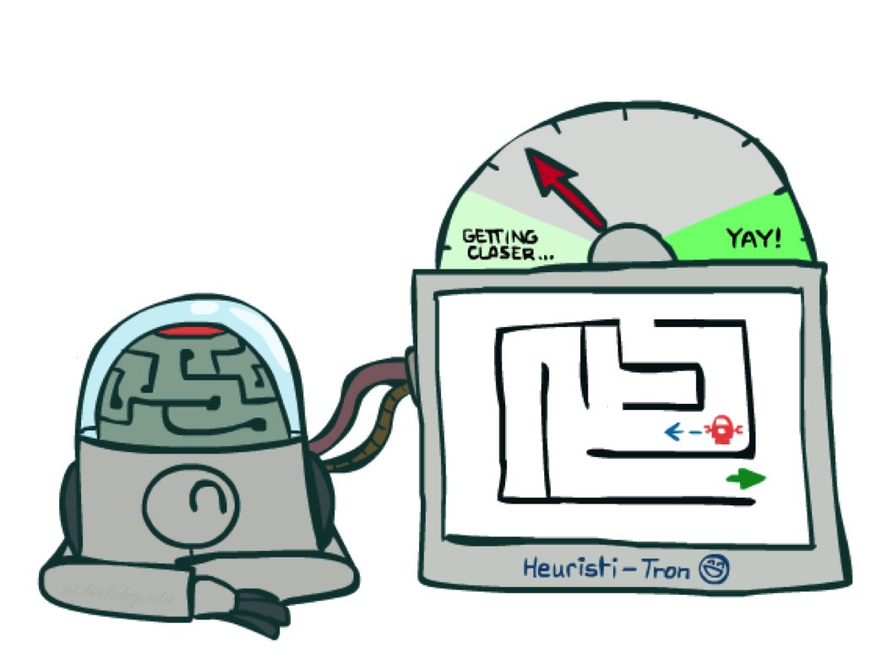
Admissible Heuristics

Slide 44
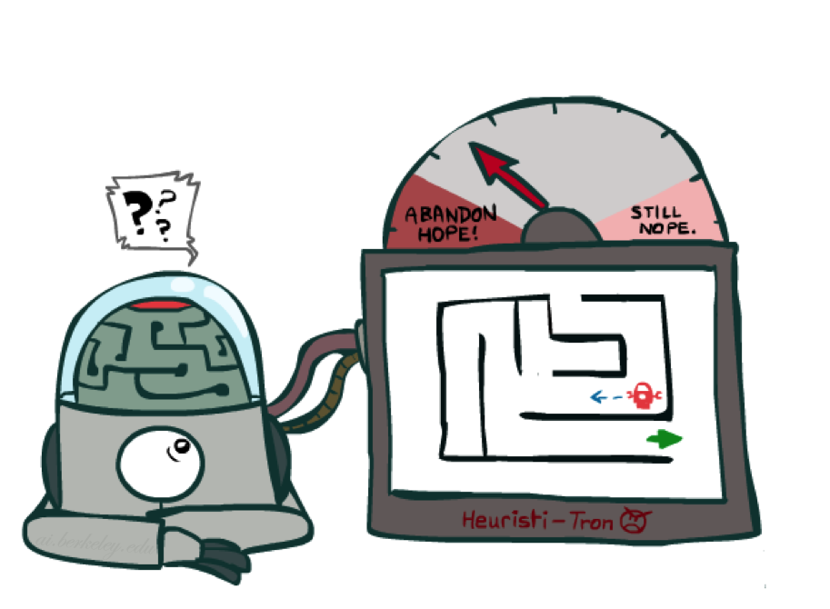
Idea: Admissibility
Inadmissible (pessimistic) heuristics break optimality by trapping good plans on the fringe
Admissible (optimistic) heuristics slow down bad plans but never outweigh true costs

Slide 45
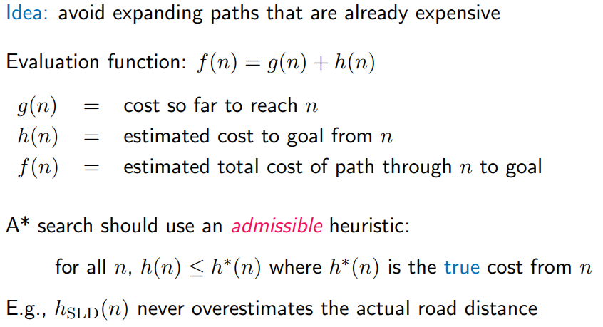
A* Search

Slide 46

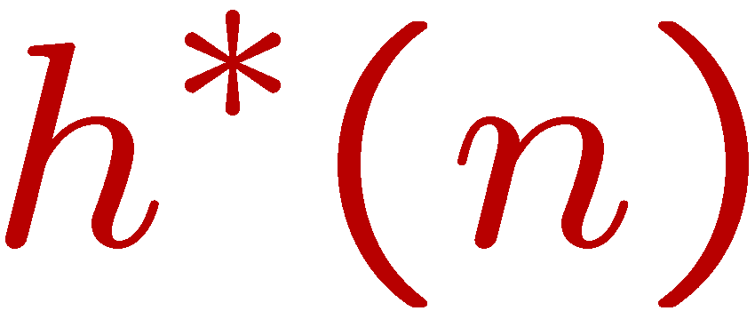
Admissible Heuristics
A heuristic h is admissible (optimistic) if:
where is the true cost to a nearest goal
Examples:
Coming up with admissible heuristics is most of what’s involved in using A* in practice.
4
15

Slide 47
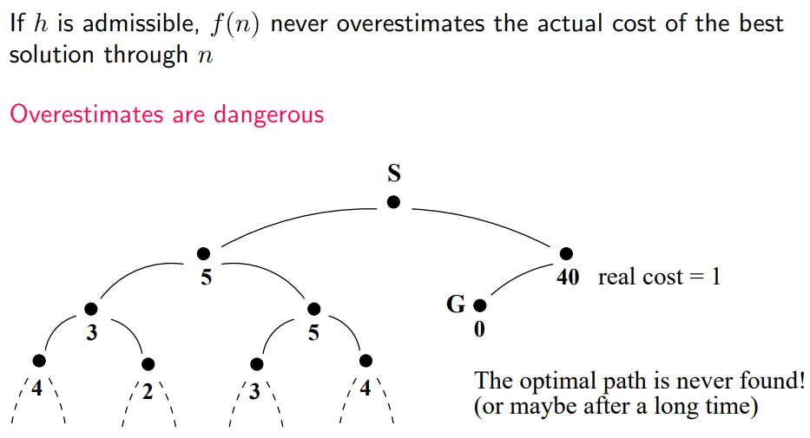
A* Search: Why an Admissible Heuristic

Slide 48
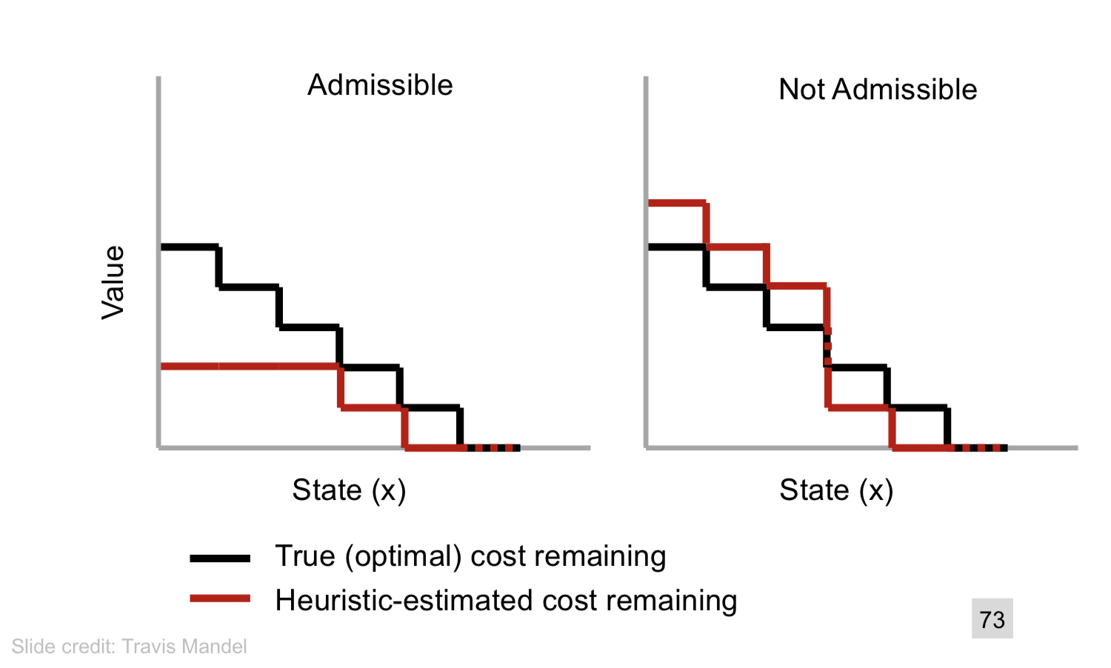
Admissible Heuristics

Slide 49

Optimality of A* Tree Search

Slide 50


Proof : Optimality of A* Tree Search
Assume:
A is an optimal goal node
B is a suboptimal goal node
h is admissible
Claim:
A will exit the fringe before B
…

Slide 51

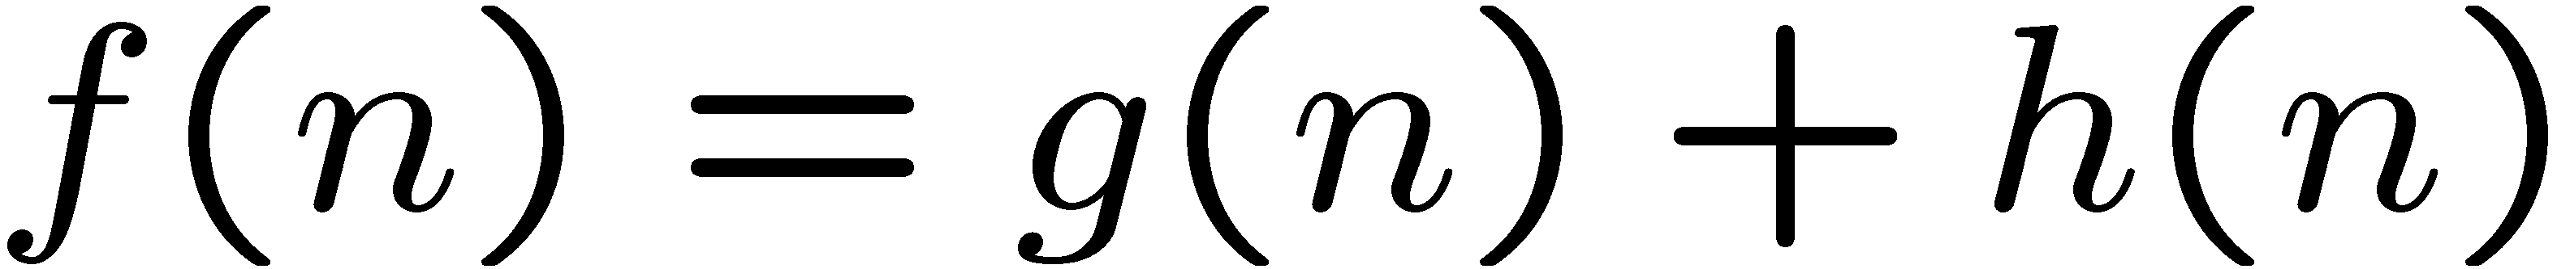
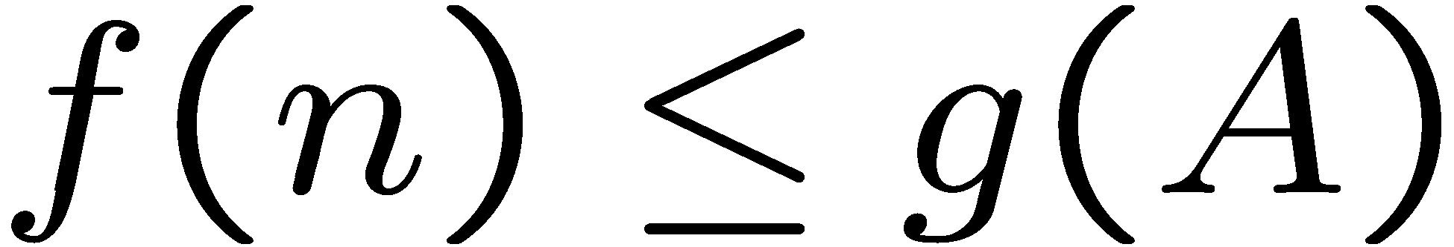
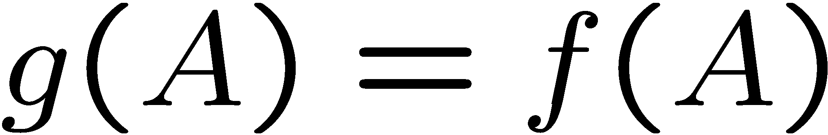
Optimality of A* Tree Search: Blocking
Proof:
Imagine B is on the fringe
Some ancestor n of A is on the fringe, too (maybe A!)
Claim: n will be expanded before B
f(n) is less or equal to f(A)
…
Definition of f-cost
Admissibility of h
h = 0 at a goal

Slide 52
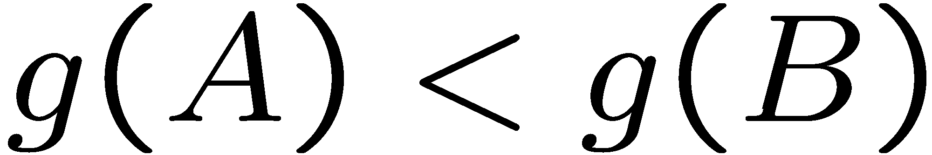
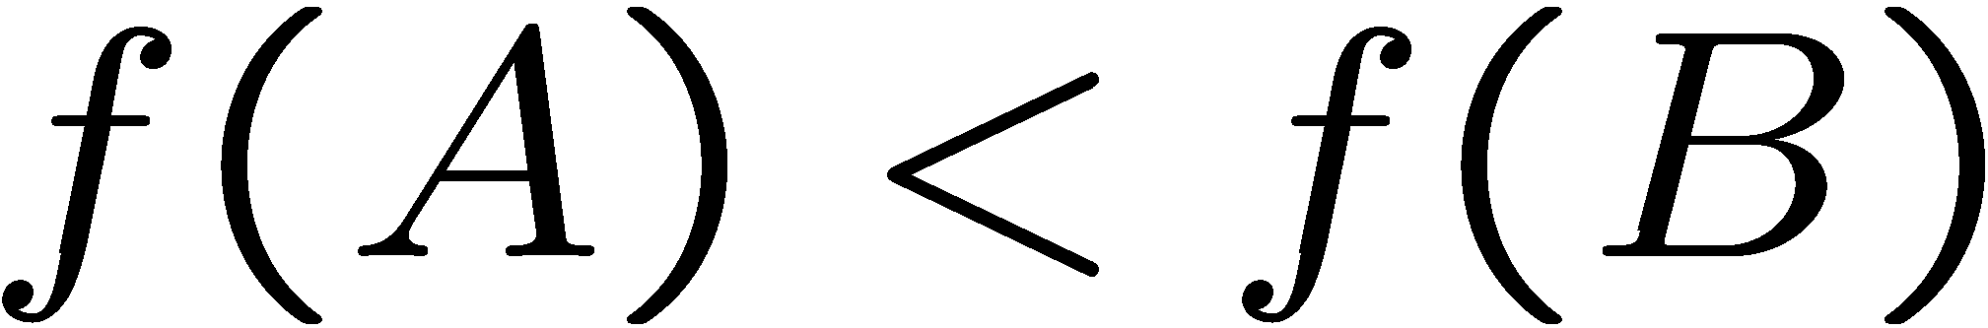
Optimality of A* Tree Search: Blocking
Proof:
Imagine B is on the fringe
Some ancestor n of A is on the fringe, too (maybe A!)
Claim: n will be expanded before B
f(n) is less or equal to f(A)
f(A) is less than f(B)
…
B is suboptimal
h = 0 at a goal

Slide 53

Optimality of A* Tree Search: Blocking
Proof:
Imagine B is on the fringe
Some ancestor n of A is on the fringe, too (maybe A!)
Claim: n will be expanded before B
f(n) is less or equal to f(A)
f(A) is less than f(B)
n expands before B
All ancestors of A expand before B
A expands before B
A* search is optimal
…

Slide 54
Properties of A*

Slide 55

Properties of A*
Uniform-Cost
A*
b
b
…
…

Slide 56
UCS vs A* Contours
Uniform-cost expands equally in all “directions”
A* expands mainly toward the goal, but does hedge its bets to ensure optimality
Start
Goal
Start
Goal
[Demo: contours UCS / greedy / A* empty (L3D1)]
[Demo: contours A* pacman small maze (L3D5)]

Slide 57
Video of Demo Contours (Empty) -- UCS

Slide 58
Video of Demo Contours (Empty) -- Greedy

Slide 59
Video of Demo Contours (Empty) – A*

Slide 60
Video of Demo Contours (Pacman Small Maze) – A*

Slide 61
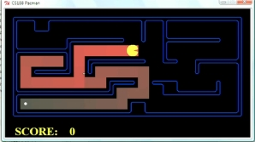
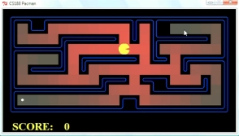
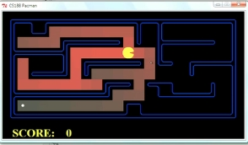
Comparison
Greedy
Uniform Cost
A*

Slide 62
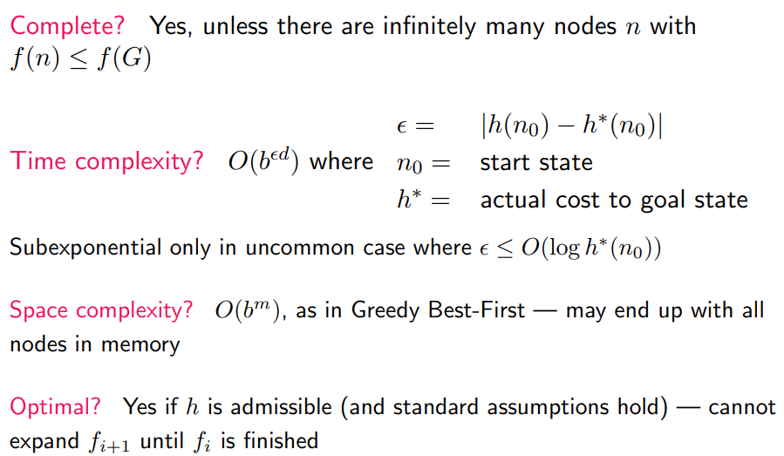
Properties of A*

Slide 63
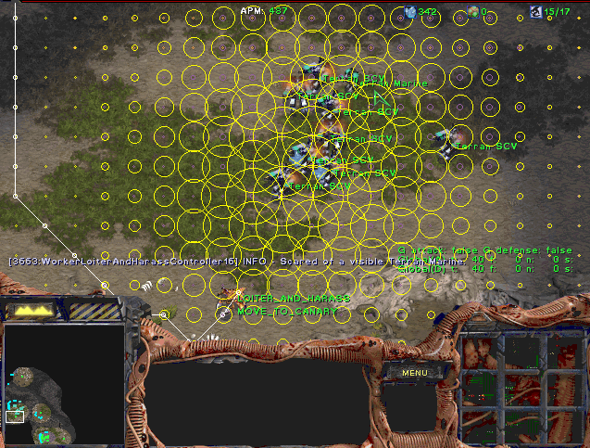
A* Applications

Slide 64
A* Applications
Video games
Pathing / routing problems
Resource planning problems
Robot motion planning
Language analysis
Machine translation
Speech recognition
…
[Demo: UCS / A* pacman tiny maze (L3D6,L3D7)]
[Demo: guess algorithm Empty Shallow/Deep (L3D8)]

Slide 65
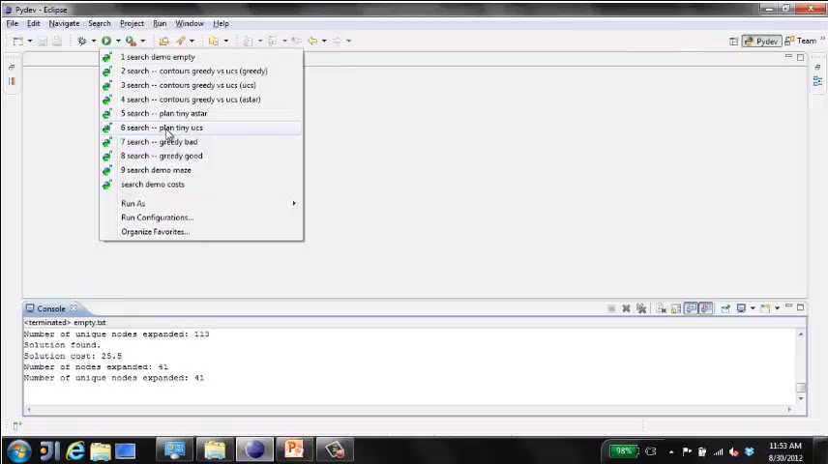
Video of Demo Pacman (Tiny Maze) – UCS / A*

Slide 66
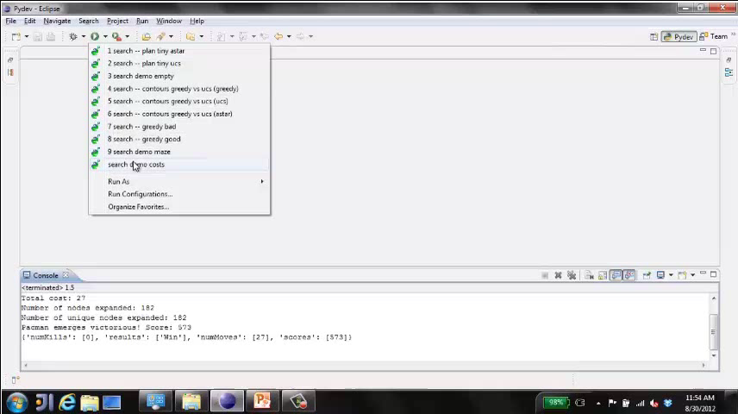
Video of Demo Empty Water Shallow/Deep – Guess Algorithm

Slide 67
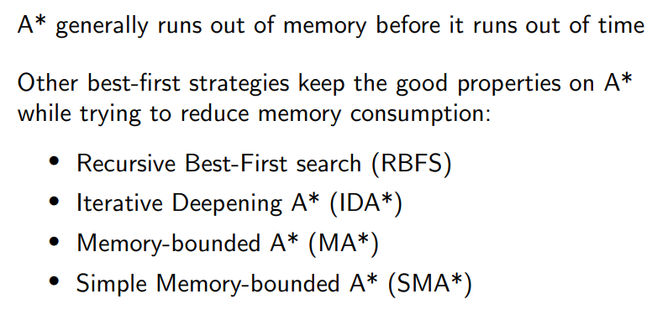
Beyond A*

Slide 68
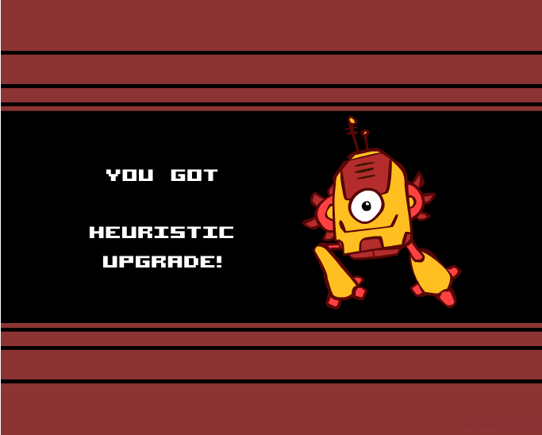
Creating Heuristics

Slide 69
Creating Admissible Heuristics
Most of the work in solving hard search problems optimally is in coming up with admissible heuristics
Often, admissible heuristics are solutions to relaxed problems, where new actions are available
Inadmissible heuristics are often useful too
366
15

Slide 70
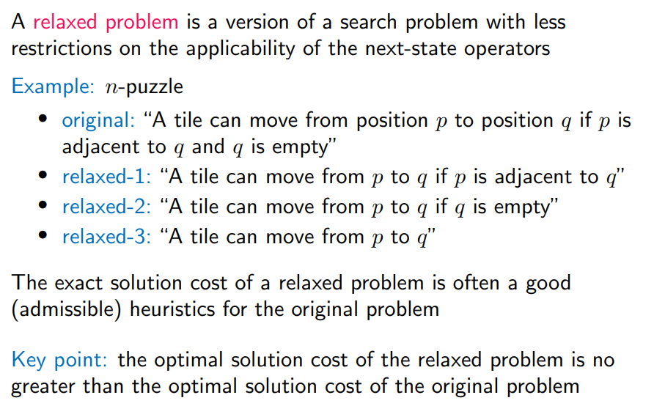
Devising Heuristic Functions

Slide 71
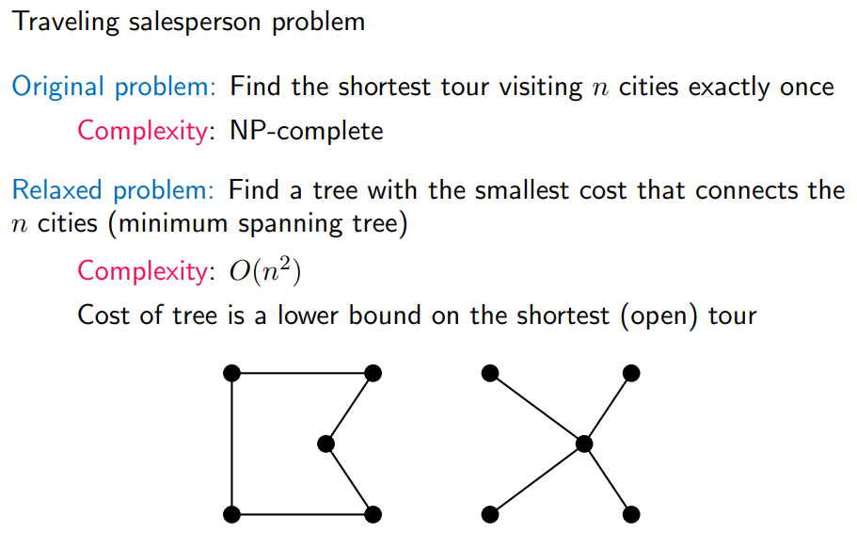
Relaxed Problems: Example

Slide 72
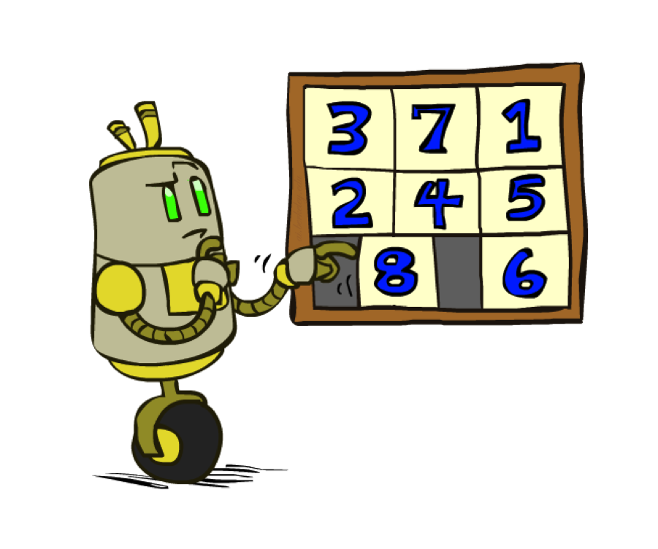
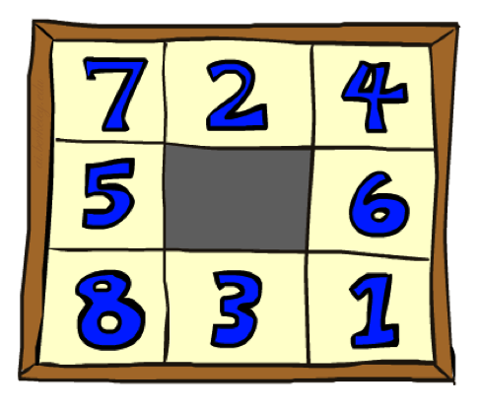
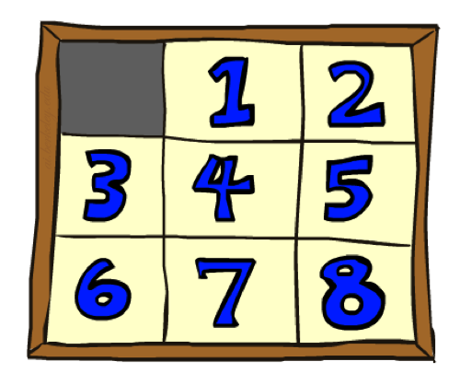
Example: 8 Puzzle
Start State
Actions
Goal State
What are the states?
How many states?
What are the actions?
How many successors from the start state?
What should the costs be?

Slide 73
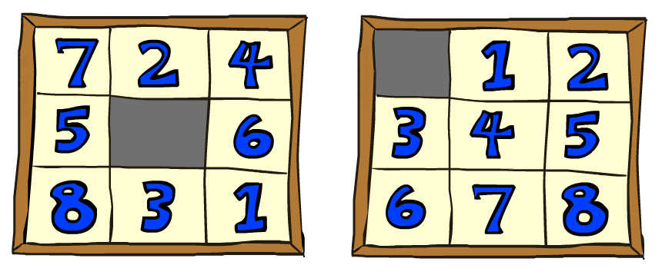
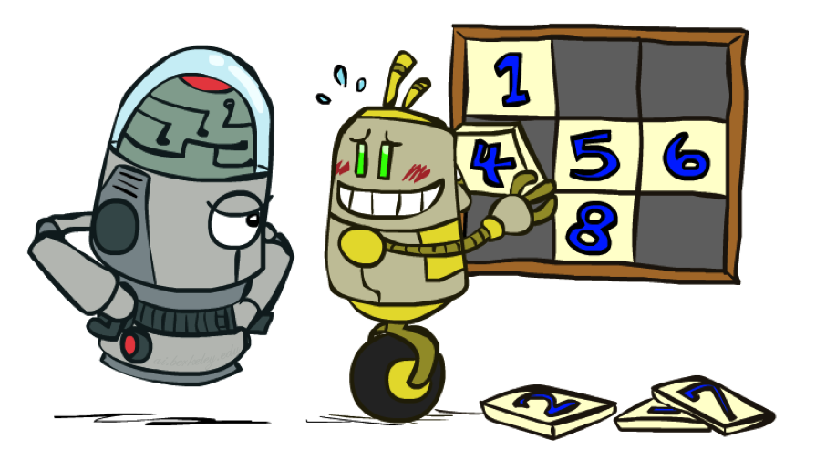
8 Puzzle I
Heuristic: Number of tiles misplaced
Why is it admissible?
h(start) =
This is a relaxed-problem heuristic
8
Start State
Goal State
 | Average nodes expanded when the optimal path has…
 | …4 steps | …8 steps | …12 steps
UCS | 112 | 6,300 | 3.6 x 10⁶
TILES | 13 | 39 | 227
Statistics from Andrew Moore

Slide 74
8 Puzzle II
What if we had an easier 8-puzzle where any tile could slide any direction at any time, ignoring other tiles?
Heuristic: Total Manhattan distance
Why is it admissible?
h(start) =
Start State
Goal State
 | Average nodes expanded when the optimal path has…
 | …4 steps | …8 steps | …12 steps
TILES | 13 | 39 | 227
MANHATTAN | 12 | 25 | 73
3 + 1 + 2 + … = 18

Slide 75
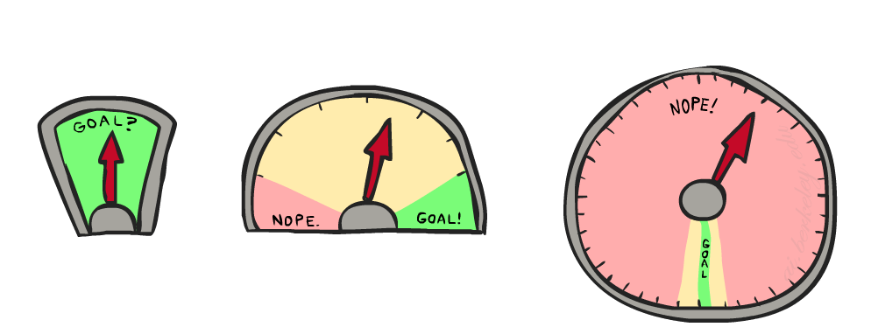
8 Puzzle III
How about using the actual cost as a heuristic?
Would it be admissible?
Would we save on nodes expanded?
What’s wrong with it?
With A*: a trade-off between quality of estimate and work per node
As heuristics get closer to the true cost, you will expand fewer nodes but usually do more work per node to compute the heuristic itself

Slide 76
Semi-Lattice of Heuristics

Slide 77
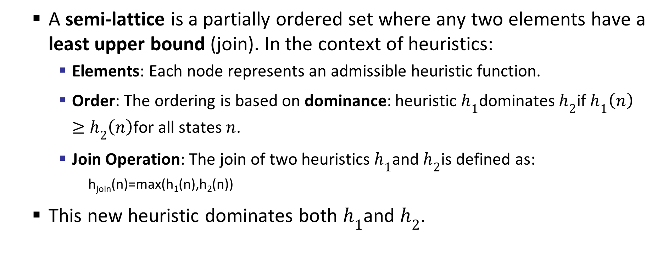
What Is a Semi-Lattice of Heuristics?
A semi-lattice is a partially ordered set where any two elements have a least upper bound (join). In the context of heuristics:
Elements: Each node represents an admissible heuristic function.
Order: The ordering is based on dominance: heuristic $h_{1}$dominates $h_{2}$if $h_{1}\left(n\right)≥h_{2}\left(n\right)$for all states $n$.
Join Operation: The join of two heuristics $h_{1}$and $h_{2}$is defined as:
h_{join}​(n)=max(h₁​(n),h₂​(n))
This new heuristic dominates both $h_{1}$and $h_{2}$.

Slide 78
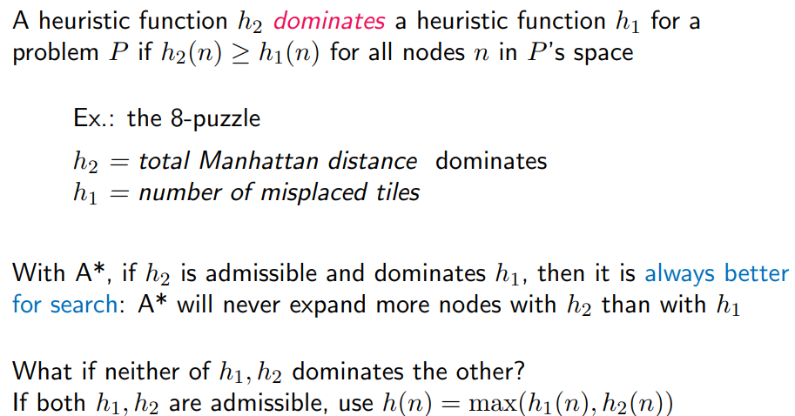
Trivial Heuristics, Dominance

Slide 79
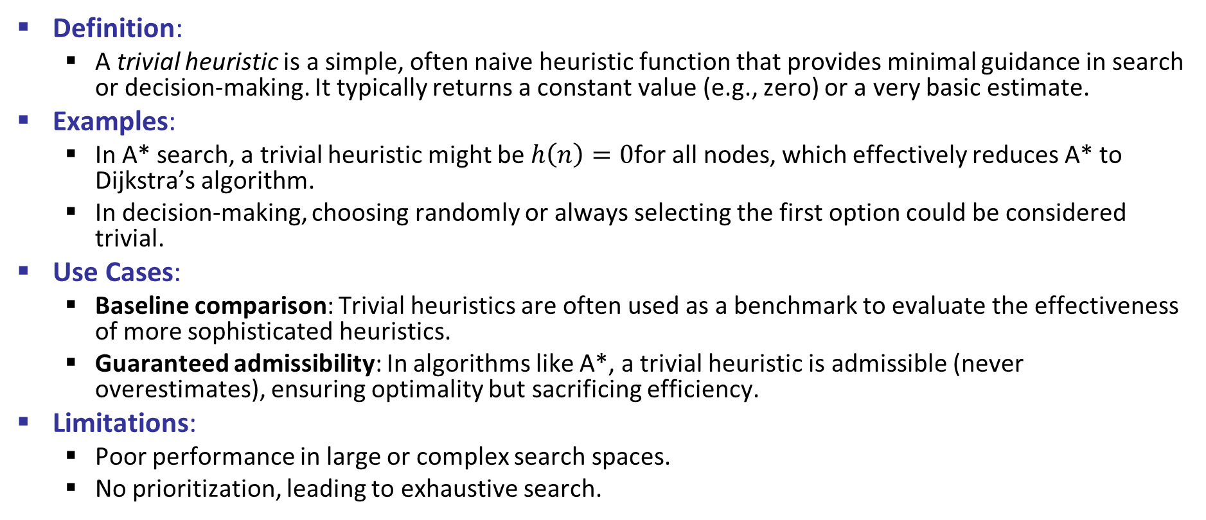
Trivial Heuristics
Definition:
A trivial heuristic is a simple, often naive heuristic function that provides minimal guidance in search or decision-making. It typically returns a constant value (e.g., zero) or a very basic estimate.
Examples:
In A* search, a trivial heuristic might be $h\left(n\right)=0$for all nodes, which effectively reduces A* to Dijkstra’s algorithm.
In decision-making, choosing randomly or always selecting the first option could be considered trivial.
Use Cases:
Baseline comparison: Trivial heuristics are often used as a benchmark to evaluate the effectiveness of more sophisticated heuristics.
Guaranteed admissibility: In algorithms like A*, a trivial heuristic is admissible (never overestimates), ensuring optimality but sacrificing efficiency.
Limitations:
Poor performance in large or complex search spaces.
No prioritization, leading to exhaustive search.

Slide 80







Trivial Heuristics, Dominance
Dominance: h_{a} ≥ h_{c} if
Heuristics form a semi-lattice:
Max of admissible heuristics is admissible
Trivial heuristics
Bottom of lattice is the zero heuristic (what does this give us?)
Top of lattice is the exact heuristic
Notes:
Semi-lattice: x <= y <-> x = x ^ y

Slide 82

Effectiveness of Heuristic Functions
b* value = x
Note: If h₁ dominates h₂, then EFB( h₂ ) ≤ EFB( h₁ )

Slide 83

Dominance and EFB: The 8-puzzle

Slide 84
Devising Heuristic Functions Automatically
Relaxation of formally described problems:
A problem with fewer restrictions on the actions is called a relaxed problem. The cost of an optimal solution to a relaxed problem is an admissible heuristic for the original problem.
Pattern databases:
Admissible heuristics can also be derived from the solution cost of a subproblem of a given problem. The idea behind pattern databases is to store these exact solution costs for every possible Pattern database subproblem instance. Then we compute an admissible heuristic h_{DB} for each state encountered during a search simply by looking up the corresponding subproblem configuration in the database.
Learning :
An alternative is to learn from experience. “Experience” here means solving lots of 8-puzzles, for instance. Each optimal solution to an 8-puzzle problem provides an example (goal, path) pair. From these examples, a learning algorithm can be used to construct a function h that can (with luck) approximate the true path cost for other states that arise during search.

Slide 85

Graph Search

Slide 86
Tree Search vs Graph Search
Tree Search
Does not check for repeated states.
Explores all paths, even if they revisit the same state multiple times.
Can be inefficient and may enter infinite loops in cyclic graphs.
Suitable when the state space is acyclic or small.
Graph Search
Checks for redundant paths by maintaining a record of visited states (usually in a "closed list").
Avoids revisiting the same state, improving efficiency.
Essential for problems with cycles or large state spaces.
Guarantees completeness and optimality (when using admissible heuristics in A*).

Slide 87
Tree Search: Extra Work!
Failure to detect repeated states can cause exponentially more work.
We call a search algorithm a graph search if it checks for redundant paths and a tree-like search if it does not check.
The BEST-FIRST-SEARCH algorithm in Figure 3.7 is a graph search algorithm; if we remove all references to reached we get a treelike search that uses less memory but will examine redundant paths to the same state, and thus will run slower.
State Graph
Search Tree

Slide 88
Graph Search
In BFS, for example, we shouldn’t bother expanding the circled nodes (why?)
S
d
e
p
b
c
e
h
r
q
a
a
h
r
p
q
f
p
q
f
q
c
G
q
c
G
a
a

Slide 89
Graph Search
Idea: never expand a state twice
How to implement:
Tree search + set of expanded states (“closed set”)
Expand the search tree node-by-node, but…
Before expanding a node, check to make sure its state has never been expanded before
If not new, skip it, if new add to closed set
Important: store the closed set as a set, not a list
Can graph search wreck completeness? Why/why not?
How about optimality?

Slide 90
Completeness and Optimality
Can Graph Search Wreck Completeness?
No, graph search does not wreck completeness — if implemented correctly.
Completeness means the algorithm will find a solution if one exists.
In graph search, we avoid revisiting states by keeping a closed list of explored nodes.
If the algorithm uses a complete search strategy (like BFS or A* with an admissible heuristic), and the closed list is managed properly, completeness is preserved.
Can Graph Search Wreck Optimality?
Yes, graph search can wreck optimality — if not carefully managed.
Optimality means the algorithm finds the least-cost solution.
In A*, optimality is guaranteed only if:
The heuristic is admissible (never overestimates).
The heuristic is consistent (monotonic).
The algorithm uses graph search with proper cost comparison.

Slide 91
A* Graph Search Gone Wrong?
State space graph
Search tree
A
S (0+2)
1
S
1
C
h=4
h=1
A (1+4)
B (1+1)
h=2
1
2
B
3
C (2+1)
C (3+1)
h=1
G
G (5+0)
G (6+0)
h=0

Slide 92

Tree Search Pseudo-Code

Slide 93

Graph Search Pseudo-Code

Slide 94
Optimality of A* Graph Search

Slide 95
Optimality of A* Graph Search
Sketch: consider what A* does with a consistent heuristic:
Fact 1: In tree search, A* expands nodes in increasing total f value (f-contours)
Fact 2: For every state s, nodes that reach s optimally are expanded before nodes that reach s suboptimally
Result: A* graph search is optimal
…
f ≤ 1
f ≤ 2
f ≤ 3

Slide 96

Consistent (or Monotonicity) Heuristics
c(n,a,n’): the cost of applying action a in state n to arrive at state n’.

Slide 97
Consistency of Heuristics
Main idea: estimated heuristic costs ≤ actual costs
Admissibility: heuristic cost ≤ actual cost to goal
h(A) ≤ actual cost from A to G
Consistency: heuristic “arc” cost ≤ actual cost for each arc
h(A) – h(C) ≤ cost(A to C)
Consequences of consistency:
The f value along a path never decreases
h(A) ≤ cost(A to C) + h(C)
A* graph search is optimal
A
1
C
h=4
h=1
h=2
3
G

Slide 98

Effectiveness of Heuristic Functions
Effectiveness is typically measured by
how well a heuristic guides the search process toward the goal with minimal computational effort.
The image highlights several important aspects:
1. Admissibility
A heuristic is admissible if it never overestimates the true cost to reach the goal.
Admissibility ensures optimality in algorithms like A*.
2. Consistency (Monotonicity)
A heuristic is consistent if for every node $n$and successor $n^{′}$:
$$h\left(n\right)≤c\left(n , n^{′}\right)+h\left(n^{′}\right)$$
Consistency implies admissibility and helps avoid re-expanding nodes.

Slide 99

Effectiveness of Heuristic Functions
3. Dominance
A heuristic $h_{1}$dominates $h_{2}$if:
$h_{1}\left(n\right)≥h_{2}\left(n\right) \text{for} \text{all} n$
Dominant heuristics are more informed and typically lead to fewer node expansions.
4. Search Efficiency
More effective heuristics reduce the number of nodes expanded.
The image likely shows a graph or table comparing heuristics by:
Number of nodes expanded
Time taken
Memory usage
5. Trade-offs
More informed heuristics may be computationally expensive to compute.
There's a balance between heuristic quality and computational cost.

Slide 100
Optimality
Tree search:
A* is optimal if heuristic is admissible
UCS is a special case (h = 0)
Graph search:
A* optimal if heuristic is consistent
UCS optimal (h = 0 is consistent)
Consistency implies admissibility
In general, most natural admissible heuristics tend to be consistent, especially if from relaxed problems

Slide 101

A*: Summary

Slide 102

A*: Summary
A* uses both backward costs and (estimates of) forward costs
A* is optimal with admissible / consistent heuristics
Heuristic design is key: often use relaxed problems

Slide 103
Example
http://qiao.github.io/PathFinding.js/visual/

