Slide 1
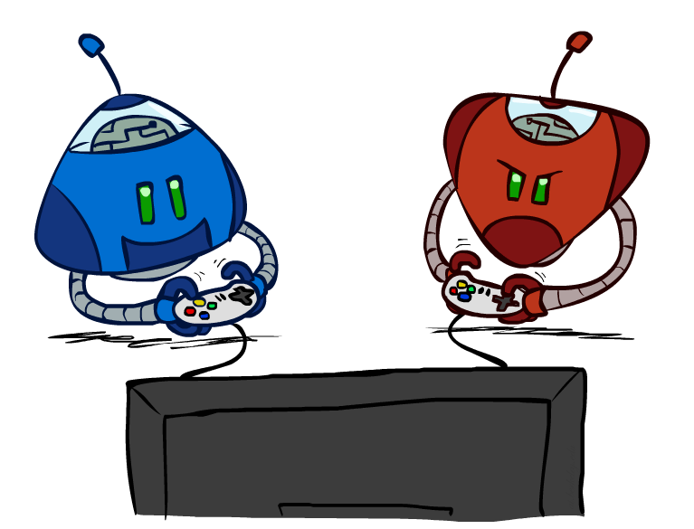
COE 4213564
Introduction to Artificial Intelligence
Adversarial Search
Many slides are adapted from CS 188 (http://ai.berkeley.edu), CS 322, CIS 521, CS 221, CS182, CS4420.
Notes:
Please retain proper attribution, including the reference to ai.berkeley.edu. Thanks!

Slide 2
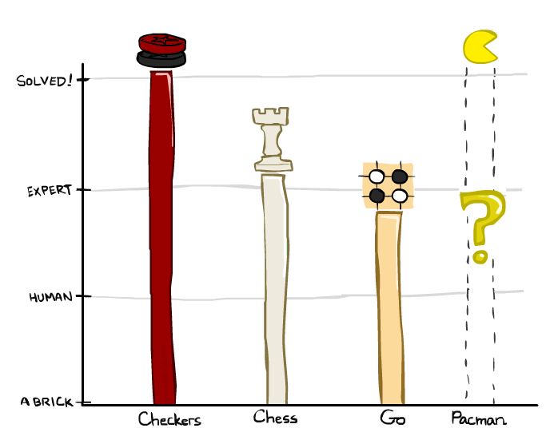
Game Playing State-of-the-Art
Checkers: 1950: First computer player. 1994: First computer champion: Chinook ended 40-year-reign of human champion Marion Tinsley using complete 8-piece endgame. 2007: Checkers solved!
https://en.wikipedia.org/wiki/Checkers
- Solved means you can force to win or draw if you play optimally.
Chess: 1997: Deep Blue defeats human champion Gary Kasparov in a six-game match. Deep Blue examined 200M positions per second, used very sophisticated evaluation and undisclosed methods for extending some lines of search up to 40 ply. Current programs are even better, if less historic.
https://en.wikipedia.org/wiki/Chess
Go: Human champions are now starting to be challenged by machines. In go, b > 300! Classic programs use pattern knowledge bases, but big recent advances use Monte Carlo (randomized) expansion methods.
https://en.wikipedia.org/wiki/Go_(game)

Slide 3

Game Playing State-of-the-Art
Checkers: 1950: First computer player. 1994: First computer champion: Chinook ended 40-year-reign of human champion Marion Tinsley using complete 8-piece endgame. 2007: Checkers solved!
Chess: 1997: Deep Blue defeats human champion Gary Kasparov in a six-game match. Deep Blue examined 200M positions per second, used very sophisticated evaluation and undisclosed methods for extending some lines of search up to 40 ply. Current programs are even better, if less historic.
Go: 2016: Alpha GO defeats human champion. Uses Monte Carlo Tree Search, learned evaluation function.
Pacman

Slide 4
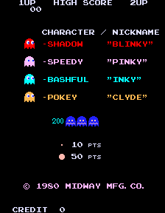
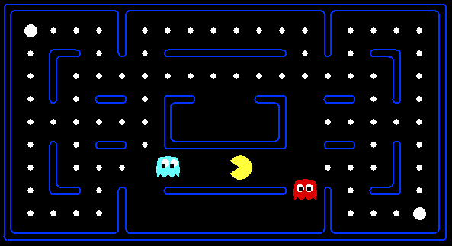
Behavior from Computation
Pac-man — The Protagonist
Inky and Clyde — The Antagonists
Pellet — The food source of our hungry friend
Power Pellet — the object that renders Pac-man’s adversaries edible.
Blinky, Pinky, Inky and Clyde, collectively known as the Ghost Gang, are a quartet of characters from the Pac-Man video game franchise. Created by Toru Iwatani, they first appear in the 1980 arcade game Pac-Man as the main antagonists.
Demo: Pacman eating food pellets, avoiding ghosts, eating power pellets and then eating ghosts and getting extra score.
[Demo: mystery pacman (L6D1)]

Slide 5

Video of Demo Mystery Pacman

Slide 6
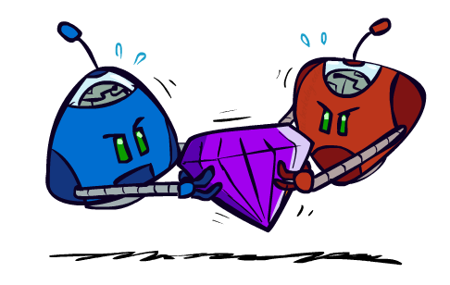
Adversarial Games

Slide 7
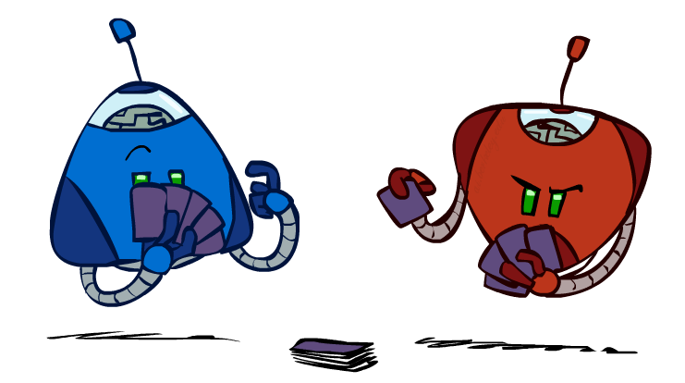
Types of Games
Many different kinds of games!
  How to categorize?
Axes:
  Deterministic or stochastic?
  Deteministic ex: Checkers, Chess
  Stocastic ex: backgammon (throw a dice)
  One, two, or more players?
  Zero sum? (All playing against each other)
  Perfect information (can you see the state)?
  Do you know everything about the current situation of the game? Chess: Yes; Poker: No (don’t know other player’s cards.)
Want algorithms for calculating a strategy (policy) which recommends a move from each state
By considering an opponent that we don’t control

Slide 8
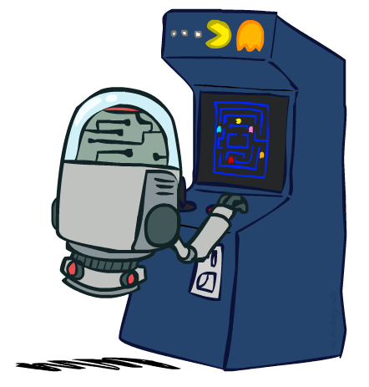
Deterministic Games
Many possible formalizations, one is:
  States: S (start at s₀)
  Players: P={1...N} (usually take turns)
  Actions: A (may depend on player / state)
  Transition Function: SxA → S
  Terminal Test: S → {t,f}
  Terminal Utilities: SxP → R
  (Every outcome of the game will be
  scored like win, lose, draw, amount of money,
  numerical score)
Solution for a player is a policy: S → A

Slide 9
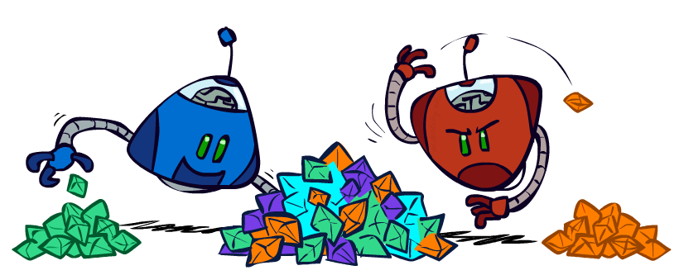
Zero-Sum Games
Zero-Sum Games
  Agents have opposite utilities (values on outcomes)
  - one agent gets it other one doesn’t get it
  Lets us think of a single value that one maximizes and the other minimizes
  “zero-sum” means that what is good for one player is just as bad for the other: there is no “win-win” outcome
  Adversarial, pure competition
General Games
  Agents have independent utilities (values on outcomes)
  Ex: Blue agent collect green jewels and red one collect orange jewels by helping each other.
  Cooperation, indifference, competition, and more are all possible
  More later on non-zero-sum games

Slide 10
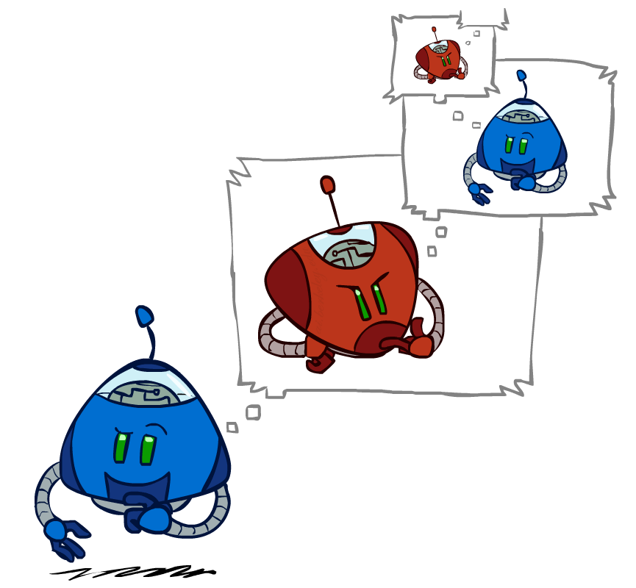
Adversarial Search
- For zero-sum games, we use approach adverserial search.
- Competitive environments, in which two or more agents have conflicting goals, giving rise to adversarial search problems

Slide 11
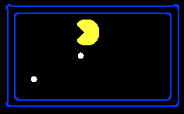
Single-Agent Trees
We define the complete game tree as a
search tree that follows every sequence of moves all the way to a terminal state.
8
2
0
…
2
6
…
4
6
Let’s look at first to single-agent trees and generalize it to two-agent trees.
Pacman trying to eat food pellets; actions : east and west
Utility function: -1 for every steps taken; +10 for every pellets eaten

Slide 12
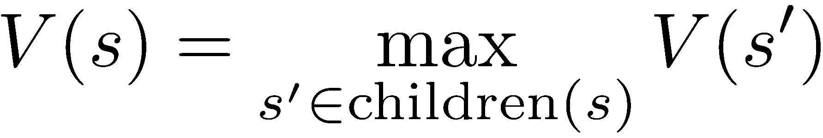
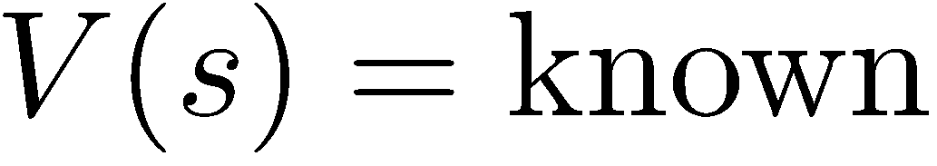
Value of a State for Single-Agent
Value of a state: The best achievable outcome (utility) from that state
Non-Terminal States:
8
6
8
8
2
0
…
2
6
…
4
6
Terminal States:

Slide 13

Adversarial Game Trees
Generalize to adversarial Games:
Pacman against to ghost
Moves in turn
At the end, get
a high score
a low score
-20
-8
…
-18
-5
…
-10
+4
-20
+8

Slide 14
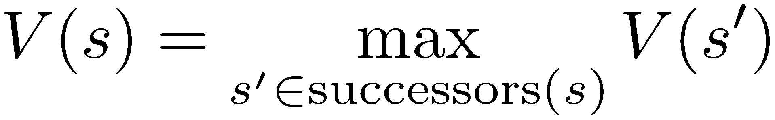
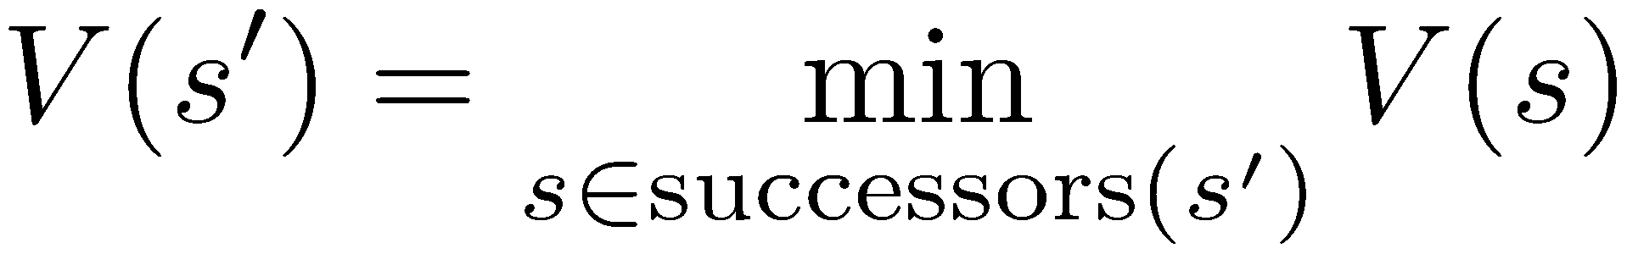
Minimax Values
States Under Agent’s Control:
States Under Opponent’s Control:
Pacman
- Assume that game is over after each player makes a move.
- Packman tries to maximize while ghost tries to minimize utility scores
-8
Ghost
-8
-10
-8
-5
-10
+8
Terminal States:

Slide 15

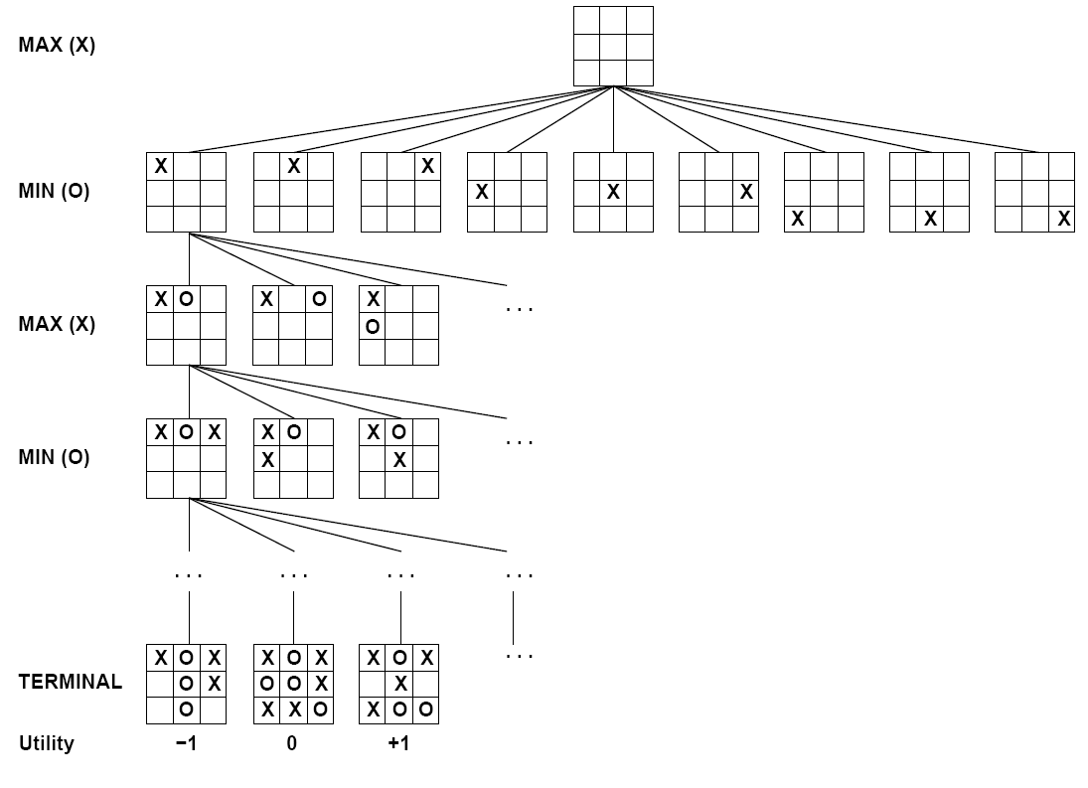

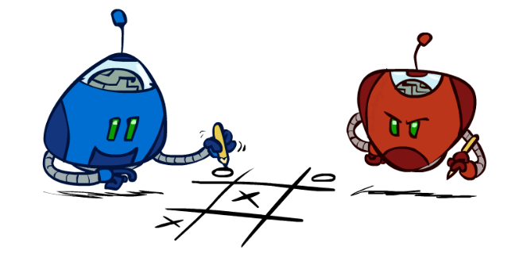
Tic-Tac-Toe Game Tree
1 (win), 0 (end in a draw), -1(lose)
The top node is the initial state, and MAX moves first, placing an X in an empty square. We show part of the tree, giving alternating moves by MIN (O) and MAX (X), until we eventually reach terminal states, which can be assigned utilities according to the rules of the game.
MAX prefers to move to a state of maximum value when it is MAX’s turn to move, and MIN prefers a state of minimum value (that is, minimum value for MAX and thus maximum value for MIN)
For tic-tac-toe the game tree is relatively small—fewer than 9!=362;880 terminal nodes (with only 5,478 distinct states).
But for chess there are over 10^40 nodes, so the game tree is best thought of as a theoretical construct that we cannot realize in the physical world.
For tic-tac-toe, if both player play optimally, the result will be a tie (draw).

Slide 16
Adversarial Search (Minimax)
Deterministic, zero-sum games:
  Tic-tac-toe, chess, checkers
  One player maximizes result
  The other minimizes result
Minimax search:
  Make a state-space search tree
  Players alternate turns
  Compute each node’s minimax value: the best achievable utility against a rational (optimal) adversary
Minimax values:
computed recursively
5
max
2
5
min
Game will be played out by following these states
8
2
5
6
Terminal values:
part of the game

Slide 17


Slide 18
Minimax Implementation
def max-value(state):
  initialize v = -∞
  for each successor of state:
    v = max(v, min-value(successor))
  return v
def min-value(state):
  initialize v = +∞
  for each successor of state:
    v = min(v, max-value(successor))
  return v

Slide 19
Minimax Implementation (Dispatch)
def value(state):
  if the state is a terminal state: return the state’s utility
  if the next agent is MAX: return max-value(state)
  if the next agent is MIN: return min-value(state)
Base Case for recursion
def max-value(state):
  initialize v = -∞
  for each successor of state:
    v = max(v, value(successor))
  return v
def min-value(state):
  initialize v = +∞
  for each successor of state:
    v = min(v, value(successor))
  return v
Notes:
Pick an order for two reasons: sequential processor and pruning

Slide 20
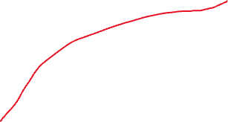
Minimax Example
3
MAXIMIZER
MİNIMIZER
3
2
2
3
12
8
2
4
6
14
5
2
Solution Path

Slide 21
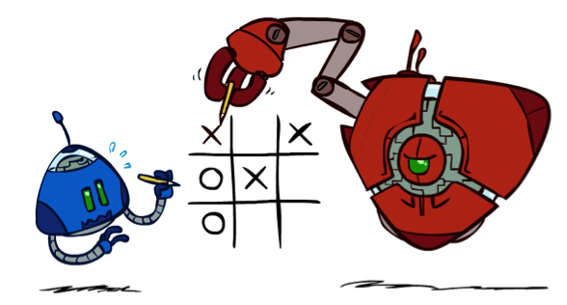
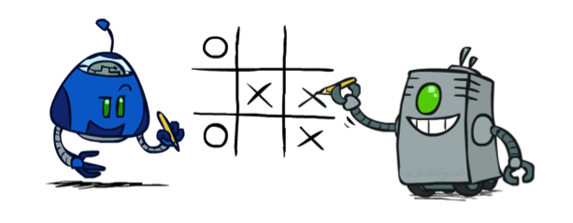


Minimax Properties
10
max
min
Optimal
Path
Not Optimal
10
10
9
100
Optimal against a perfect player. Otherwise?
Player may do mistakes. Not optimal, then select a different path stochastically.
Demo 1: Min score by eaten by ghost in one step. (Minmax solution)
Demo 2: Not smart, taking random actions and takes risks. It might give better solutions at different runs.
[Demo: min vs exp (L6D2, L6D3)]

Slide 22
Video of Demo Min vs. Exp (Min)

Slide 23
Video of Demo Min vs. Exp (Exp)

Slide 24
Minimax Efficiency

Slide 25
Minimax Efficiency
How efficient is minimax?
  Just like (exhaustive) DFS
  Time: O(b^{m})
  Space: O(bm)
Example: For chess, b ≈ 35, m ≈ 100
  Exact solution is completely infeasible
  But, do we need to explore the whole tree?

Slide 26

Resource Limits
We can not explore the entire game tree because of finite computing power

Slide 27
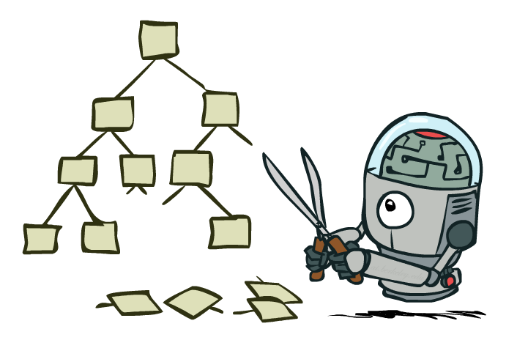
Game Tree Pruning
The number of game states is exponential in the depth of the tree.
No algorithm can completely eliminate the exponent,
But we can sometimes cut it in half, computing the correct minimax decision without examining every state by pruning large parts of the tree that make no difference to the outcome.
The particular technique we examine is called alpha–beta pruning.

Slide 28
Alpha-Beta Pruning
Alpha-Beta Pruning is a search optimization technique used in decision-making algorithms, especially in two-player games like chess, checkers, or tic-tac-toe. It improves the efficiency of the Minimax algorithm by eliminating branches of the game tree that don’t need to be explored.
Core Idea:
Minimax Algorithm: Evaluates possible moves by simulating all future plays, assuming both players play optimally.
Problem: Exploring the entire game tree is computationally expensive.
Solution (Alpha-Beta Pruning): Skip branches that cannot possibly affect the final decision.
Key Concepts:
Alpha (α): Best value that the maximizer (player trying to maximize score) can guarantee so far.
Beta (β): Best value that the minimizer (player trying to minimize score) can guarantee so far.
Pruning Rule:
  If at any point α ≥ β, further exploration of that branch is unnecessary because the opponent will never allow that path to be chosen.

Slide 29
Minimax Pruning
3
3
2
3
12
8
2
14
5
2
Maximizer will not select any nodes that has values less than 3, skip (prune) these nodes.

Slide 30
Alpha-Beta Pruning
General configuration (MIN version)
  We’re computing the MIN-VALUE at some node n
  We’re looping over n’s children
  n’s estimate of the childrens’ min is dropping
  Who cares about n’s value? MAX
  Let a be the best value that MAX can get at any choice point along the current path from the root
  If n becomes worse than a, MAX will avoid it, so we can stop considering n’s other children (it’s already bad enough that it won’t be played)
MAX version is symmetric
MAX
MIN
a
MAX
MIN
n

Slide 31
Alpha-Beta Pruning

Slide 32
Alpha-Beta Pruning
we can infer that the value of the root is at least 3.

Slide 33
Alpha-Beta Implementation
  α: MAX’s best option on path to root
  β: MIN’s best option on path to root
def max-value(state, α, β):
  initialize v = -∞
  for each successor of state:
    v = max(v, value(successor, α, β))
    if v ≥ β return v
    α = max(α, v)
  return v
def min-value(state , α, β):
  initialize v = +∞
  for each successor of state:
    v = min(v, value(successor, α, β))
    if v ≤ α return v
    β = min(β, v)
  return v
Notes:
Pick an order for two reasons: sequential processor and pruning

Slide 34
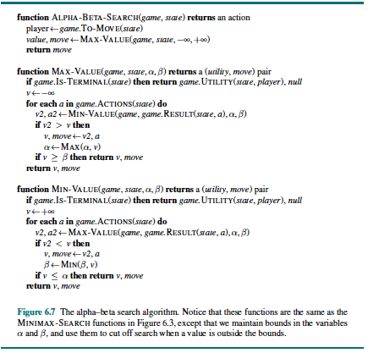
Alpha-Beta Implementation

Slide 35
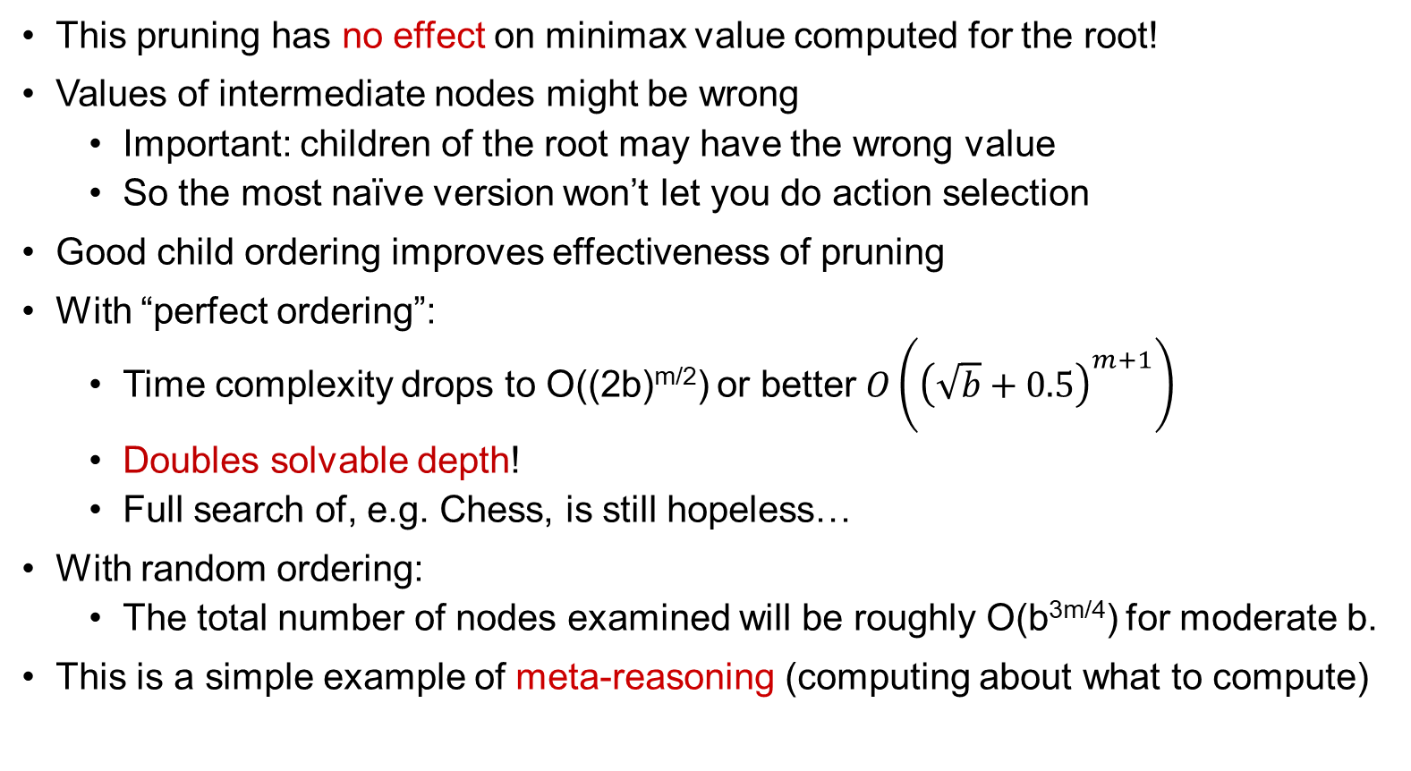
Alpha-Beta Pruning Properties
This pruning has no effect on minimax value computed for the root!
Values of intermediate nodes might be wrong
  Important: children of the root may have the wrong value
  So the most naïve version won’t let you do action selection
Good child ordering improves effectiveness of pruning
With “perfect ordering”:
  Time complexity drops to O((2b)^{m/2}) or better $O\left({\left(\sqrt{b}+0.5\right)}^{m+1}\right)$
  Doubles solvable depth!
  Full search of, e.g. Chess, is still hopeless…
With random ordering:
  The total number of nodes examined will be roughly O(b^{3m/4}) for moderate b.
This is a simple example of meta-reasoning (computing about what to compute)
max
min
10
10
0

Slide 36
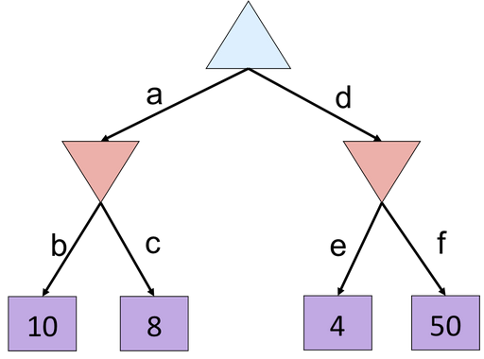


Alpha-Beta Quiz
8
4
8

Slide 37
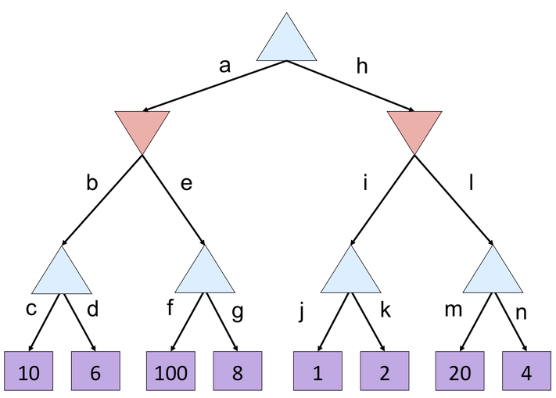
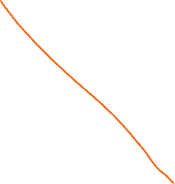

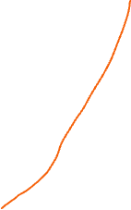

Alpha-Beta Quiz 2
10
10
2
100
2
20
10

Slide 38
Resource Limits
We can not explore the entire game tree because of finite computing power.

Slide 39
Minimax with depth limits
3
12
8
2
4
6
14
5
2
To make use of our limited computation time, we can cut off the search early and apply a heuristic evaluation function to states, effectively treating nonterminal nodes as if they were terminal.
Why Cut Off the Search?
The exponential growth of the game tree makes it computationally infeasible to search all the way to terminal states (i.e., checkmate or draw) in most positions. So instead, engines:
  Set a depth limit (e.g., 20 plies).
  Stop expanding nodes once this depth is reached.
  Apply a heuristic evaluation function to estimate the value of the position at that point.

Slide 40
Resource Limits
Problem: In realistic games, cannot search to leaves!
Another Solution: Depth-limited search
  Instead, search only to a limited depth in the tree
  Replace terminal utilities with an evaluation function for non-terminal positions
Example:
  Suppose we have 100 seconds, can explore 10K nodes / sec
  So can check 1M nodes per move
  α-β reaches about depth 8 – decent chess program
Guarantee of optimal play is gone
More plies makes a BIG difference
Another method: Use iterative deepening for an anytime algorithm where you go level by level depending on your computing power.
max
4
-2
4
min
-1
-2
4
9
?
?
?
?

Slide 41
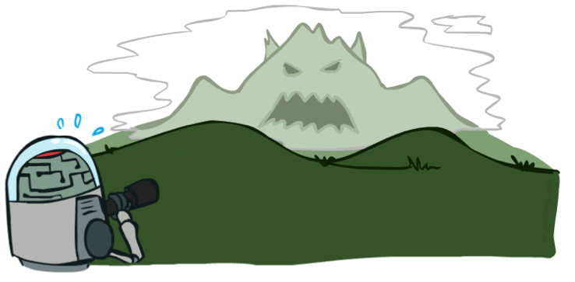

Depth Matters
Evaluation functions are always imperfect
The deeper in the tree the evaluation function is buried, the less the quality of the evaluation function matters
An important example of the tradeoff between complexity of features and complexity of computation
Better evaluation functions requires more time and produces better results by going deeper levels of the search tree
Demo 1: evaluation function with 2 levels of depth
Demo 1: evaluation function with 10 levels of depth
[Demo: depth limited (L6D4, L6D5)]

Slide 42
Video of Demo Thrashing (depth d=2)
In the context of game search, thrashing refers to a situation where the search algorithm repeatedly revisits the same states or performs redundant computations, wasting time and resources instead of making progress toward a better solution.
[Demo: thrashing d=2, thrashing d=2 (fixed evaluation function) (L6D6)]

Slide 43
A danger of replanning agents
Replanning agents are AI systems that continuously update their plan based on changes in the environment or new information. While this makes them adaptive, it introduces a potential danger:
Main Danger: Infinite Replanning (Oscillation)
If the environment changes frequently or the agent keeps finding slightly better plans, it may never execute any plan fully.
The agent spends all its time planning instead of acting, leading to thrashing or starvation of action.

Slide 44
Why Pacman Starves
A danger of replanning agents!
  He knows his score will go up by eating the dot now (west, east)
  He knows his score will go up just as much by eating the dot later (east, west)
  There are no point-scoring opportunities after eating the dot (within the horizon, two here)
  Therefore, waiting seems just as good as eating: he may go east, then back west in the next round of replanning!

Slide 45
Video of Demo Thrashing -- Fixed (d=2)
[Demo: thrashing d=2, thrashing d=2 (fixed evaluation function) (L6D7)]

Slide 46
heuristics with Alpha-Beta
Why combine heuristics with Alpha-Beta?
Full search is impossible for complex games.
Heuristics allow the algorithm to make reasonable decisions within time limits.
Alpha-Beta ensures fewer nodes are explored, speeding up the search.

Slide 47

Heuristic Alpha-Beta Tree Search
To make use of our limited computation time, we can cut off the search early and apply a heuristic evaluation function to states, effectively treating nonterminal nodes as if they were terminal.
In other words, we replace the UTILITY function with EVAL, which estimates a state’s utility.
  UTILITY(s): The true payoff or value of a state s if it is a terminal state (end of the game).
  EVAL(s) : A heuristic estimate of the value of state s when the search cannot reach a terminal state (due to depth limit or time constraints).
We also replace the terminal test by a cutoff test, which must return true for terminal states, but is otherwise free to decide when to cut off the search, based on the search depth and any property of the state that it chooses to consider.
That gives us the formula H-MINIMAX(s, d) for the heuristic minimax value of state s at search depth d

Slide 48
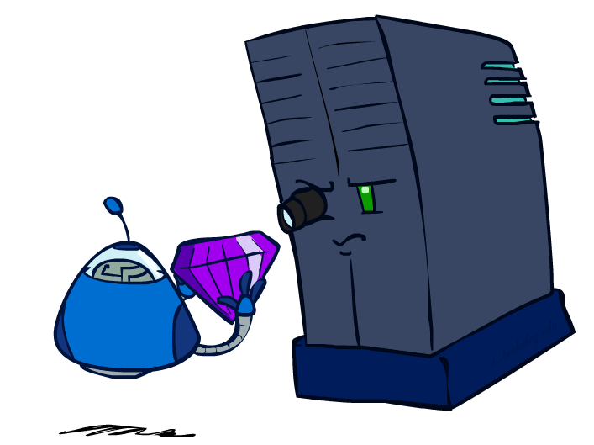
Evaluation Functions
A heuristic evaluation function EVAL(s; p) returns an estimate of the expected utility of state s to player p, just as the heuristic functions of Chapter 3 return an estimate of the distance to the goal.
For terminal states, it must be that
  EVAL(s; p)=UTILITY(s; p) and
For nonterminal states, the evaluation must be somewhere between a loss and a win:
UTILITY(loss; p) EVAL(s; p) UTILITY(win; p).

Slide 49
Evaluation Functions
Beyond those requirements, what makes for a good evaluation function? First, the computation must not take too long! (The whole point is to search faster.)
Second, the evaluation function should be strongly correlated with the actual chances of winning.
One might well wonder about the phrase “chances of winning.”
For example,
  chess is not a game of chance: we know the current state with certainty, and no dice are involved; if neither player makes a mistake, the outcome is predetermined.
  But if the search must be cut off at nonterminal states, then the algorithm will necessarily be uncertain about the final outcomes of those states (even though that uncertainty could be resolved with infinite computing resources).

Slide 50
Evaluation Functions : Features
Most evaluation functions work by calculating Features various features of the state—
for example, in chess, we would have features for
  the number of white pawns,
  black pawns, white queens,
  black queens, and so on.
The features, taken together, define various categories or equivalence classes of states: the states in each category have the same values for all the features.
In principle, the expected value can be determined for each category of states, resulting in an evaluation function that works for any state. In practice, this kind of analysis requires too many categories and hence too much experience to estimate all the probabilities.
Instead, most evaluation functions compute separate numerical contributions from each feature and then combine them to find the total value

Slide 51
Evaluation Functions
Evaluation functions score non-terminals in depth-limited search
Ideal function: returns the actual minimax value of the position
In practice: typically weighted linear sum of features:
e.g. f₁(s) = (num white queens – num black queens), etc.

Slide 52




Evaluation for Pacman
- Check evaluation function, change the evaluation or your institution if it does not produce good results.
- Find smart evaluation functions.
[Demo: thrashing d=2, thrashing d=2 (fixed evaluation function), smart ghosts coordinate (L6D6,7,8,10)]

Slide 53
Video of Demo Smart Ghosts (Coordination)

Slide 54
Video of Demo Smart Ghosts (Coordination) – Zoomed In

Slide 55
Video of Demo: Limited Depth (2)

Slide 56
Video of Demo: Limited Depth (10)

Slide 57
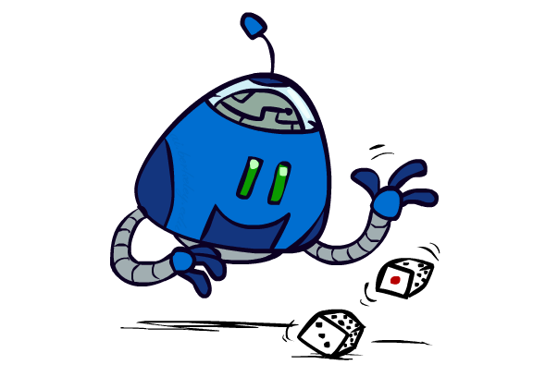
Uncertain Outcomes

Slide 58


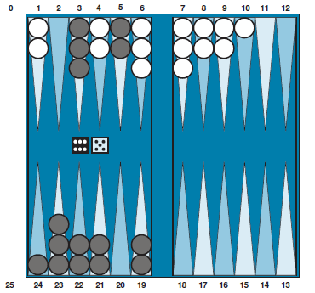
Worst-Case vs. Average Case
Idea: Uncertain outcomes controlled by chance, not an adversary!
max
min
10
10
9
100
Stochastic games bring us a little closer to the unpredictability of real life by including a random element, such as the throwing of dice.
Backgammon is a typical stochastic game that combines luck and skill.
-Agent(s) don’t play optimal. They plays stochastically
  Agent may throw a dice for a move
  Agent not so clever
-Add chance nodes (circles)
-Find the weighted average for chance
-We can calculate the expected value of a position: the average over all Expected value possible outcomes of the chance nodes.
Notes:
At least 10, or otherwise just rather dead; or just 100, or otherwise rather dead; that’s yet something different than minimax or expectimax

Slide 59
Expectimax Search
Why wouldn’t we know what the result of an action will be?
  Explicit randomness: rolling dice
  Unpredictable opponents: the ghosts respond randomly
  Actions can fail: when moving a robot, wheels might slip
Values should now reflect average-case (expectimax) outcomes, not worst-case (minimax) outcomes
Expectimax search: compute the average score under optimal play
  Max nodes as in minimax search
  Chance nodes are like min nodes but the outcome is uncertain
  Calculate their expected utilities
  I.e. take weighted average (expectation) of children
Later, we’ll learn how to formalize the underlying uncertain-result problems as Markov Decision Processes
max
chance
10
10
4
10
5
9
7
100
[Demo: min vs exp (L7D1,2)]

Slide 60
Video of Demo Minimax vs Expectimax (Min)

Slide 61
Video of Demo Minimax vs Expectimax (Exp)

Slide 62
Expectimax Pseudocode
def value(state):
  if the state is a terminal state: return the state’s utility
  if the next agent is MAX: return max-value(state)
  if the next agent is EXP: return exp-value(state)
def max-value(state):
  initialize v = -∞
  for each successor of state:
    v = max(v, value(successor))
  return v
def exp-value(state):
  initialize v = 0
  for each successor of state:
  p = probability(successor)
    v += p * value(successor)
  return v
Notes:
Pick an order for two reasons: sequential processor and pruning

Slide 63
Expectimax Pseudocode
def exp-value(state):
  initialize v = 0
  for each successor of state:
  p = probability(successor)
    v += p * value(successor)
  return v
1/2
1/6
1/3
5
8
7
24
-12
v = (1/2) (8) + (1/3) (24) + (1/6) (-12) = 10

Slide 64
Expectimax Example
8
8
4
7
3
12
9
2
4
6
15
6
0
Assume that all probablities are equal

Slide 65
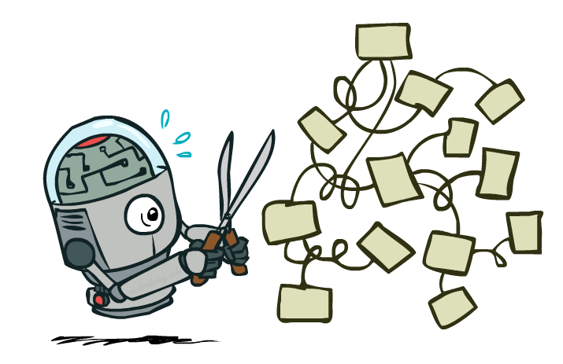
Expectimax Pruning?
3
12
9
2
Can we apply pruning ? No.
The last value in a node can be very large and change the average.

Slide 66
Depth-Limited Expectimax
Stop earlier without going to all the way to the bottom.
You need a good evaluation function that gives you an approximate value (estimate)
Estimate of true expectimax value (which would require a lot of work to compute)
400
300
…
…
492
362
…

Slide 67
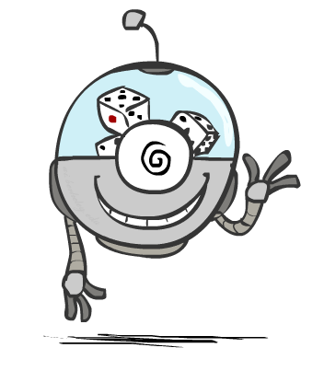
Probabilities

Slide 68
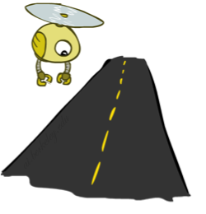
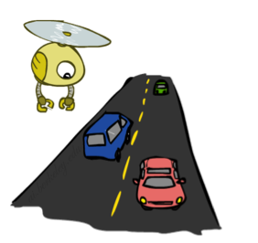
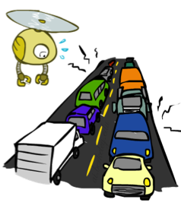
Reminder: Probabilities
A random variable represents an event whose outcome is unknown
A probability distribution is an assignment of weights to outcomes
Example: Traffic on freeway
  Random variable: T = whether there’s traffic
  Outcomes: T in {none, light, heavy}
  Distribution: P(T=none) = 0.25, P(T=light) = 0.50, P(T=heavy) = 0.25
Some laws of probability (more later):
  Probabilities are always non-negative
  Probabilities over all possible outcomes sum to one
As we get more evidence, probabilities may change:
  P(T=heavy) = 0.25, P(T=heavy | Hour=8am) = 0.60
  We’ll talk about methods for reasoning and updating probabilities later
0.25
0.50
0.25

Slide 69
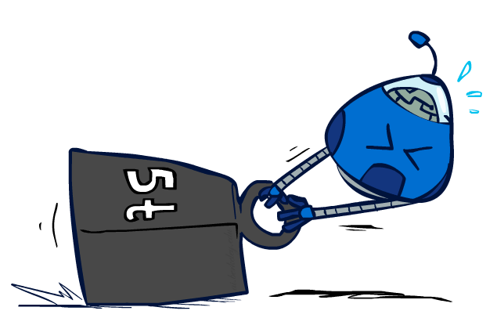
Reminder: Expectations
The expected value of a function of a random variable is the average, weighted by the probability distribution over outcomes
Example: How long to get to the airport?
Time:
20 min
30 min
60 min
+
+
35 min
x
x
x
Probability:
0.25
0.50
0.25

Slide 70
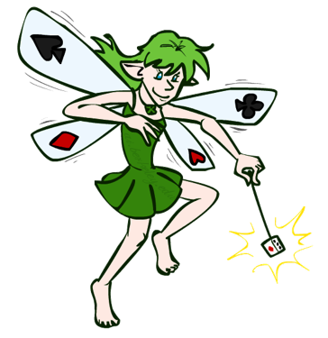
What Probabilities to Use?
In expectimax search, we have a probabilistic model of how the opponent (or environment) will behave in any state
  Model could be a simple uniform distribution (roll a die)
  Model could be sophisticated and require a great deal of computation
  We have a chance node for any outcome out of our control: opponent or environment
  The model might say that adversarial actions are likely!
For now, assume each chance node magically comes along with probabilities that specify the distribution over its outcomes
Having a probabilistic belief about another agent’s action does not mean that the agent is flipping any coins!

Slide 71
Quiz: Informed Probabilities
Let’s say you know that your opponent is actually running a depth 2 minimax, using the result 80% of the time, and moving randomly otherwise
Question: What tree search should you use?
Answer: Expectimax!
  To figure out EACH chance node’s probabilities, you have to run a simulation of your opponent
  This kind of thing gets very slow very quickly
  Even worse if you have to simulate your opponent simulating you…
  … except for minimax, which has the nice property that it all collapses into one game tree
0.1 0.9

Slide 72
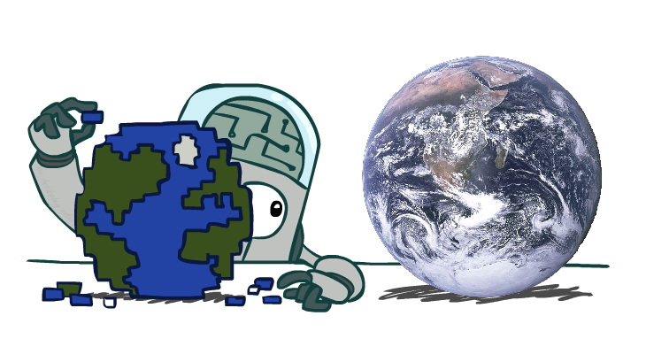
Modeling Assumptions

Slide 73
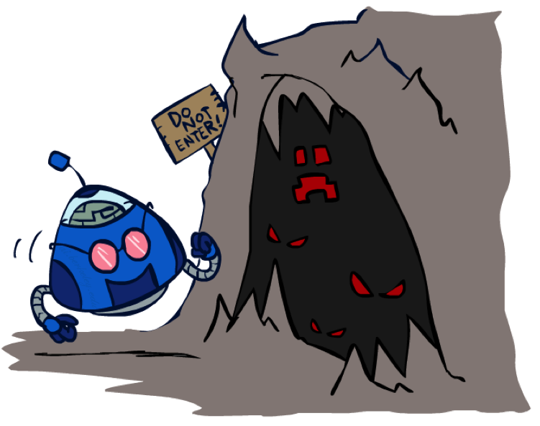
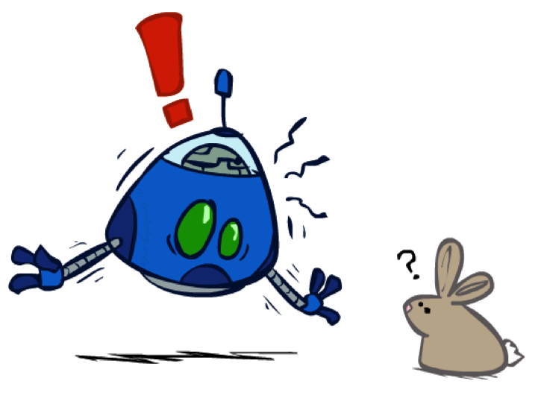
The Dangers of Optimism and Pessimism
Dangerous Optimism
Assuming chance when the world is adversarial
Dangerous Pessimism
Assuming the worst case when it’s not likely

Slide 74
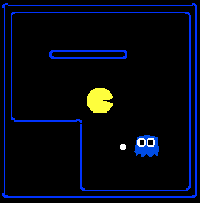
Assumptions vs. Reality
 | Adversarial Ghost | Random Ghost
Minimax Pacman | Won 5/5 Avg. Score: 483 | Won 5/5 Avg. Score: 493
Expectimax Pacman | Won 1/5 Avg. Score: -303 | Won 5/5 Avg. Score: 503
Results from playing 5 games
Pacman used depth 4 search with an eval function that avoids trouble
Ghost used depth 2 search with an eval function that seeks Pacman
[Demos: world assumptions (L7D3,4,5,6)]
Notes:
python pacman.py -g SmartGhost -l trapped2 -p ExpectimaxAgent -a depth=4,evalFn=better

Slide 75
Assumptions vs. Reality
 | Adversarial Ghost | Random Ghost
Minimax Pacman | Won 5/5 Avg. Score: 483 | Won 5/5 Avg. Score: 493
Expectimax Pacman | Won 1/5 Avg. Score: -303 | Won 5/5 Avg. Score: 503
Results from playing 5 games
Pacman used depth 4 search with an eval function that avoids trouble
Ghost used depth 2 search with an eval function that seeks Pacman
[Demos: world assumptions (L7D3,4,5,6)]
Notes:
python pacman.py -g SmartGhost -l trapped2 -p ExpectimaxAgent -a depth=4,evalFn=better

Slide 76
Video of Demo World Assumptions
Random Ghost – Expectimax Pacman

Slide 77
Video of Demo World Assumptions
Adversarial Ghost – Minimax Pacman

Slide 78
Video of Demo World Assumptions
Adversarial Ghost – Expectimax Pacman

Slide 79
Video of Demo World Assumptions
Random Ghost – Minimax Pacman

Slide 80
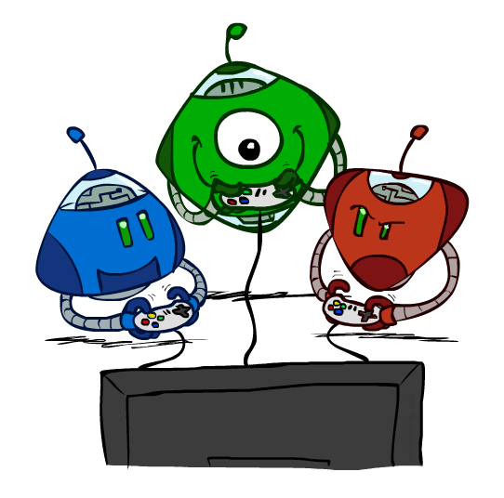
Other Game Types

Slide 81

Mixed Layer Types
E.g. Backgammon
Expectiminimax
  Environment is an extra “random agent” player that moves after each min/max agent
  Each node computes the appropriate combination of its children
Notes:
If it’s terminal or we reached our depth limit, return utility

Slide 82
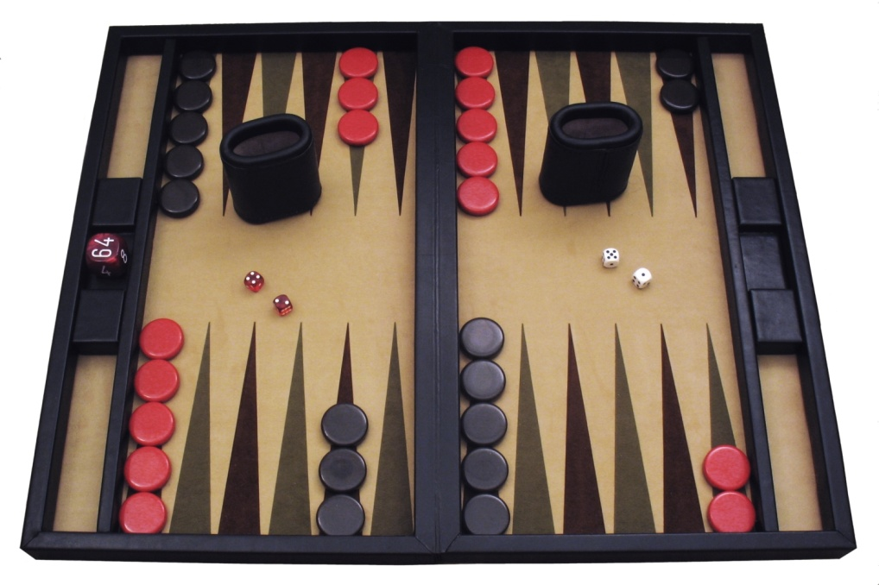
Example: Backgammon
Dice rolls increase b: 21 possible rolls with 2 dice
  Backgammon ≈ 20 legal moves
  Depth 2 = 20 x (21 x 20)³ = 1.2 x 10⁹
As depth increases, probability of reaching a given search node shrinks
  So usefulness of search is diminished
  So limiting depth is less damaging
  But pruning is trickier…
Historic AI: TDGammon uses depth-2 search + very good evaluation function + reinforcement learning:
world-champion level play
1st AI world champion in any game!
Image: Wikipedia

Slide 83
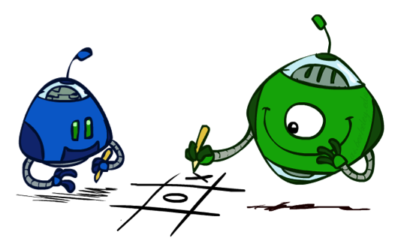
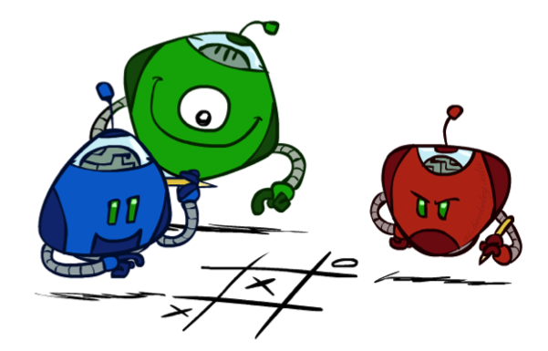
Multi-Agent Utilities
What if the game is not zero-sum, or has multiple players?
Generalization of minimax:
  Terminals have utility tuples
  Node values are also utility tuples
  Each player maximizes its own component
  Can give rise to cooperation and
  competition dynamically…
5,2,5
5,2,5
6,1,2
6,1,2
5,1,7
5,2,5
1,6,6
1,6,6
7,1,2
6,1,2
7,2,1
5,1,7
1,5,2
7,7,1
5,2,5
in a three-player game with players A, B, and C, a vector (v_{A};v_{B};v_{C})is associated with each node.

Slide 84
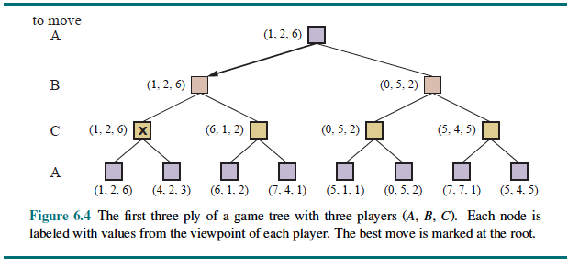
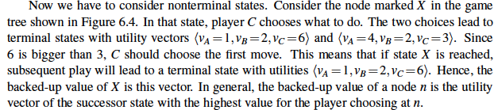
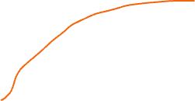
Multi-Agent Utilities

